Slide 1
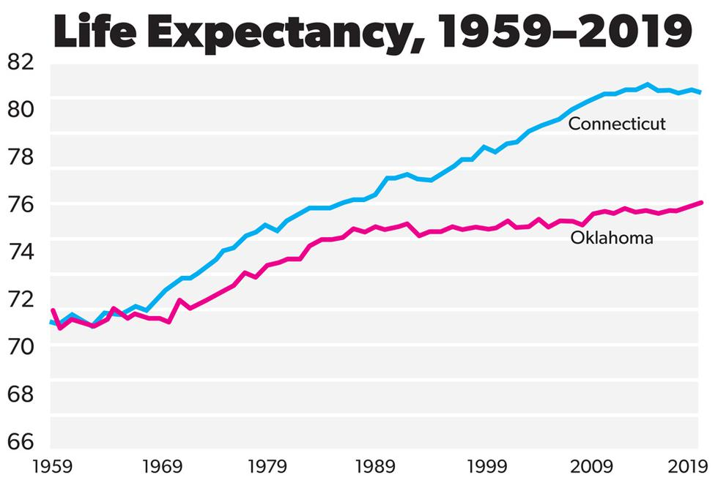
Live Free AND Die:
Why are Voters in “Red” Counties Dying Younger Than in “Blue” Counties?
Tim Londergan and Steve Vigdor
Traveling University
October 18, 2026
Based on our evidence-based, data-rich blog posts at:
www.debunkingdenial.com
See especially: Live Free AND Die; The Diploma Divide
Notes:
TL starts here

Slide 2
DISCLAIMER: The views expressed in these videos and on our blog site are our own, and do not represent positions taken by Indiana University.

Slide 3



Vigdor/Londergan Science Blog: “Debunking Denial”
www.debunkingdenial.com
Categories covered:
Bad Science
Brain Science &
Brainwashing
Climate change
Conspiracy theories
Cosmology & Astrophysics
Critical thinking
Cyber issues
Demographics
Education
Elections
Energy production
Environment
Evolution
Genes & Genetic
Engineering
Gun violence
Human Sexuality
Medicine, COVID, &
Vaccinations
Miscellany
Network science
“New Age” hoaxes
Ozone layer
Partisan divides over science
Scientific breakthroughs
Toxic products

Slide 4
Outline of Presentation
Why life expectancy is increasing worldwide
The evidence of a growing partisan mortality and education gap in the U.S.
The impact of COVID-19
Chronic disease prevalence in the U.S.
The impact of state government control, laws, and attitudes:
  Smoking restrictions and lung cancer
  Gun laws and firearm deaths
  Abortion laws and maternal and infant mortality
  Medicaid expansion & cuts; medical infrastructure
  Vaccine hesitancy – impact of RFK, Jr.
Future Trends and Summary

Slide 5
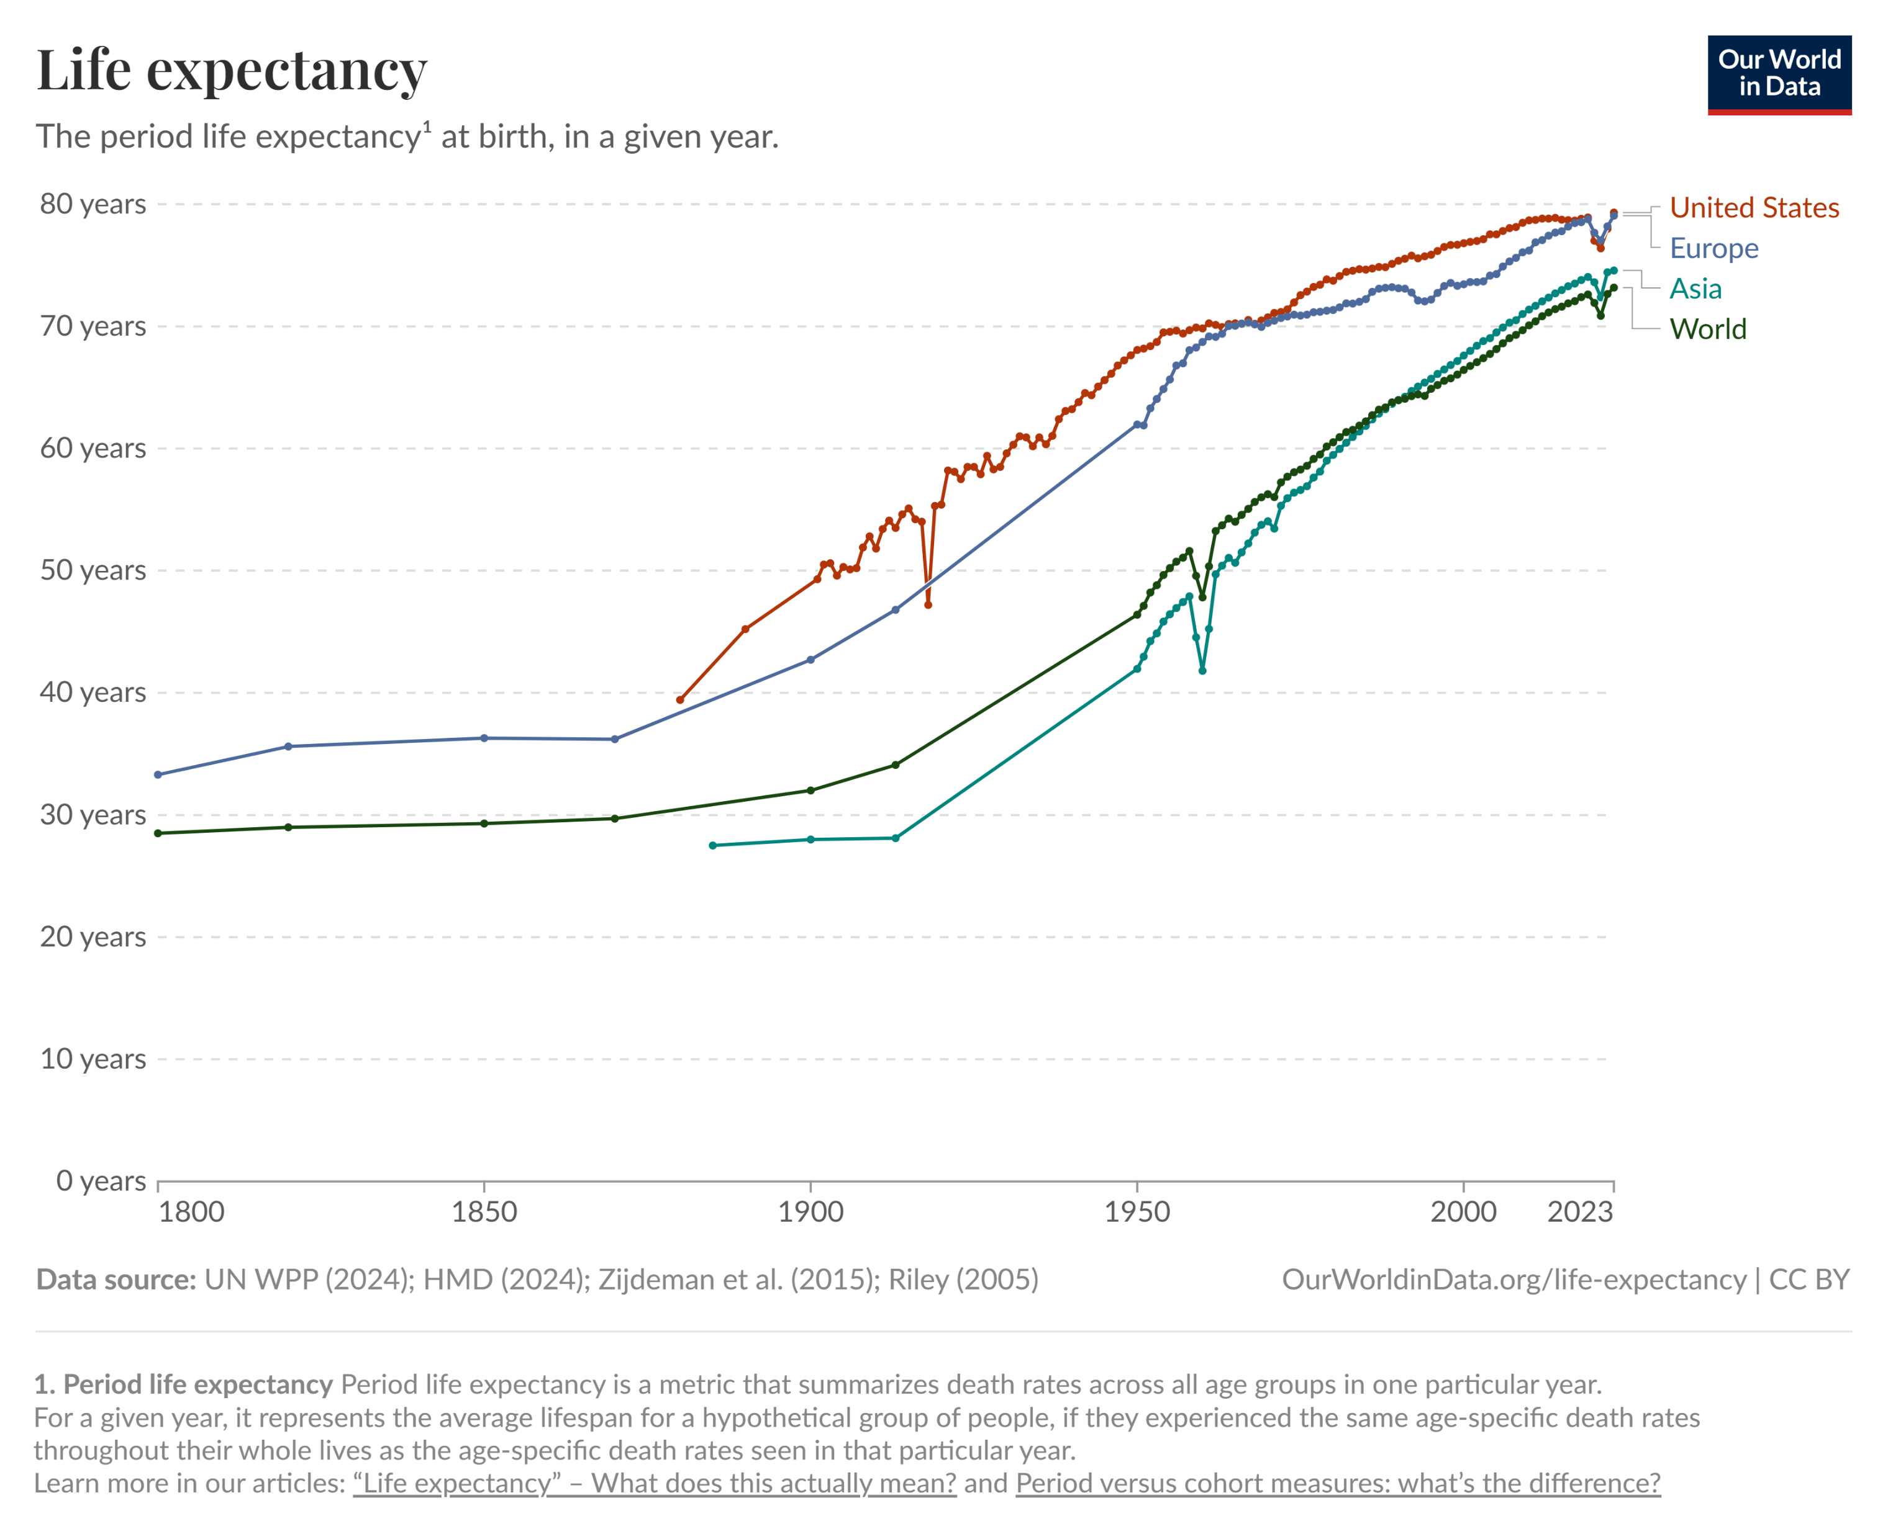
Life Expectancy Has Been Generally Increasing Worldwide
Most important reasons:
Improved vaccines and medical treatments
Improved air and water quality (EPA in US)
Improved personal hygiene
Improved nutrition
Improved access to hospitals and healthcare insurance (Medicare, Medicaid, and Obamacare in US)
Improved education

Slide 6
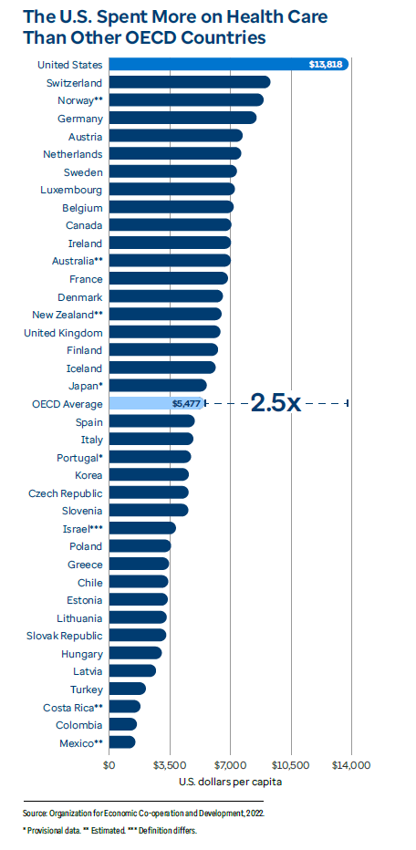
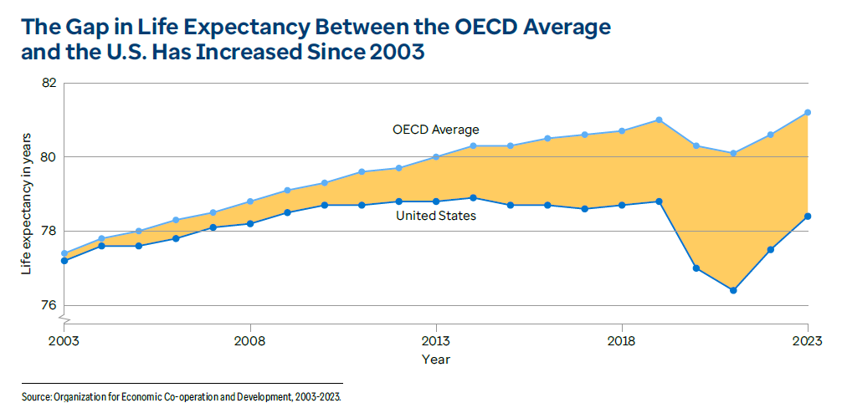
But the U.S. is Falling Behind OECD Countries
U.S. currently ranks #30 out of 38 OECD countries in life expectancy, despite spending 2.5 x OECD per capita average on healthcare.

Slide 7
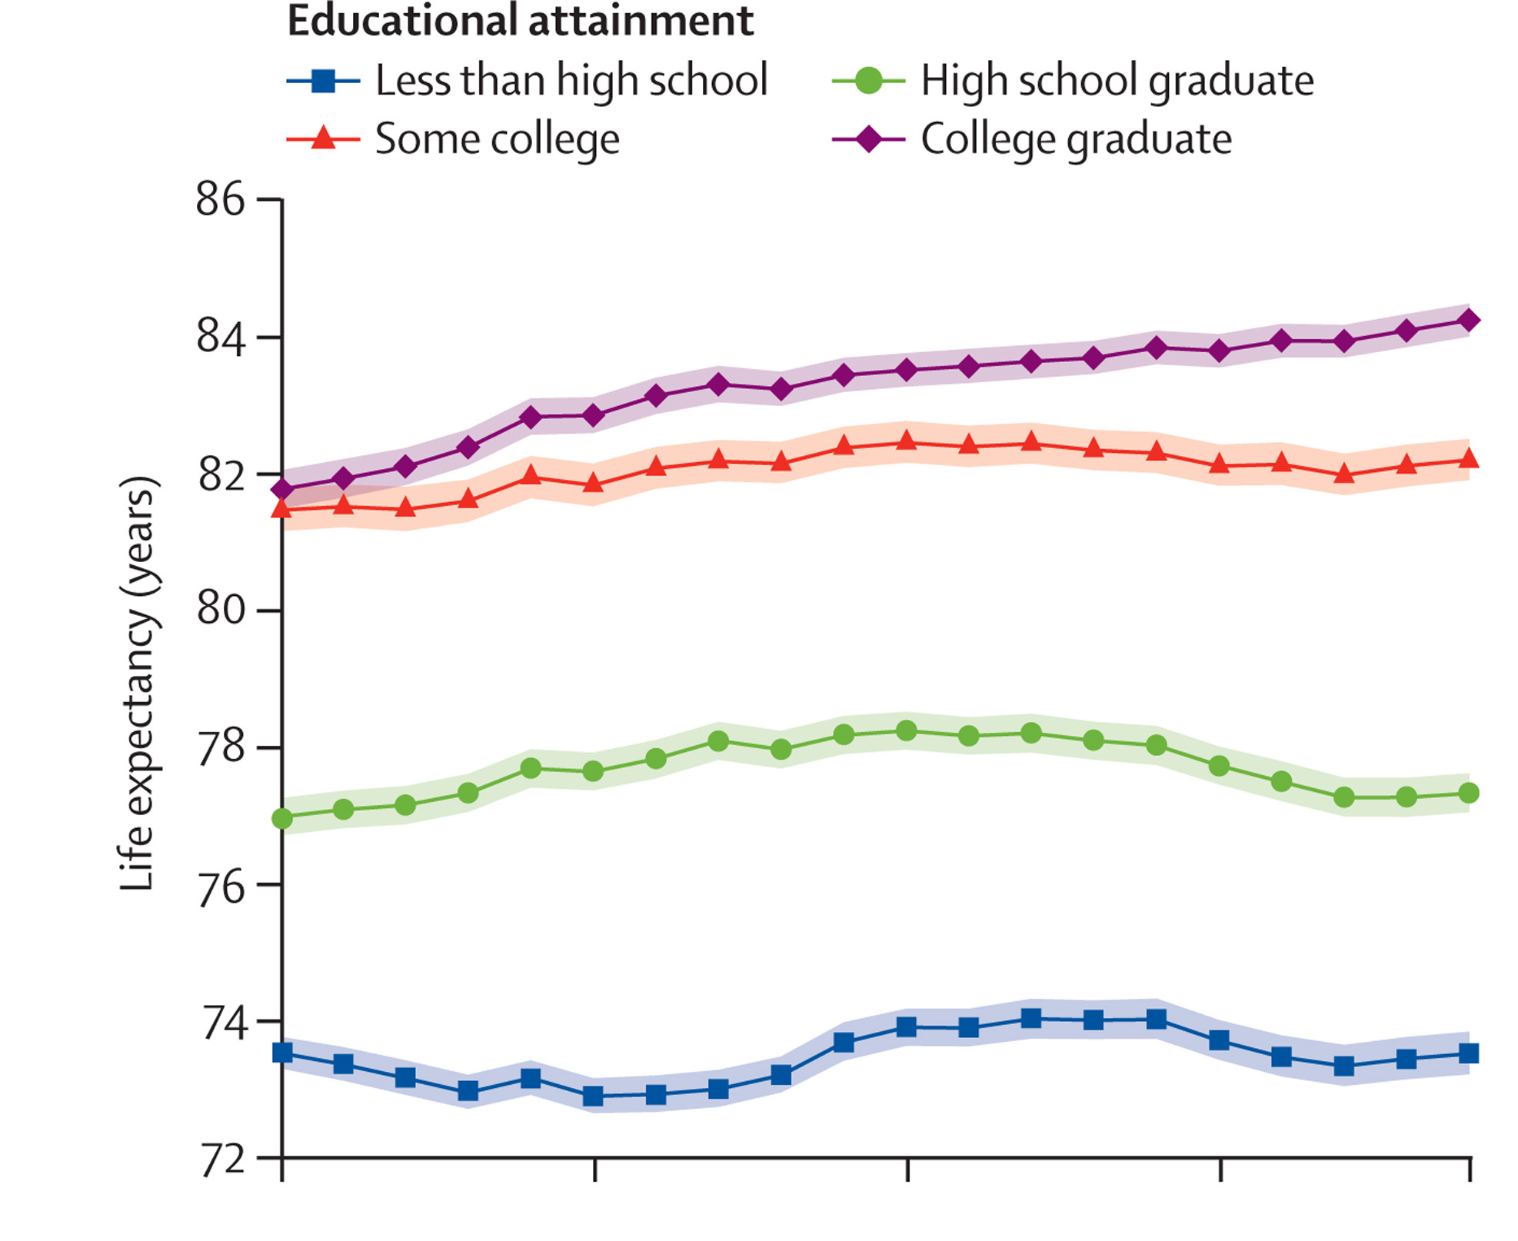
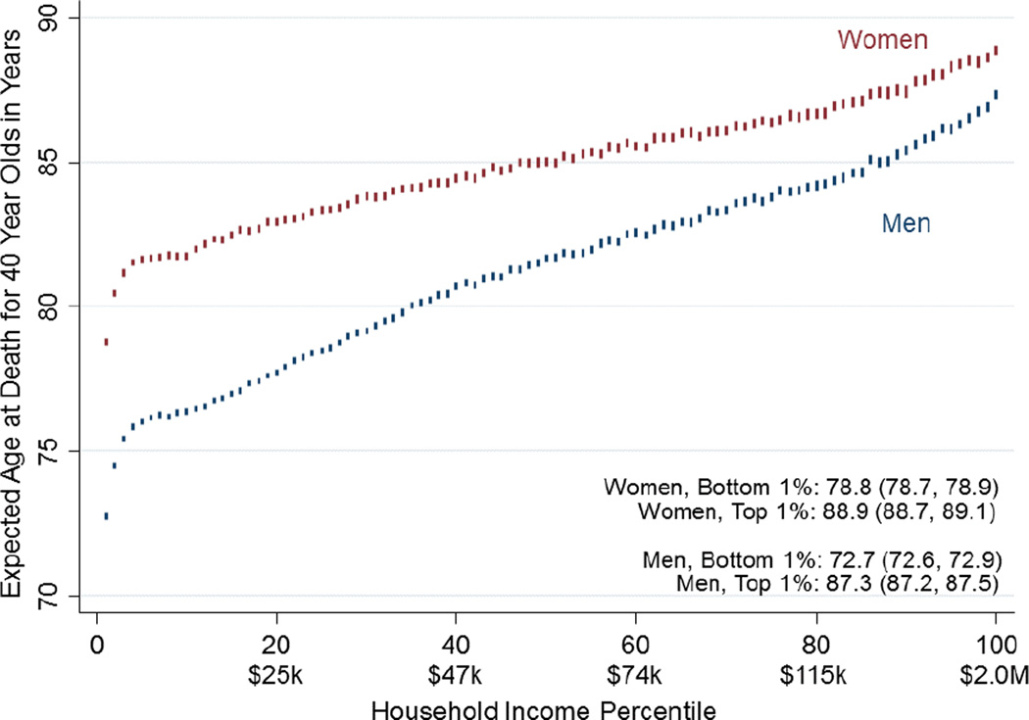
U.S. Life Expectancy Strongly Correlated with Income and Education
Expected age at death for US 40-year olds
2000 2005 2010 2015 2019
Year
Higher income ⇒ access to higher quality healthcare (no Natl. Health Service) College grad ⇒ Better health info, less dangerous jobs, remote work during COVID

Slide 8
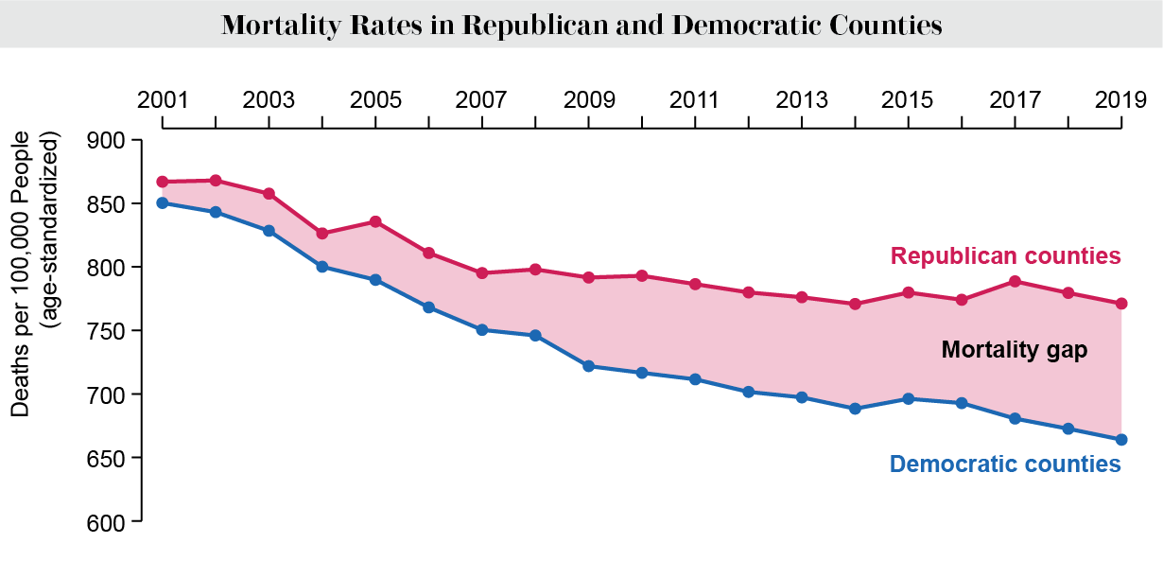
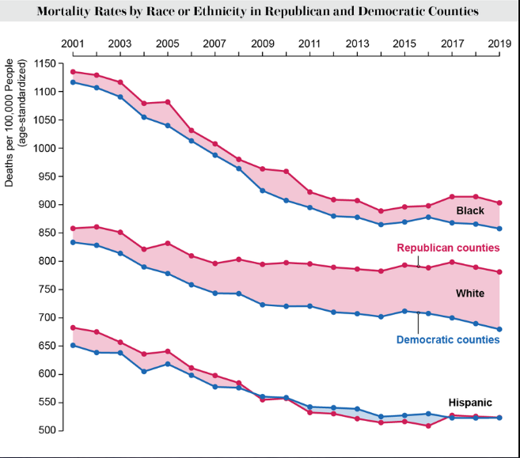
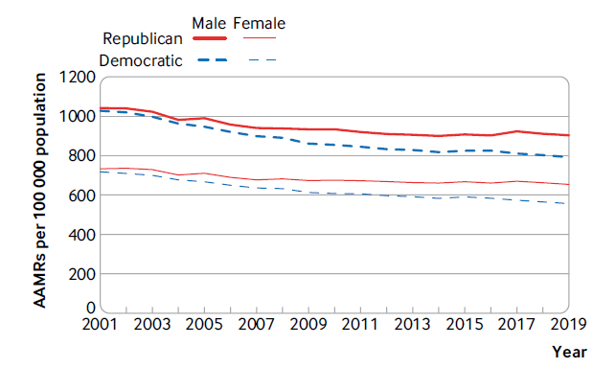
But there is an increasing partisan mortality gap in the U.S.
Death rates are higher in Republican-voting counties than in Democrat-voting counties. Effect is largest among white voters of both sexes.
“Hispanic paradox”

Slide 9
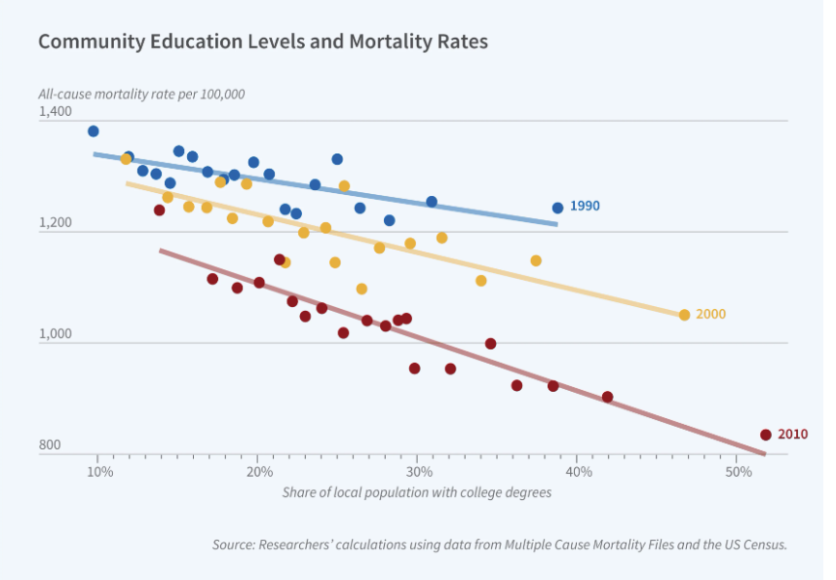
Mortality Rates are Correlated with Community Educational Level
J.H. Bor, et al., National Bureau of Economic Research
Each point averages over counties containing ~5% of US population.
The correlation has grown stronger during 21st century.
All-cause mortality rate per 100,000 (age- and sex-adjusted)
Share of local population with college degrees

Slide 10
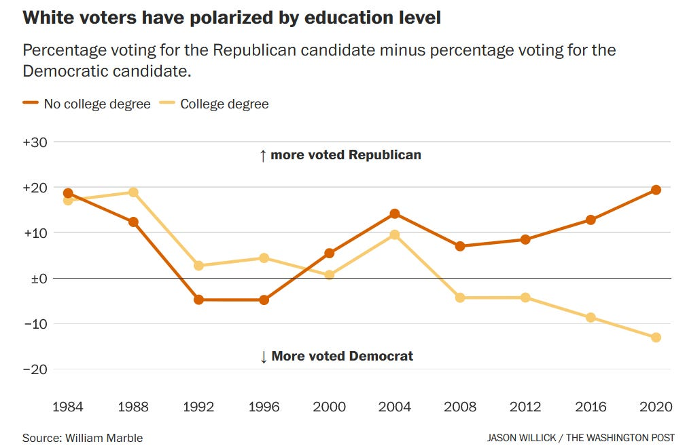
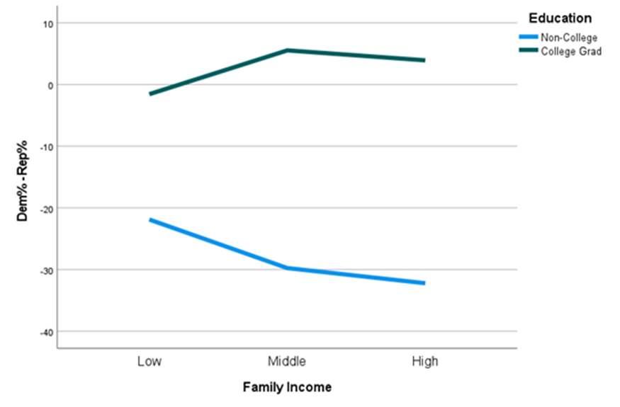
The Growing Partisan Mortality Gap Tracks With Growing Partisan College Education Gap
Net party identification (Dem% - Rep%) by family income and education among whites in 2020
The diploma divide is present across all family income levels
But education level does not account for all of the partisan mortality gap.

Slide 11
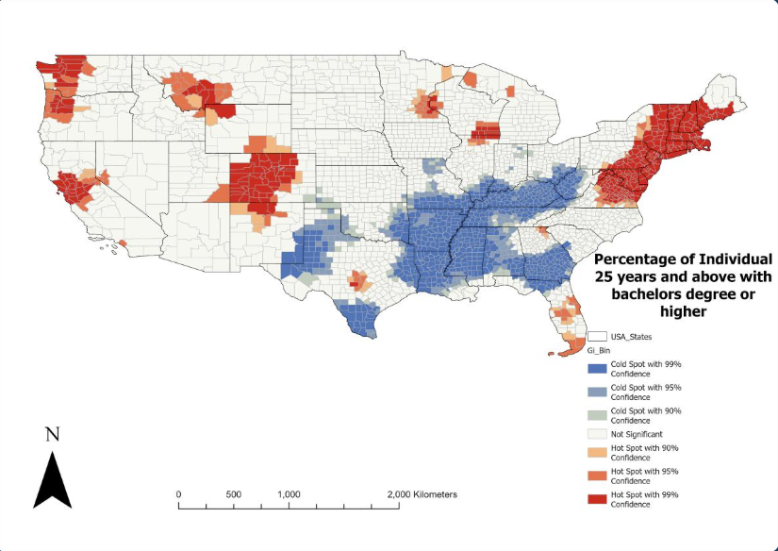
College-Educated Americans Tend to Cluster Geographically
Clustering results from self- sorting and localization of best jobs.
Hot spots for college grads have best access to high-quality healthcare.
Red and orange: Hot spots for college grad clustering
Shades of blue: Cold spots for college grad clustering
Cold spots for college grads align with geographic regions with worst health outcomes.
“Hot” (“cold”) ⇒ fraction of college grads is significantly higher (lower) than nat’l average.

Slide 12
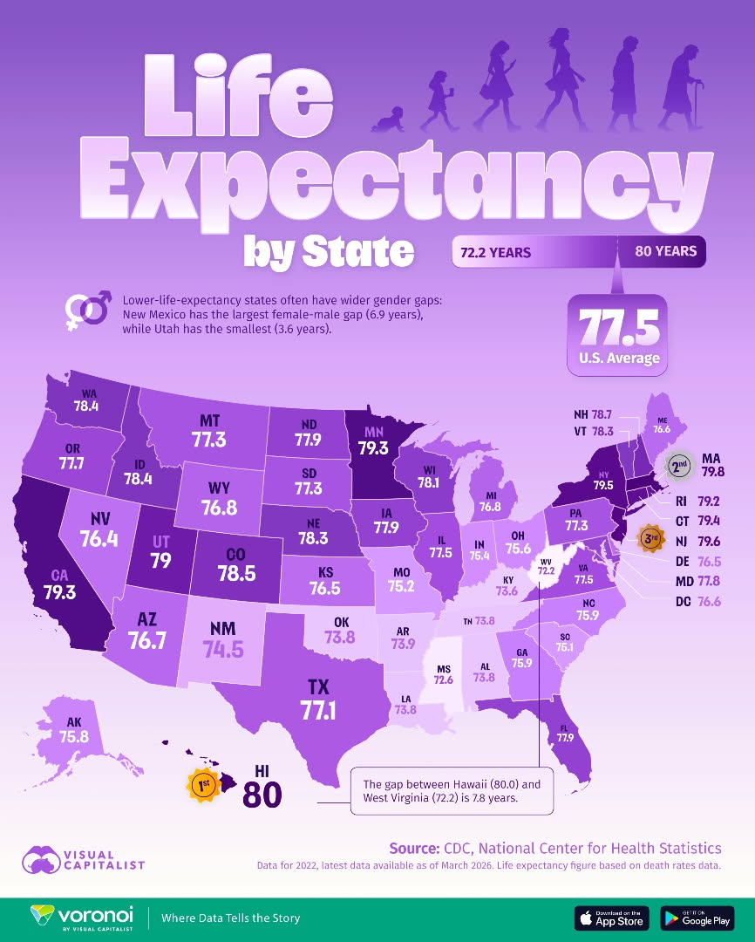
There are significant state-to-state differences in life expectancy:
A 7.8-year difference in 2022 average life expectancies between the highest (Hawaii) and lowest (W Virginia) states
Life expectancies:
Red States → Lowest
Blue States → Highest

Slide 13
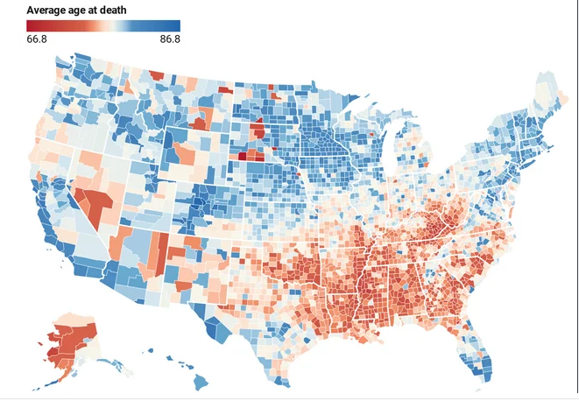
There is a 20-year span in life expectancies among U.S. counties!
Death rates are regionally high and life expectancy low in Republican-preferring areas in the Deep South and Appalachia (also Native American reservations)
2020 life expectancy by U.S. county
Overall mortality rates in the South may be influenced by large Black populations, but what about time-dependence of rates?

Slide 14
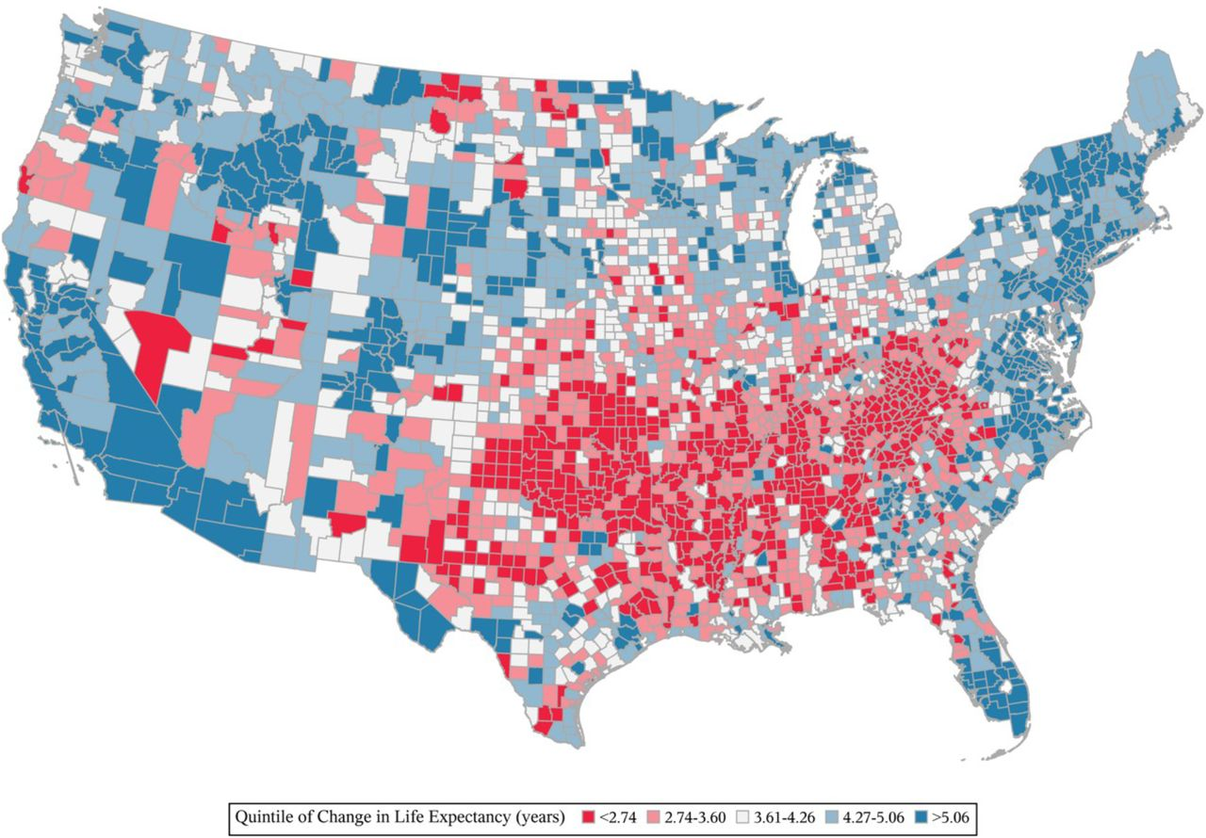
The Smallest Increase in Life Expectancy Occurs in Reliable “Red” States
Change in life expectancy 1980 - 2014
Smallest increases in life expectancy have occurred in Louisiana, Mississippi, Alabama, Oklahoma, Arkansas, Kansas, Missouri, Tennessee, Kentucky, and West Virginia
Again, the growth in mortality gap has occurred mostly among white males and females.

Slide 15
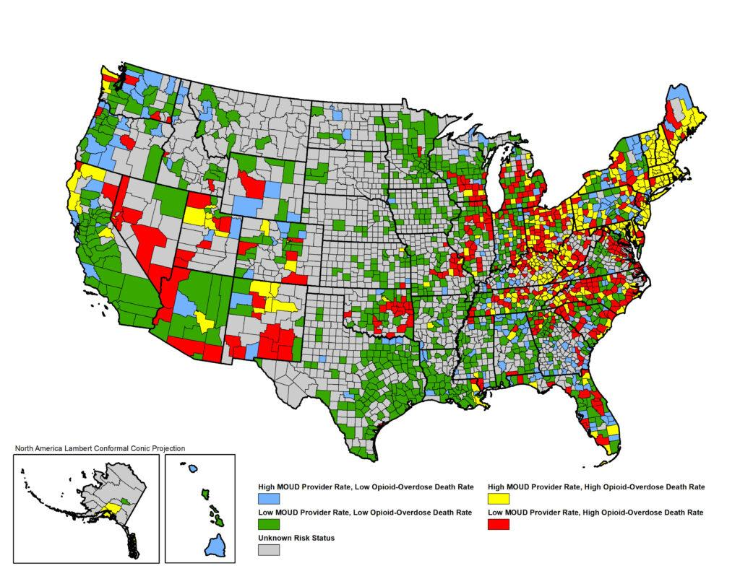
Growing Mortality Gap Not Strongly Correlated with Opioid Deaths
Highest opioid death rates in counties colored red and yellow
In 2020 book Deaths of Despair and the Future of Capitalism, Case & Deaton attribute rising deaths from suicide, drugs, and alcohol to despair among white, middle-aged American males without a college degree.
While such males often vote Republican, these factors are secondary contributors to overall mortality, inconsistent with the dominant geographic distribution and gender-independence of the growing partisan mortality gap.
Notes:
Switch to SV here

Slide 16
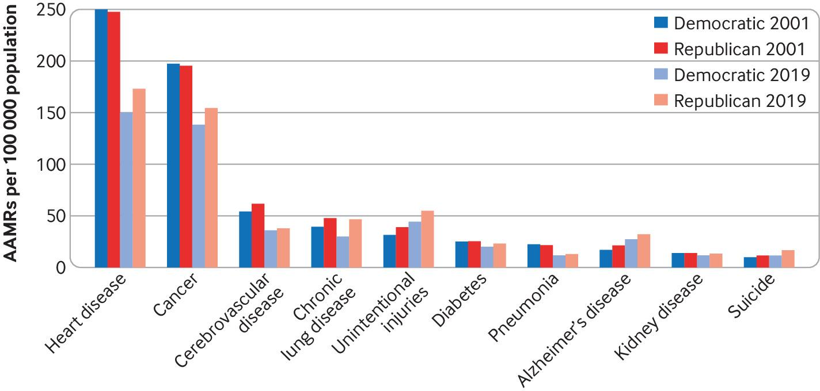
Leading Causes of American Deaths Pre-COVID
Mortality changes from 2001 to 2019 have been worse for Republican voters than for Democratic voters across a diverse array of causes.

Slide 17
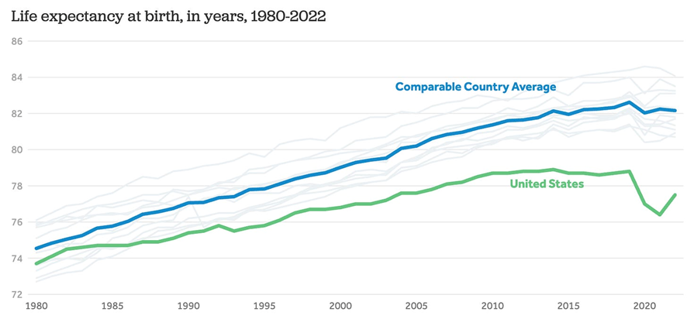
The U.S. suffered disproportionately from COVID-19
{Australia, Austria, Belgium, Canada, France, Germany, Japan, the Netherlands, Sweden, Switzerland, and U.K.}
US = 4.2% of world pop’n;
17% of world COVID deaths
Worldwide, 7.1 million died from COVID-19; U.S. had 1.2 million COVID deaths.
U.S. government response was generally ineffective, filled with mixed messaging, partisan misinformation.

Slide 18
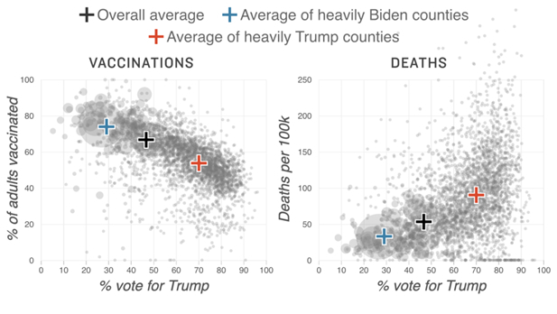
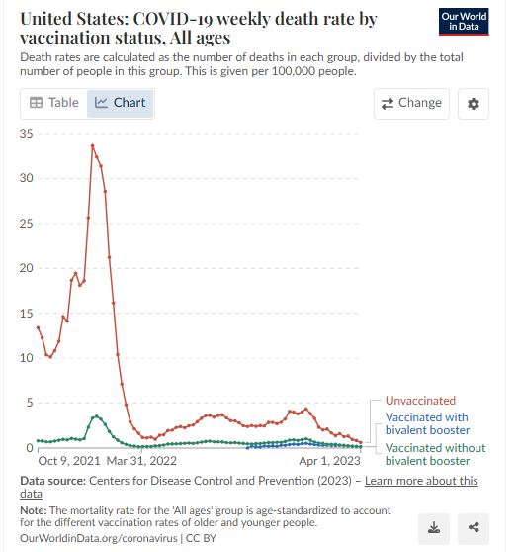
COVID-19 death rate much higher in Trump counties ⇒ Mortality gap accelerated
COVID-19 death rate an order of magnitude higher for unvaccinated vs. vaccinated individuals
(10/21 – 4/23)
May 2021 – Dec. 2021 COVID vaccination and death rates strongly correlated with 2020 county vote for Trump

Slide 19
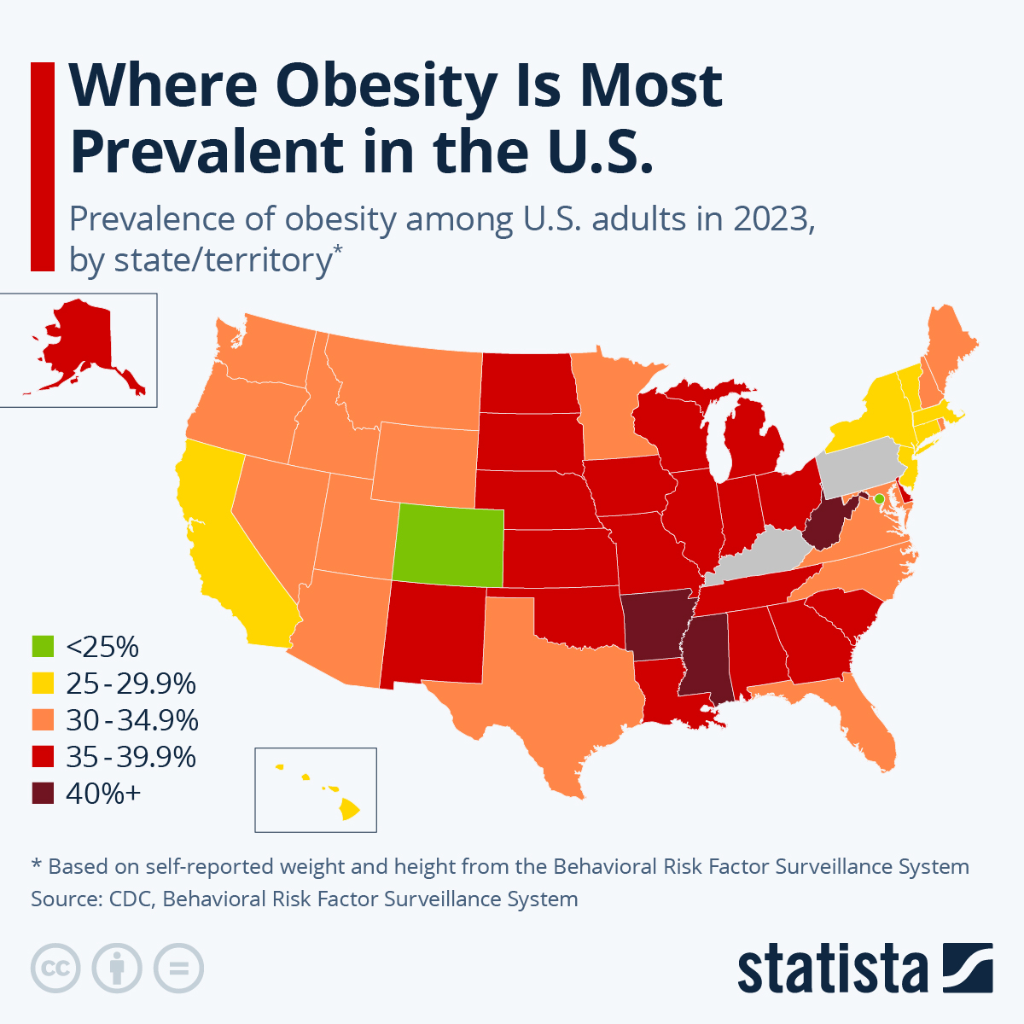
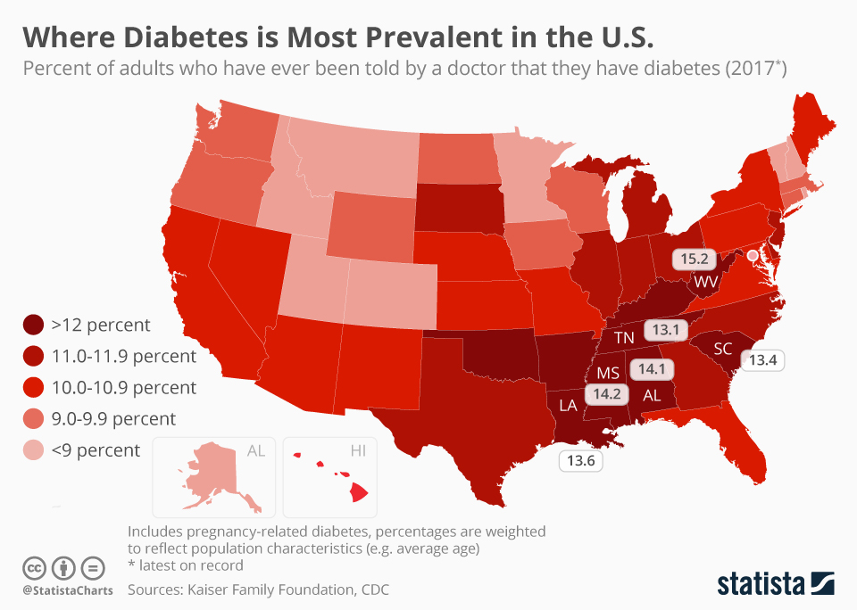
Chronic Disease: Obesity and Diabetes
Obesity and diabetes most prevalent in red states, especially Deep South and Appalachia

Slide 20
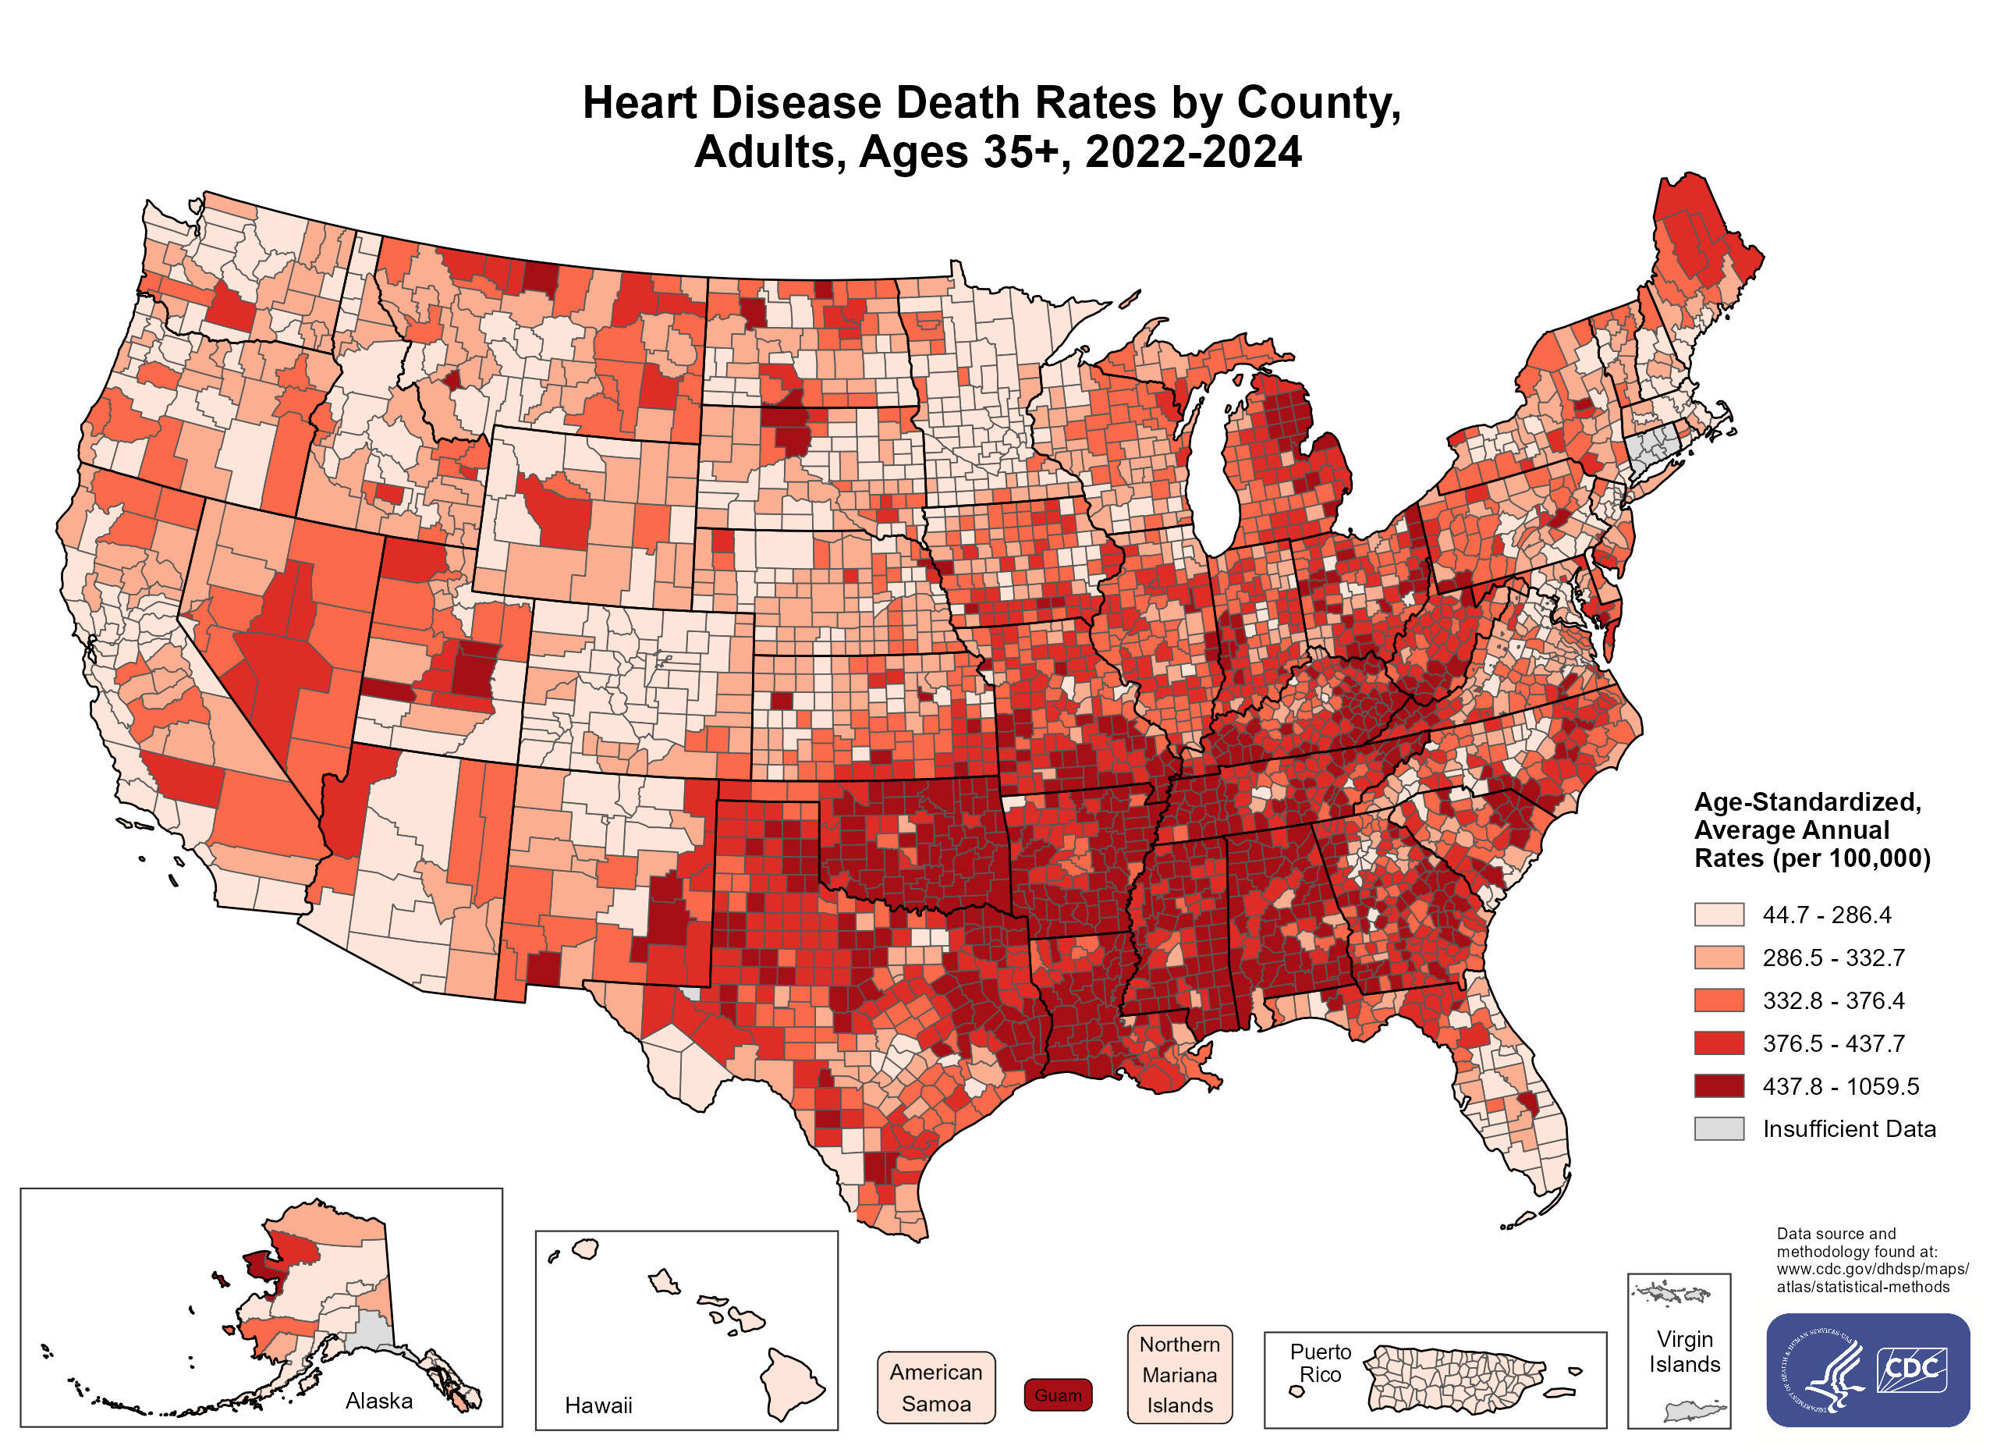
Chronic Disease: Heart Disease, Still the Number One Killer
Age-adjusted heart disease death rates per 100,000 inhabitants over 35 years of age, by county

Slide 21
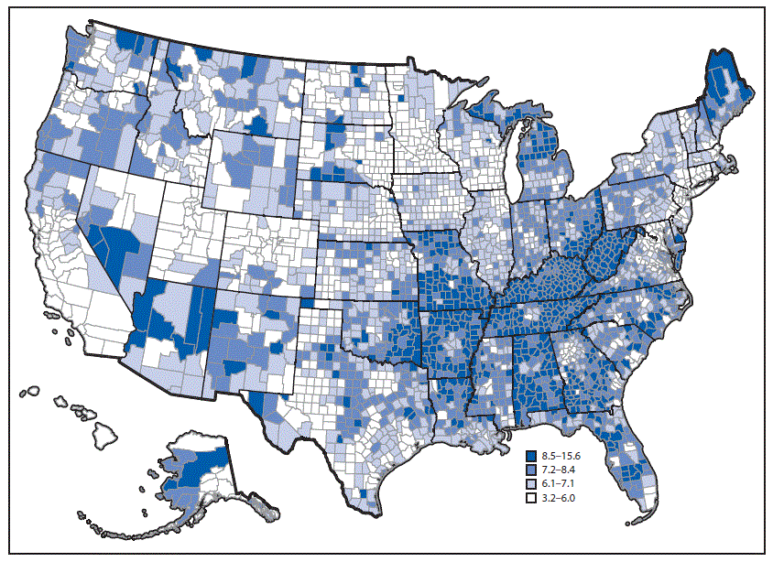
Chronic Disease: Chronic Obstructive Pulmonary Disease (COPD)
CDC statistics for prevalence of diagnosed COPD per 100,000 inhabitants age 18+, by U.S. county in 2015
COPD prevalence only weakly correlated with PM2.5 air pollution, which is also bad in industrial Midwest and southern California.
Note the presence of “cold spots” within the high-prevalence states

Slide 22
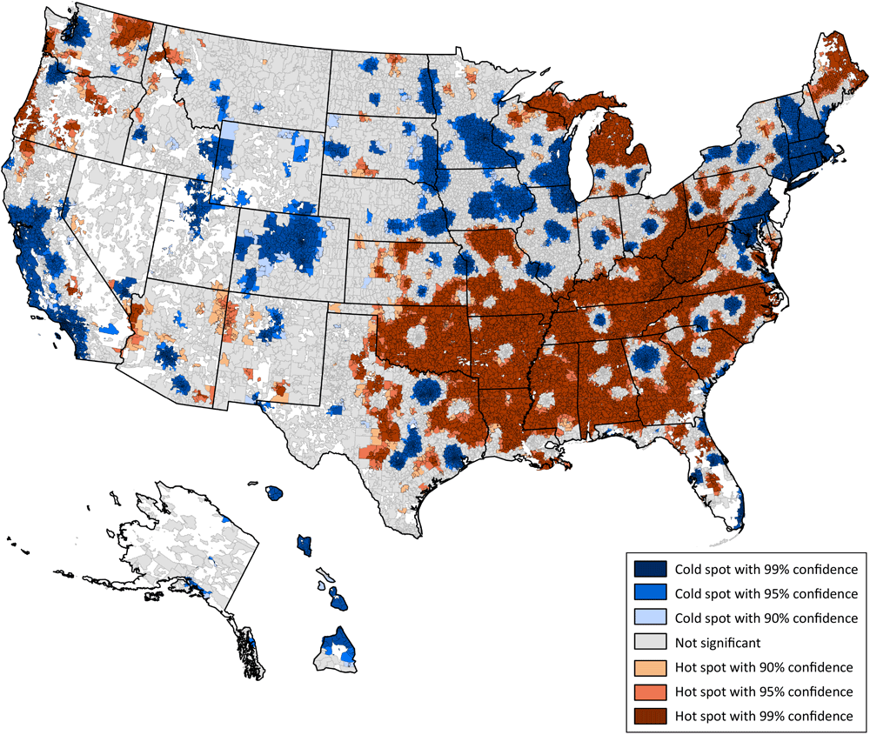
Hot Spots and Cold Spots for all Chronic Diseases
Benavidez, et al. (2024) analyzed, by zip code, prevalence of 10 most costly chronic diseases: obesity, hypertension, high cholesterol, coronary heart disease, COPD, asthma, chronic kidney disease, diabetes, cancer (except skin), and depression.
These health issues are mostly rural! Note the chronic disease “cold spots” in large southern cities -- Atlanta, Nashville, Charlotte, Raleigh-Durham, Dallas-Fort Worth, Austin, Houston – despite large low-income black populations.

Slide 23
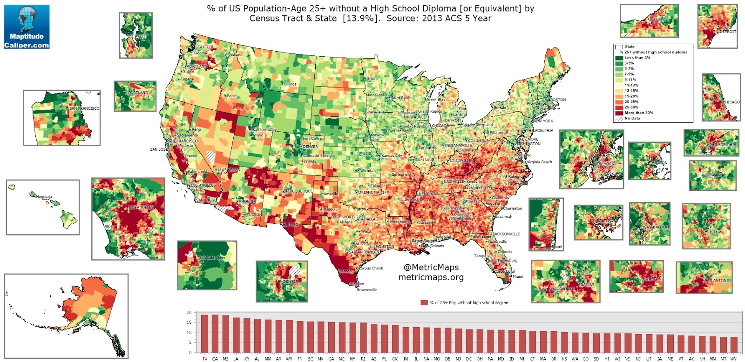
Chronic Disease Prevalence Partially Correlated with Education Levels
“Hispanic paradox” may be at work in accounting for no chronic disease anomalies on Texas-Mexico border or San Joaquin Valley.

Slide 24
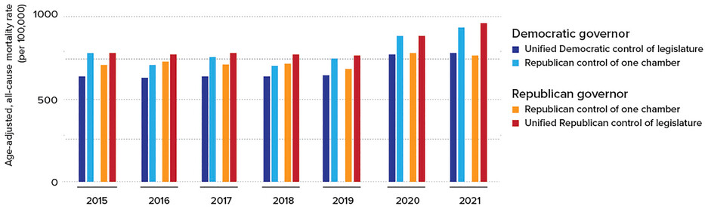
The Impact of State Government
Age-adjusted all-cause mortality rates for 2015-21 organized by partisan control of state government
The largest differences occur between states with full Democratic control (dark blue) and full Republican control (dark red). Note COVID increase in 2020-21.

Slide 25
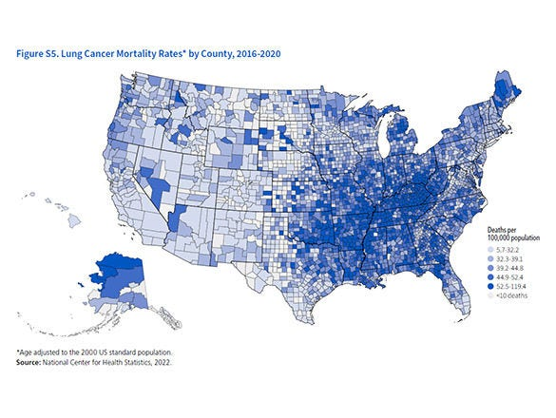
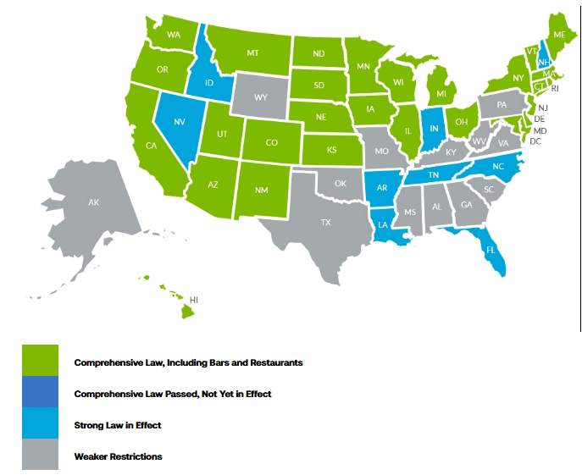
State Laws: Smoking Restrictions and Lung Cancer Deaths
Southern and Appalachian states with weakest smoking restrictions (grey in left frame) have highest lung cancer mortality (dark blue counties in right frame, 2016 - 2020).

Slide 26
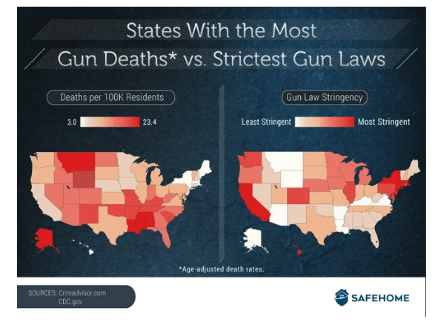
State Laws: Gun Restrictions and Firearm Deaths
States with the least stringent gun laws (white and light tan in right frame) tend to have the highest gun death rates (red states in left frame).
The prevalence of guns in a state is highly correlated with firearm death rate.

Slide 27
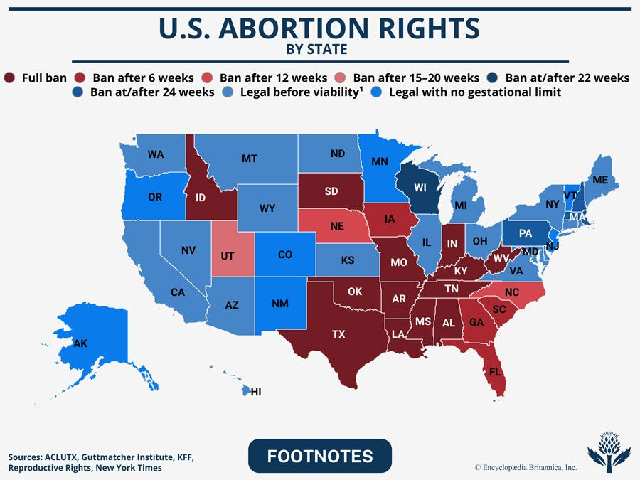
State Laws: Abortion Laws
As of May, 2026,
17 Republican-controlled states currently ban all abortions or those after first 6 weeks of pregnancy
Notes:
Switch back to TL here

Slide 28
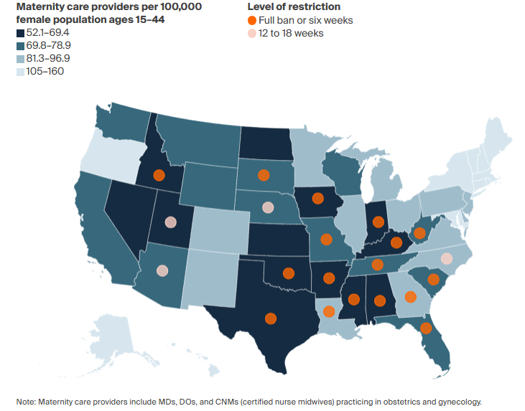
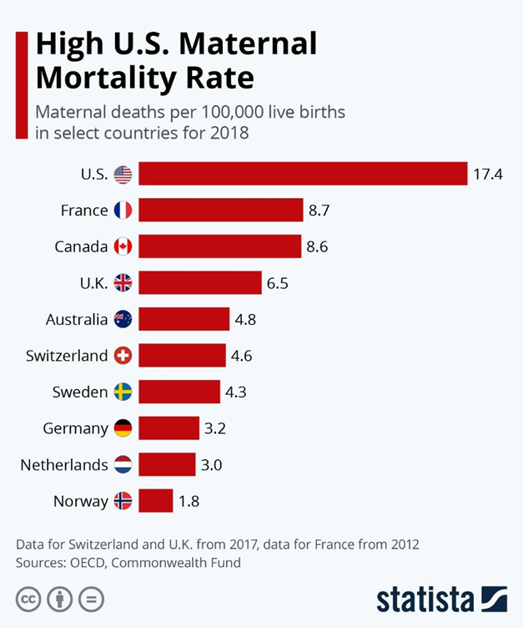
Abortion Bans Scare Away Maternity Care Providers
U.S. had highest maternal mortality rate among developed countries even before Dobbs.

Slide 29
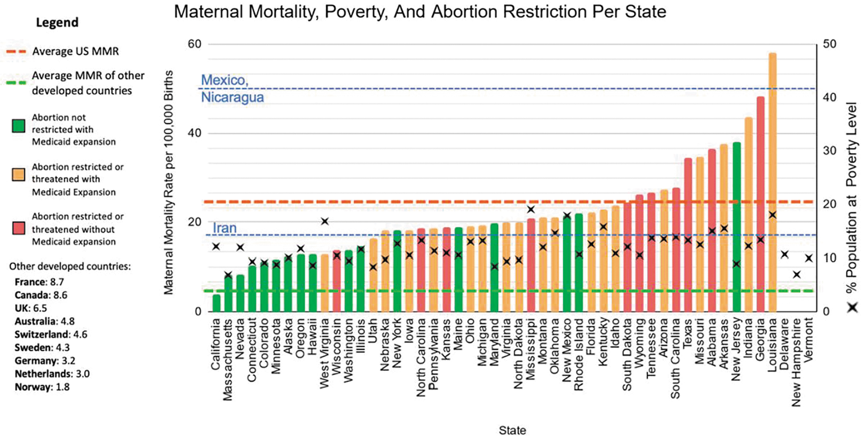
Maternal Mortality Strongly Correlated with Abortion Restrictions
Maternal death rate in Texas increased 56% from 2019 to 2022, compared with 11% nationwide.
U.S. average maternal mortality rate
Indiana: 3rd highest MMR in US

Slide 30
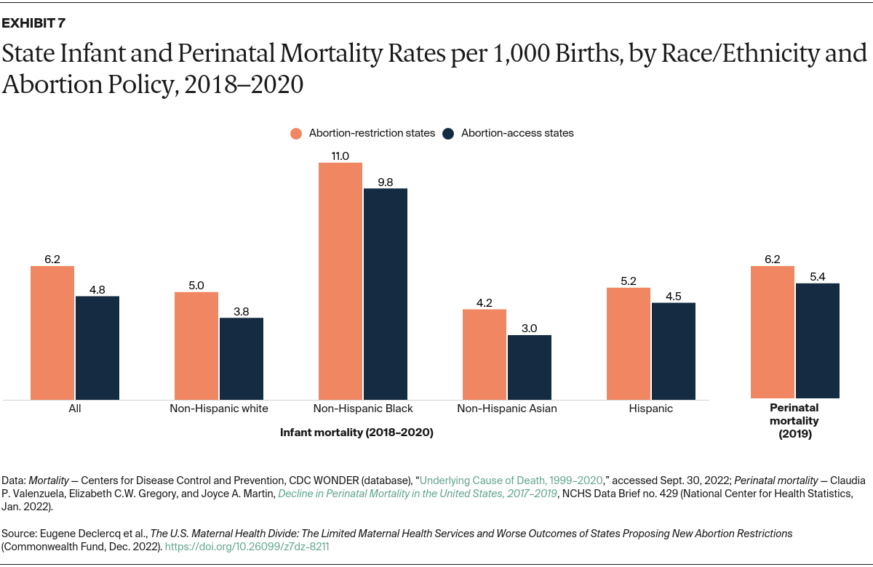
Draconian Abortion Laws Also Correlated with Increased Infant Mortality
In the year following Texas’ 2021 abortion law, infant mortality rate rose by 13%.
In the year following the 2022 Dobbs decision, national infant mortality rate rose by 7%.
Laws requiring women to carry non-viable pregnancies to term raise perinatal (fetus + newborn) mortality.
U.S. currently ranks #32 among 38 OECD countries in infant mortality rate.

Slide 31
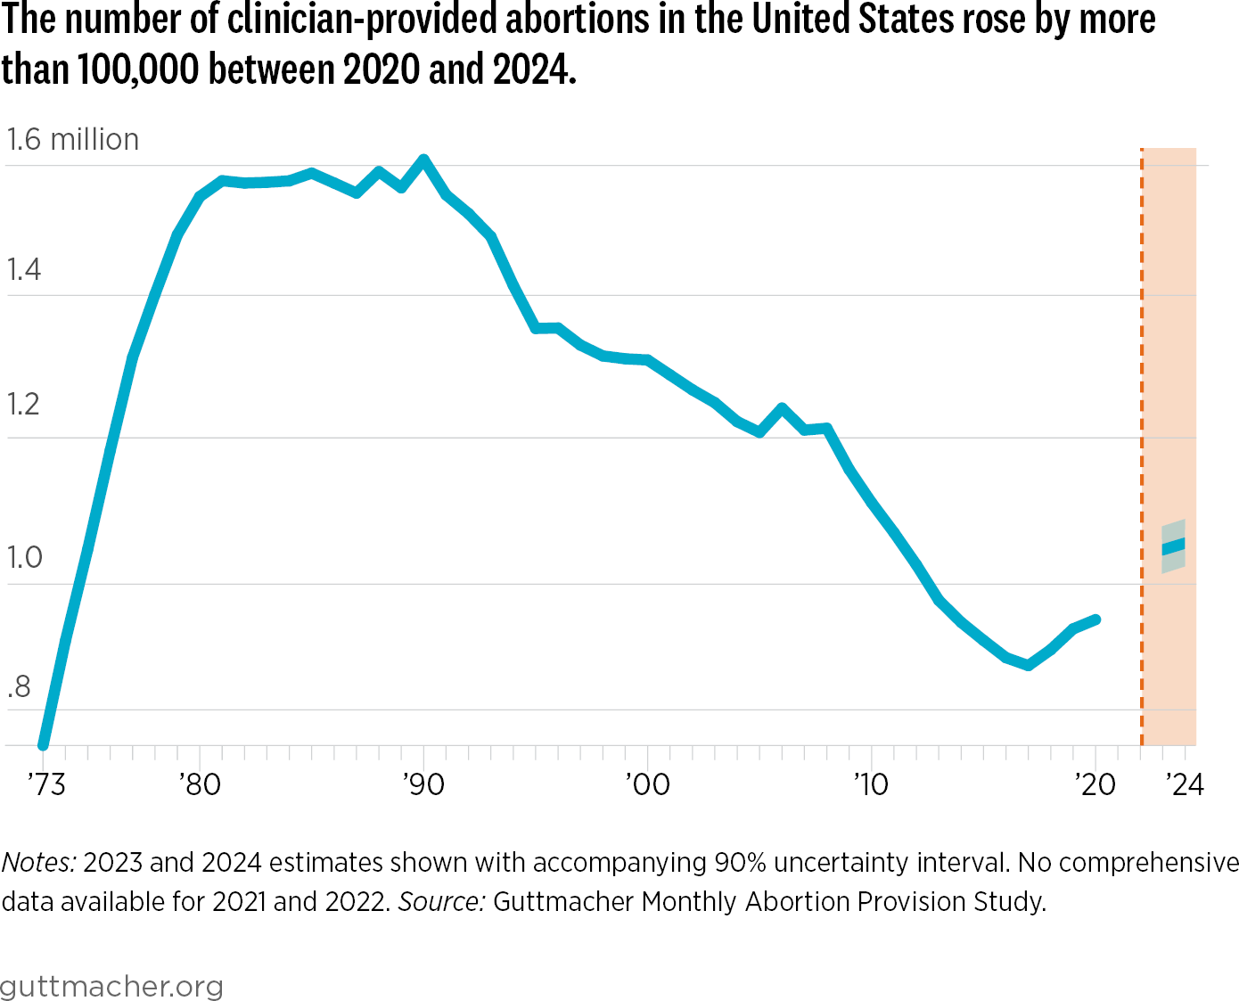
Post-Dobbs, the U.S. has increasing rate of abortions
Abortions have increased by more than 10% compared to 2020. More than 60% are now medication abortions and about 15% involve pregnant women crossing state lines.
Draconian state abortion restrictions have managed to increase abortions, increase maternal mortality, and increase infant mortality. Is this progress?
Dobbs decision

Slide 32
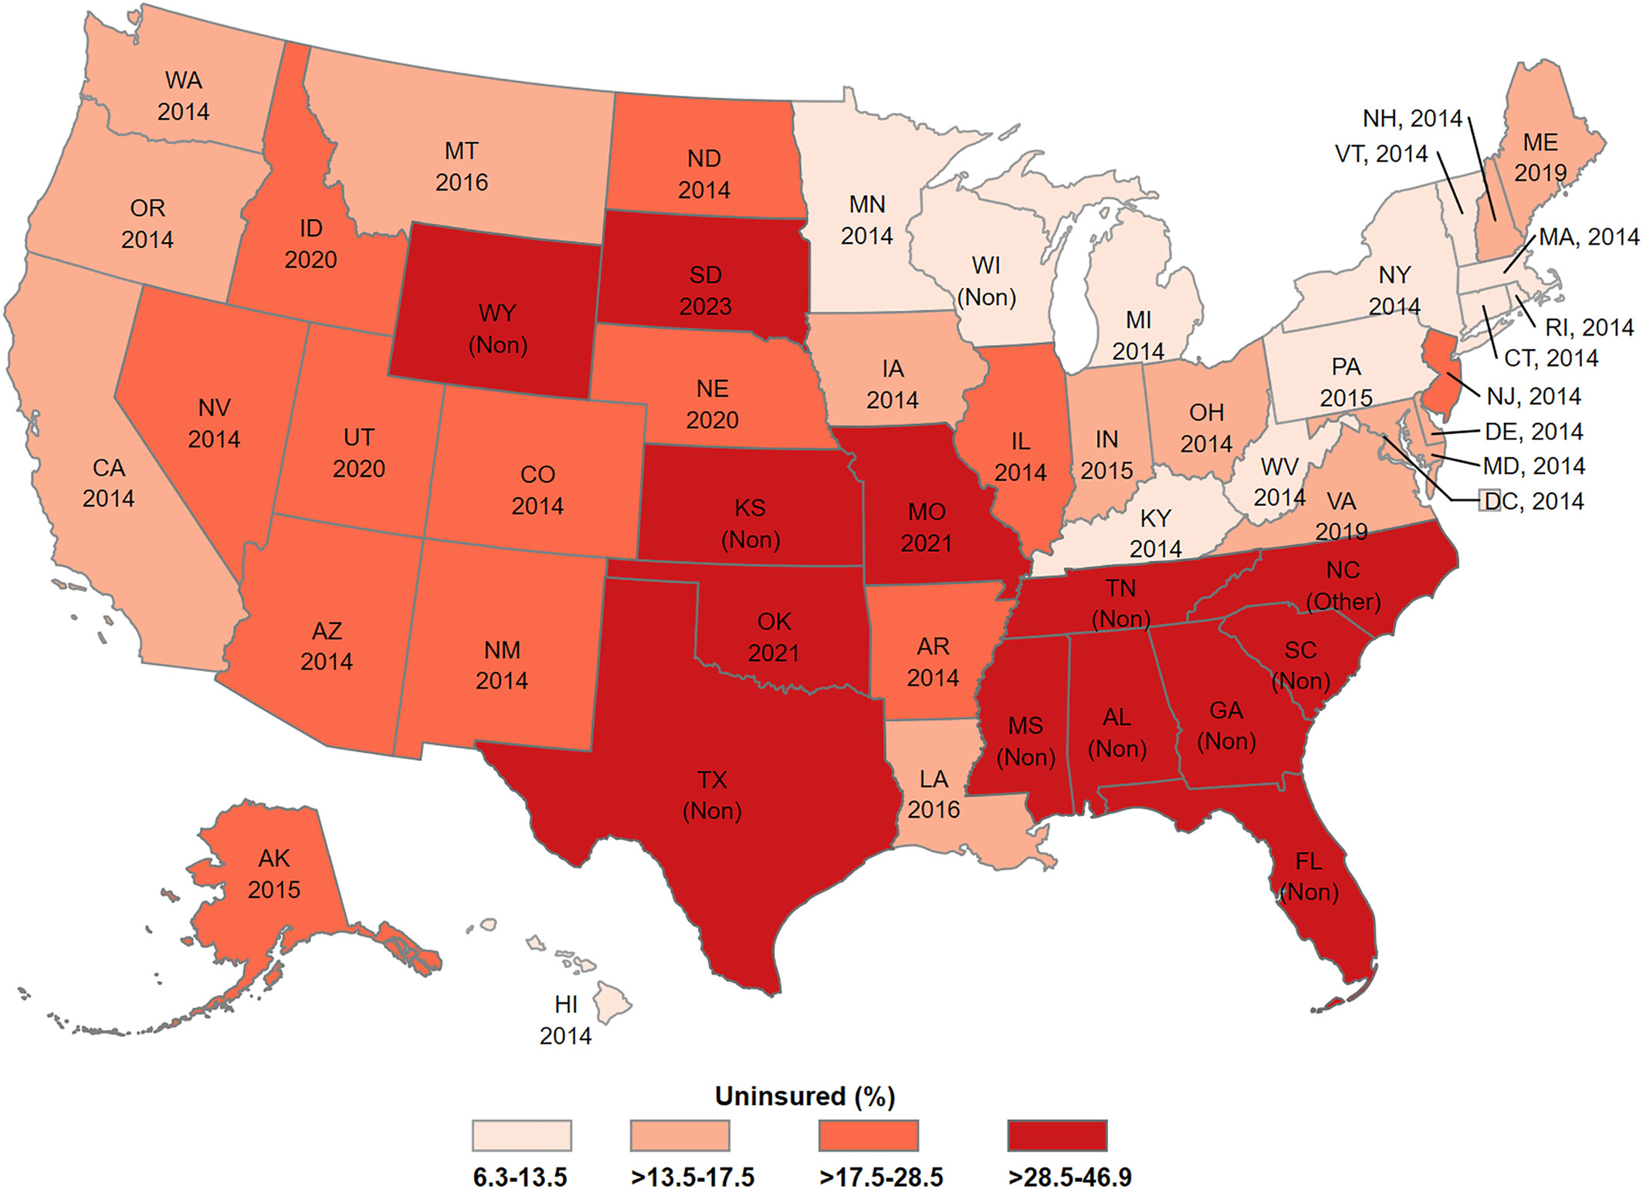
State Laws: Medicaid Expansion and the Uninsured
States that have not adopted Obamacare’s Medicaid expansion, or adopted it only since 2020, tend to have the highest uninsured rates among their inhabitants below the poverty level.
The exception is Wisconsin, which has its own version of Medicaid, called BadgerCare Plus.

Slide 33
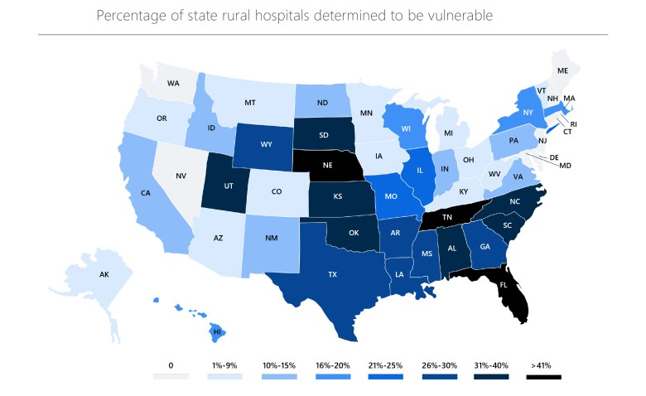
Republican States Have the Most Rural Hospitals at Risk
Over past 15 years, 182 rural hospitals have closed or stopped providing inpatient care. 432 more are currently vulnerable to closure.
$1 Trillion Medicaid cuts over next decade in Trump’s “Big Beautiful Budget Bill” would force many rural hospitals in red states to go out of business.
Together with termination of ACA subsidies, this will increase the Red-Blue mortality gap!

Slide 34
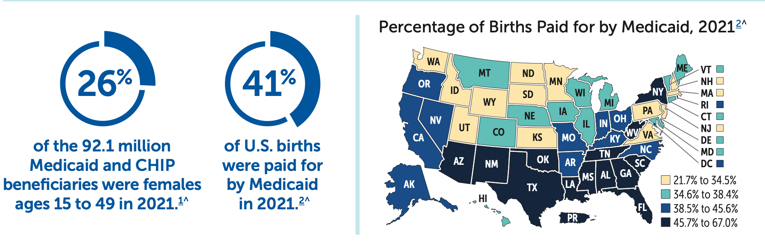
Medicaid Cuts Will Also Increase Maternal and Infant Mortality
Red states in the South – the same ones that will disproportionately lose rural hospitals – will be especially hard hit. About 2/3 of rural counties lack hospital-based obstetric services according to National Rural Health Association!

Slide 35
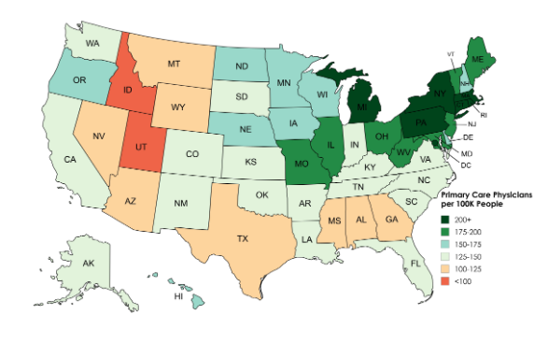
Many Republican States Also Have Fewer Primary Care Physicians
Primary care physicians per 100K residents in each state, 2024
Notes:
Switch back to SV here

Slide 36
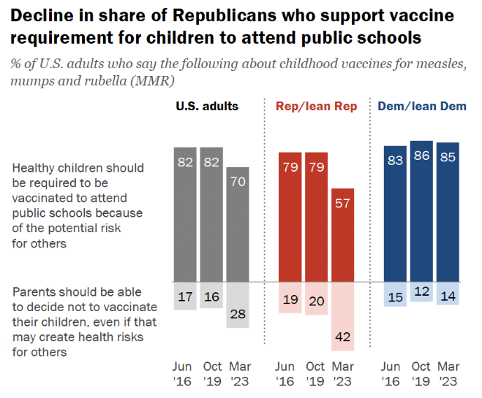
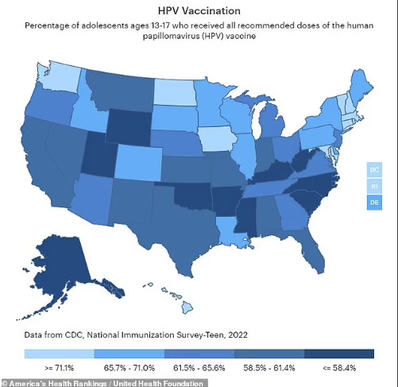
COVID Has Increased Republican Hesitancy About Other Vaccines
Red states also tend to have below average rates of HPV vaccination for adolescents.
Hesitancy about MMR vaccines makes red states especially vulnerable to measles outbreaks.

Slide 37
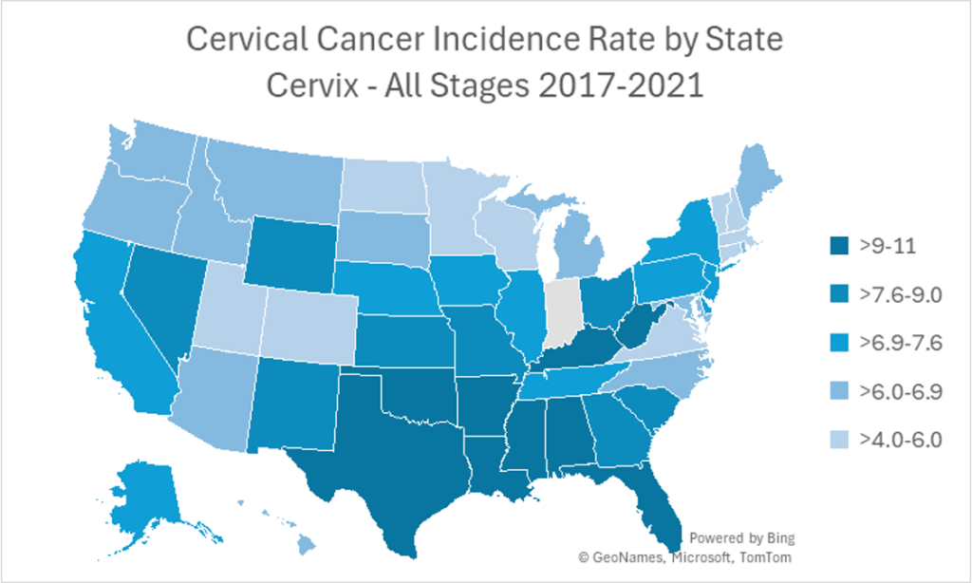
Vaccine Hesitancy Has Consequences: Cervical Cancer
Rate of new cervical cancers in U.S. 2017 – 2021
The darker the blue color, the higher the rate of cervical cancer per 100,000 women. The states with the highest rates are Mississippi, Louisiana and Oklahoma.
Source: Utah Women’s Health Review

Slide 38
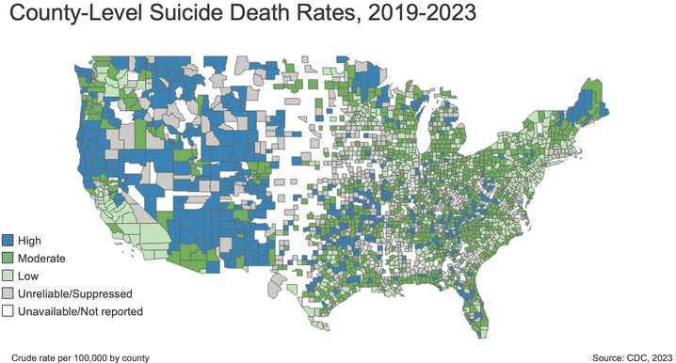
Miscellany: Suicide Rates
Suicide rates tend to be highest in sparsely populated rural counties, especially in the West + Alaska
Feelings of isolation & lack of opportunity, along with state gun laws, are believed to contribute.
Since rural counties vote predominantly for Republicans, this also contributes to mortality gap.

Slide 39
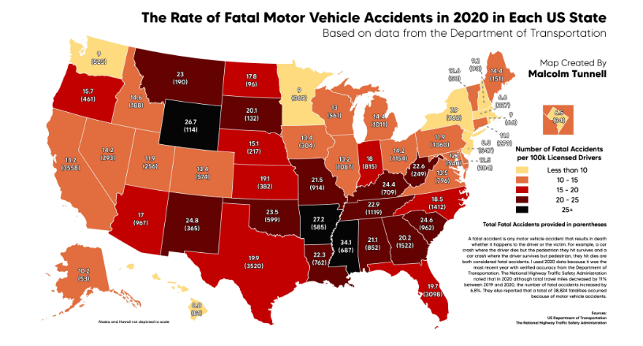
Miscellany: Traffic Fatalities
Traffic fatality rates also tend to be higher in red states, perhaps because drivers in these states drive more miles per capita annually than in other states.

Slide 40
Healthy and Unhealthy Big Cities
In 2024, WalletHub evaluated “more than 180 of the most populated U.S. cities across 41 key indicators of good health.”
They used weighted metrics covering: healthcare (e.g., premature death rate); food (e.g., average adult consumption of fruits and vegetables); fitness (e.g., share of adults who engage in regular physical activity); green space (e.g., % of population with adequate access to public areas for physical activity).
10 healthiest cities: San Francisco, CA; Honolulu, HI; Seattle, WA; San Diego, CA; Washington, DC; Portland, OR; Denver, CO; Salt Lake City, UT; Scottsdale, AZ; Irvine, CA
10 UNhealthiest cities: Brownsville, TX; Gulfport, MS; Laredo, TX; Columbus, GA; Shreveport, LA; Augustus, GA; Fayetteville, NC; Corpus Christi, TX; Detroit, MI; Huntington, WV;. Except for Detroit, note absence of major “blue-dot” cities in red, blue, and purple states, often deemed “death traps” by Donald Trump.

Slide 41
Summary
Average life expectancy of Americans in Republican counties is significantly less than that in Democratic counties: the gap has been growing steadily in 21st century.
Gap growing fastest among white voters of both sexes in rural South + Appalachia.
Symptoms include higher incidences in “red” counties of: obesity; diabetes; heart disease; COPD; other chronic diseases; lung cancer; cervical cancer; firearm deaths; maternal and infant mortality; COVID deaths; suicides; even traffic deaths.
Contributing factors include: educational disparities; lifestyle and diet; access to quality healthcare services, hospitals, and insurance; decreased trust in scientists, doctors, and vaccines; state laws concerning Medicaid, smoking, and guns; state laws regarding abortion rights and women’s healthcare; susceptibility to medical misinformation; isolation and lack of opportunity in rural areas; poverty.
RFK, Jr. as HHS Secretary, Medicaid cuts in “Big Beautiful Bill,” and termination of ACA subsidies are likely to accelerate the mortality gap in future years.

Slide 42
Troublesome Outlook: The RFK, Jr. Effect
Botched response to several recent measles outbreaks
Muzzled National Cancer Institute and oversaw proposed targeted elimination of funding for cancer research
Wholesale replacement of CDC’s vaccine advisory committee with many anti-vaxxers, led to change in newborn Hepatitis B vaccine recommend’n.
Terminated mRNA vaccine research, despite great promise for cancer treatment and infectious disease prevention
Restricted COVID vaccine access
Appointed charlatan to study autism & announced unsupported conclusion about Tylenol prenatal usage & autism
AI-drafted MAHA Report guesses about causes of chronic disease most prevalent in red state rural areas
Huge staffing and leadership cuts at CDC, NIH, FDA; fired CDC Director for not pre-approving decisions of new vaccine panel

Slide 43
Conclusions
Many Republican voters interpret “freedom” today to include a growing distrust of experts, with a substantial cost in death rate.
Live Free AND Die! Give me Liberty AND Give Me Death!
In order to shrink the mortality gap we need policies that:
Enhance rural healthcare and support rural hospitals
Improve health education and combat medical misinformation
Promote medicine and science as inherently non-partisan approaches to truth about human interactions with nature
Educate voters that election preferences impact their health
These changes are largely opposed to directions of current Republican state and federal policies, including the “One Big Beautiful Bill” Act.

Slide 44
BACKUP SLIDES

Slide 45
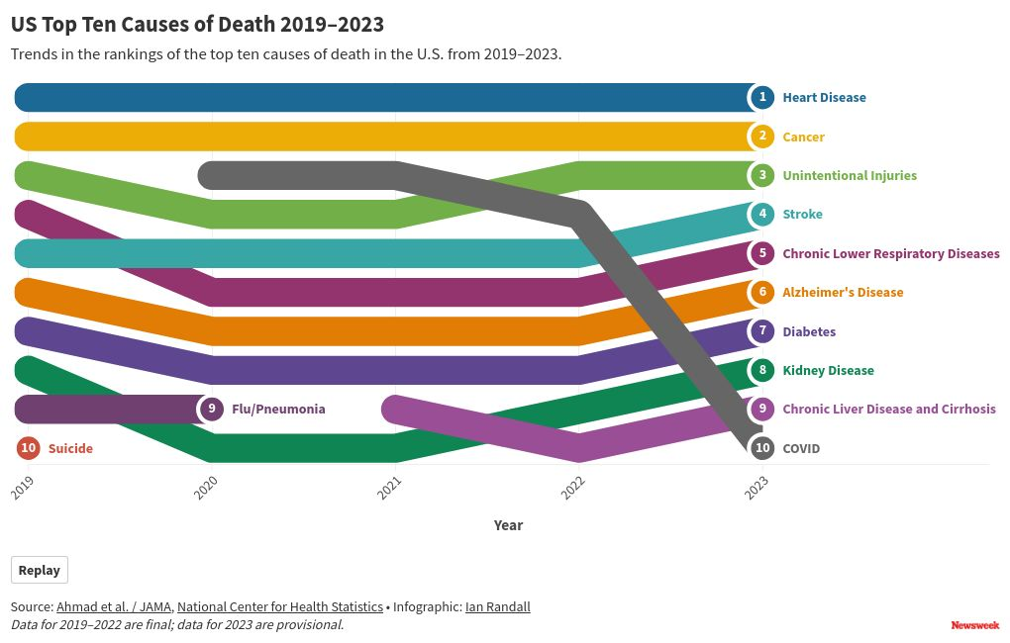
Leading Causes of U.S. Deaths Over Time

Slide 46
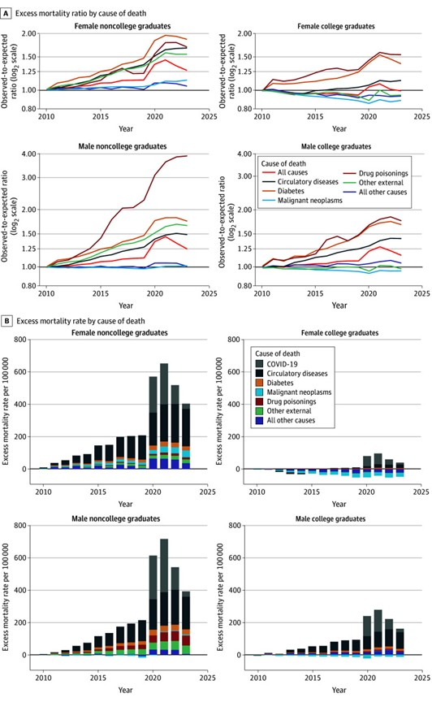
Excess US Mortality Rates Over Extrapolation from 2006-2010
By Mortality Cause, Gender, and College/Non-college
2025 analysis by Paglino, Wrigley-Field, and Stokes (JAMA Health Forum)

Slide 47
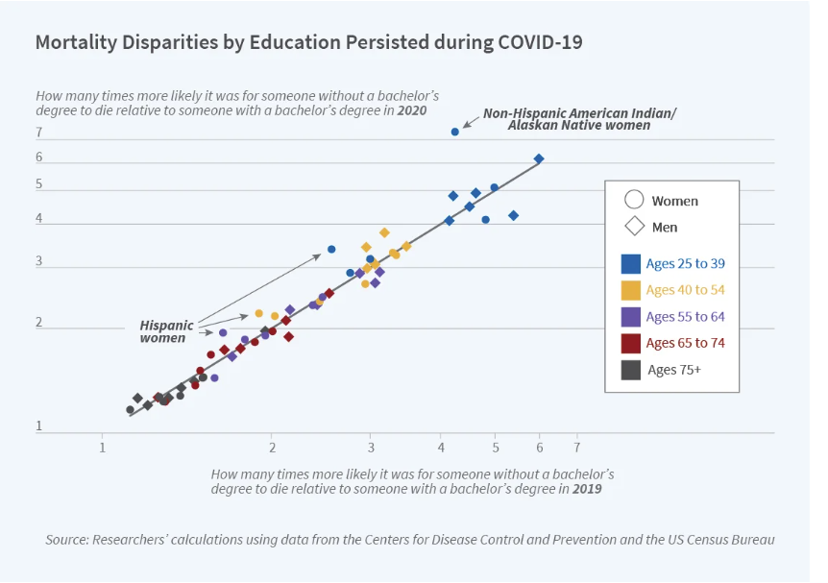
A College Degree Lowered Mortality Before and During COVID

Slide 48
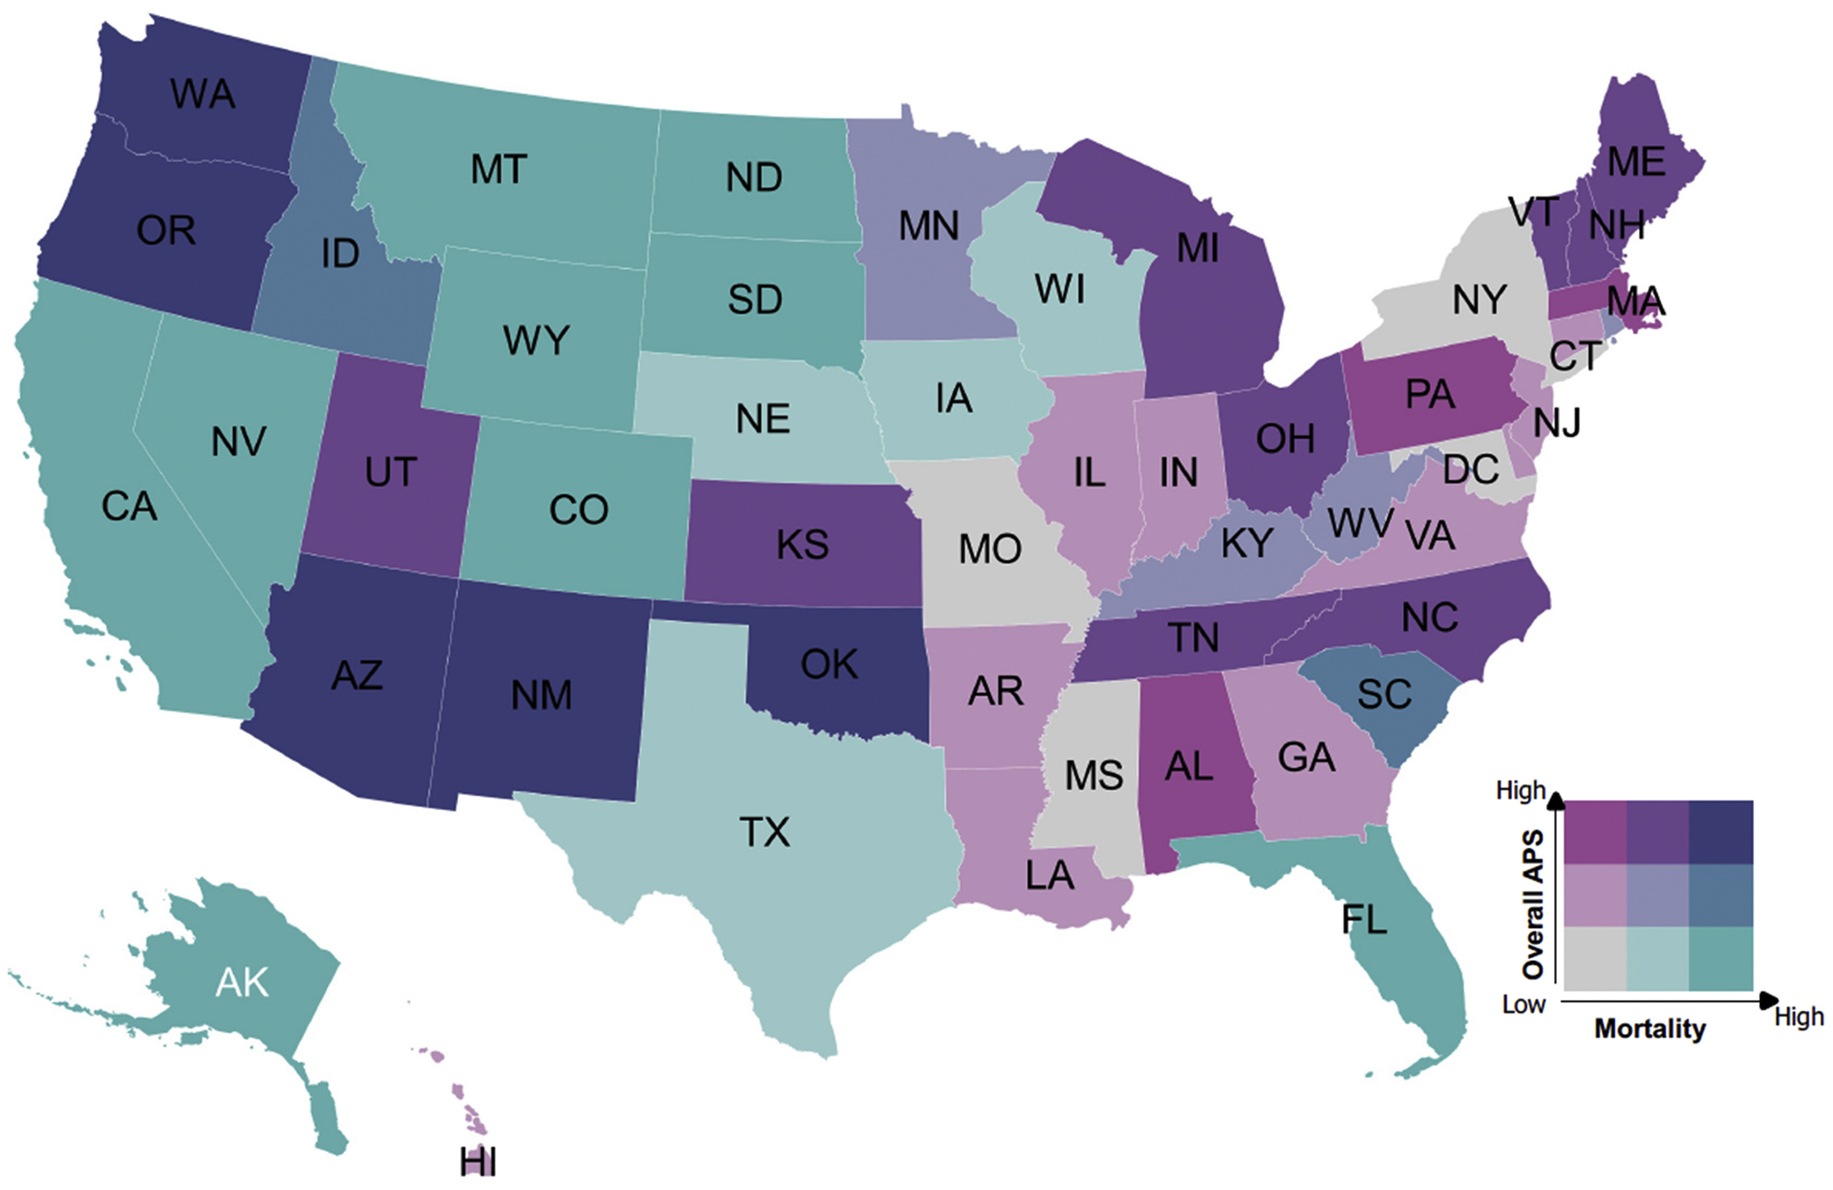
Alcohol-Related Death Rates vs. Alcohol Policy Strength (APS)

Slide 49


Prevalence of Guns Dominates Firearm Death Rates
Red states tend to have higher firearm death rates than blue states.

Slide 50

Alzheimer’s Mortality Rates for 2023, Age-Adjusted
Alzheimer’s disease death rates per 100,000 total population (age-adjusted mortality rate) for 2023, from CDC

Slide 51

Income Levels Are Low in Rural South and Appalachia, but also in many other regions of the U.S.

Slide 52

COVID Reduced the Hispanic Paradox Effect on Mortality Rates

Slide 53


County Health Variations Among Indiana Counties
Life expectancy varies from 69.0 (Scott) to 80.7 (Hamilton) years
Obesity rates vary from 35.0% (Hamilton) to 51.0% (Vermillion)

