Slide 1
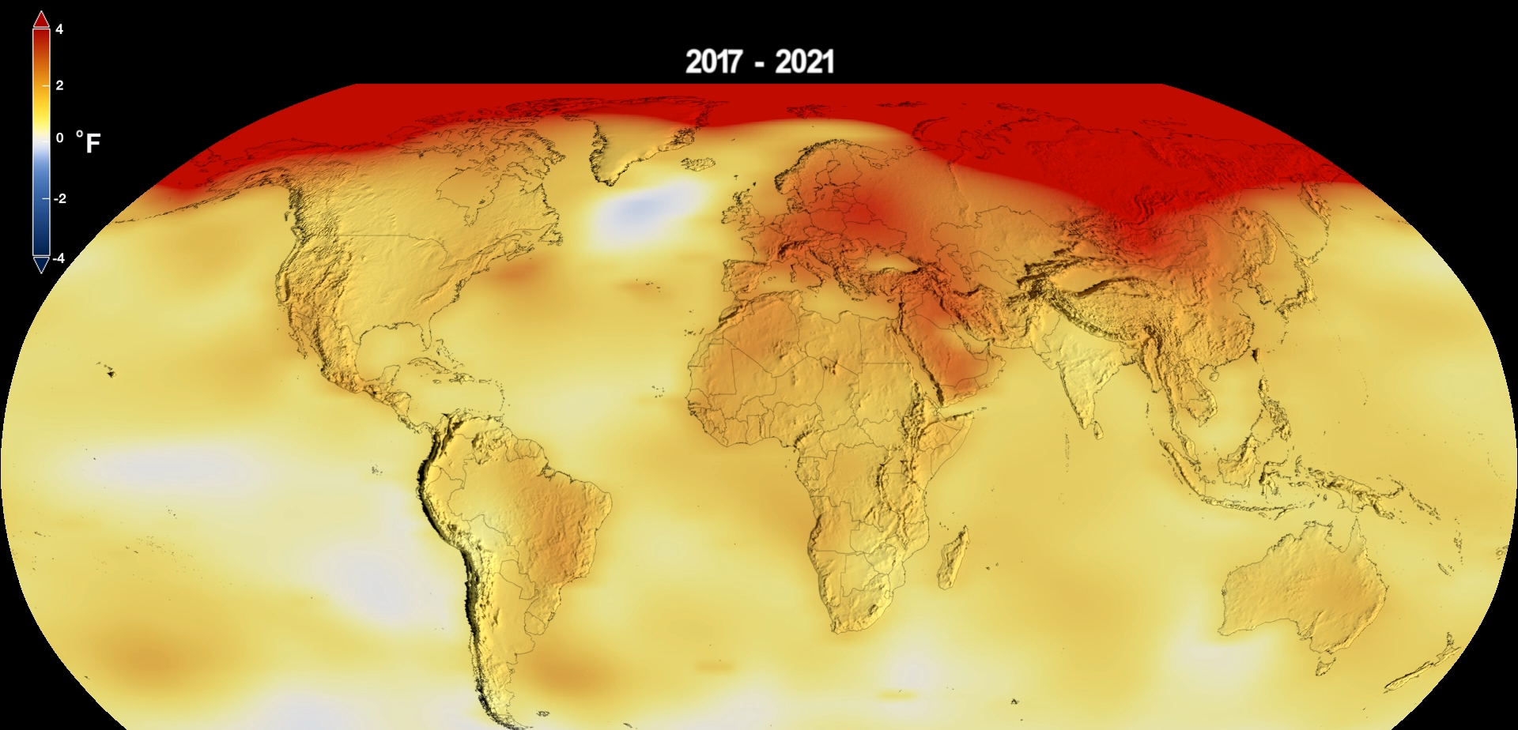
Why You Should Care About Climate Change: What the Data Tell Us
Part III: Climate Tipping Points: What May Change Irreversibly
Part IV: How Can Humans Mitigate Climate Change Impacts?
Tim Londergan and Steve Vigdor, Traveling University, May 17, 2026

Slide 2



Vigdor/Londergan Science Blog: “Debunking Denial”
www.debunkingdenial.com
Categories covered:
Bad Science
Brain Science &
Brainwashing
Climate change
Conspiracy theories
Cosmology & Astrophysics
Critical thinking
Cyber issues
Demographics
Education
Elections
Energy production
Environment
Evolution
Genes & Genetic
Engineering
Gun violence
Medicine, COVID, &
Vaccinations
Miscellany
Network science
“New Age” hoaxes
Ozone layer
Partisan divides over science
Scientific breakthroughs
Toxic products

Slide 3

A skeptic will question claims, then embrace the evidence. A denier will question claims, then reject the evidence.
Neil deGrasse Tyson
DISCLAIMER: The views expressed in these videos and on our blog site are our own, and do not represent positions taken by Indiana University.

Slide 4
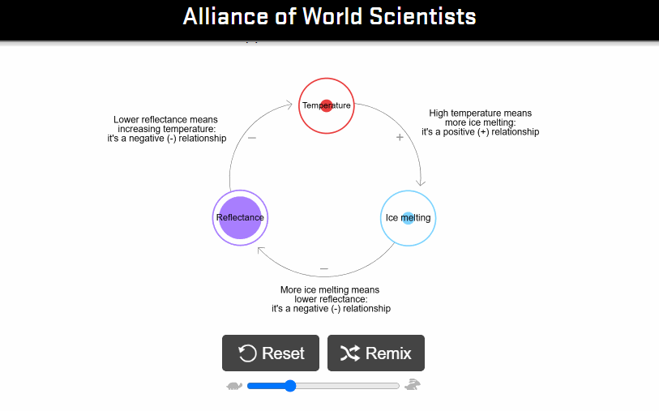
Example of a Climate Change Positive Feedback Loop
Video: When global temp. increases due to greenhouse gases in atmosphere, ice sheets melt, reducing Earth’s reflection of sunlight. Absorption of more sunlight increases global temps, further enhancing the feedback loop.
See more examples of climate feedback loops at: https://scientistswarning.forestry.oregonstate.edu/climate-feedback-loops-project
E.g., Melting of Greenland Ice Sheet

Slide 5

How Do Tipping Points Occur?
Example: ball in valley with two minima, as external forces change shape of the well
At first the ball vibrates a bit around a seemingly stable minimum.
But as shape changes and feedback amplifies vibration, ball passes a tipping point, making an abrupt transition to a new stable point of very different character.
Climate: once a dynamical system passes a tipping point, positive feedback effects drive the system inexorably toward a new state, making it difficult or prohibitively expensive to return to the prior state

Slide 6
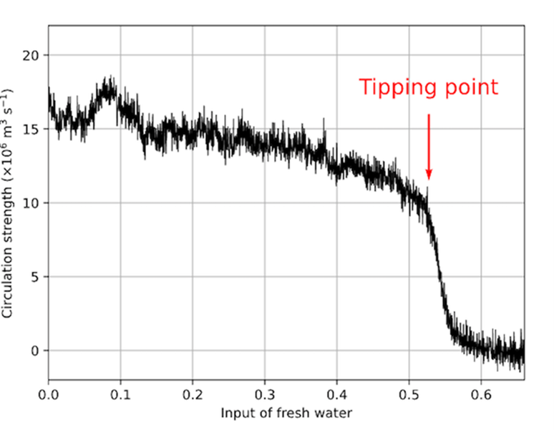
Climate Change Impacts on Some Earth Systems Get Amplified by Feedback, May Trigger “Tipping Points” to Dramatic Change
2025 Global Tipping Points Report, University of Exeter (500 pages)
Focus on those systems that are closest to tipping point under current conditions.
Atlantic Ocean current circulation strength
5 Earth systems are most susceptible to near-term tipping points:
Warm water coral reefs dying;
Greenland Ice Sheet melting;
West Antarctic Ice Sheet melting;
North Atlantic Ocean current collapsing;
Arctic permafrost thawing.
Input flow rate of cold fresh water
Model/ Atlantic Ocean Circulation Tipping Point

Slide 7
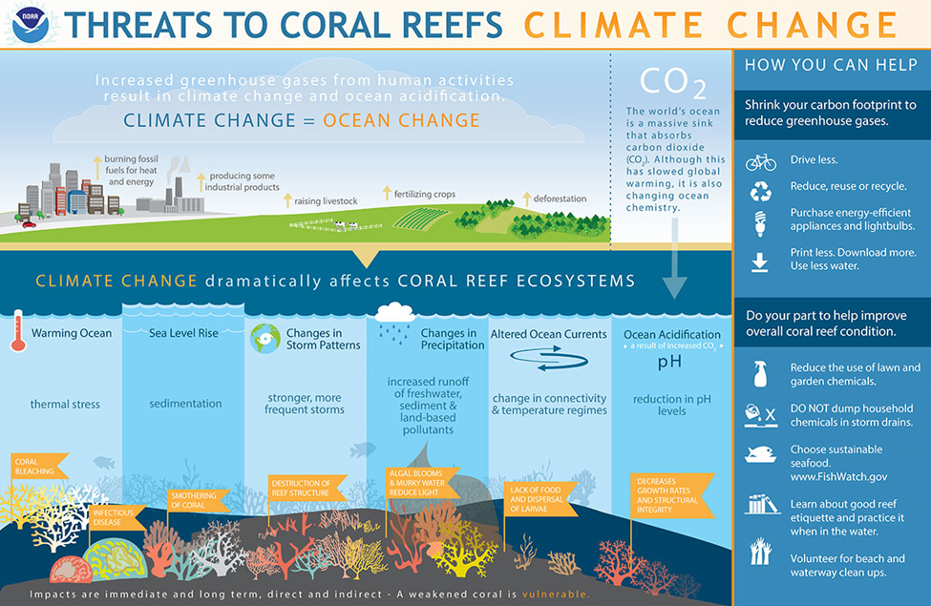
Climate Change Threats to Coral Reef Systems
25% of all marine species depend on reefs in some stage of their development
Thermal stress causes coral bleaching by expelling algae
Rising sea levels → increased sedimentation can smother coral
Pollutants produce algal blooms that reduce sunlight to corals
Altered ocean currents: diminish food for corals; hamper dispersal of coral larvae
Ocean acidification: affects integrity of reef; decreases rate of reef growth

Slide 8
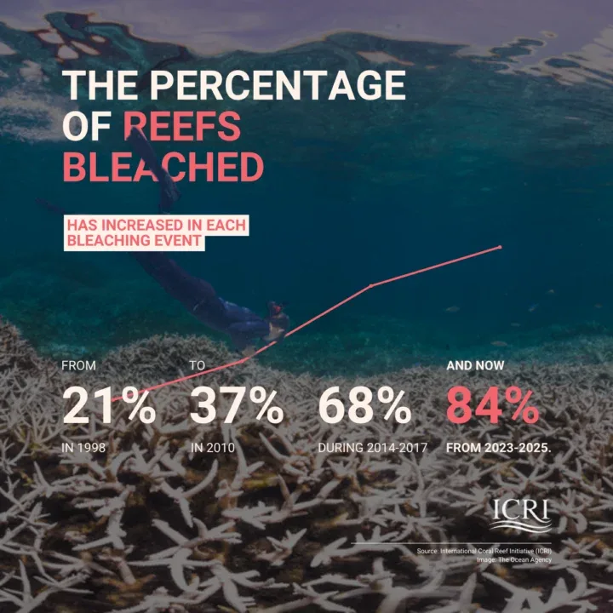
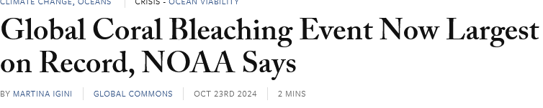
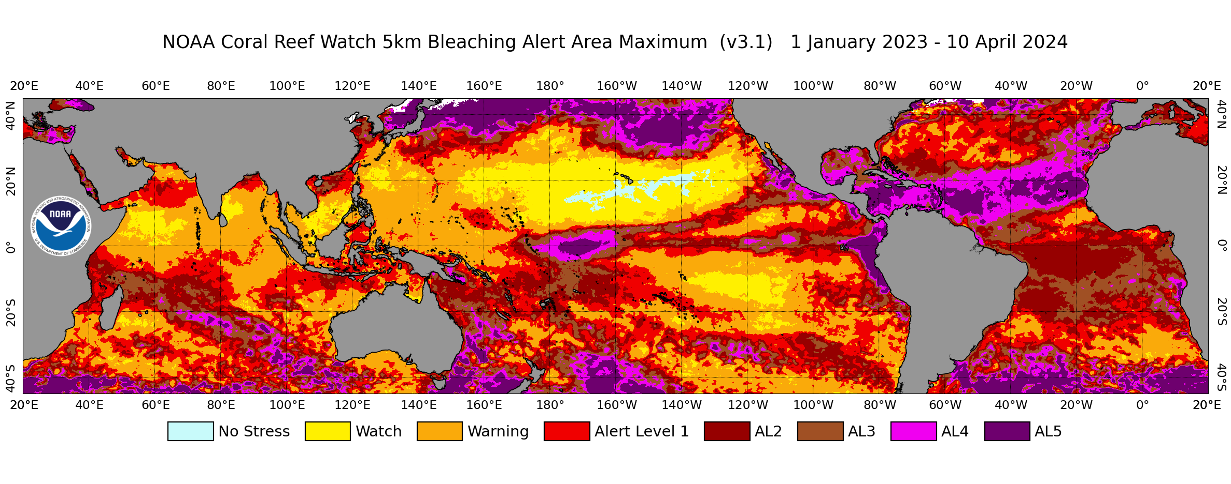
Unheard-of fraction of coral reefs were bleached in 2024 episode
> Reefs sometimes recover from bleaching, but 30% of worldwide reefs already lost this century! Many more at short-term risk!
Color-coded map shows magnitude of 2024 damage to coral reefs (land masses shown in gray)

Slide 9
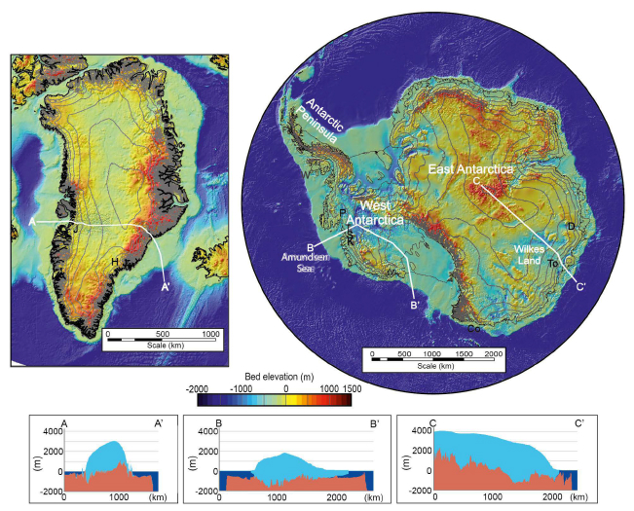
Greenland and West Antarctic Ice Sheet Tipping Points
Topographic maps of Greenland and Antarctic
Polar regions heating much faster than mid-latitudes
Ice sheet melting is accelerating ⇒ possibility of tipping points
Greenland sheet is a massive dome, up to 10,000 feet, atop bedrock; it melts from the top down.
West Antarctic glaciers extend into sea, fissuring from the bottom up.
Different topography yields different feedback loops

Slide 10
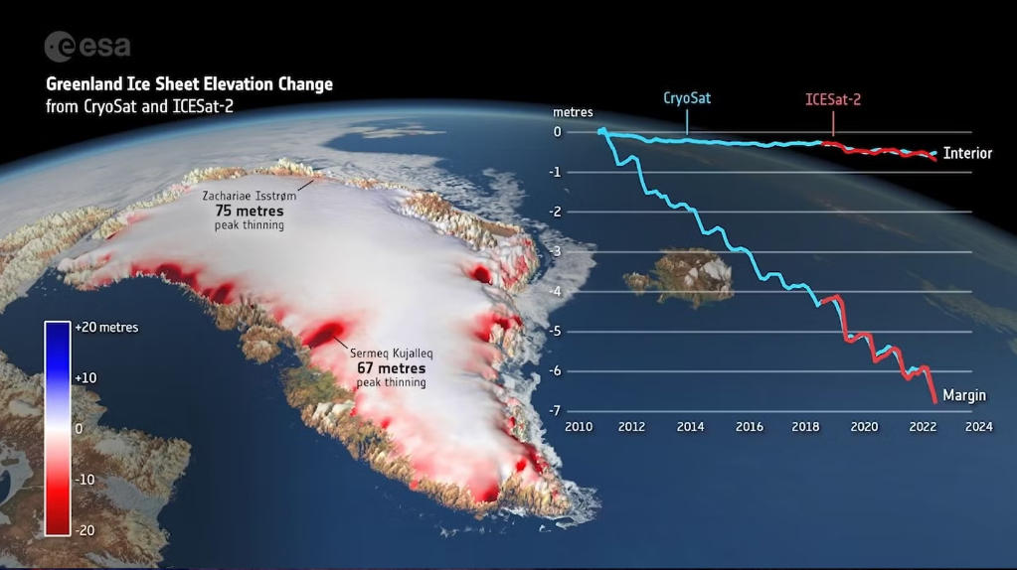
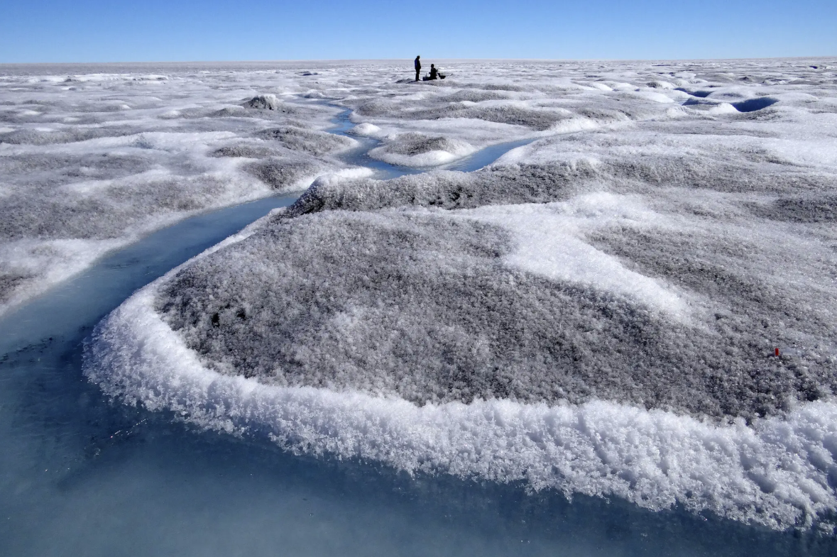
The massive Greenland ice sheet is melting from the top as peak gets exposed to warming air, but runoff has lowered elevations by 60-70 feet at some coastal places.
Wind blows nutrient-laden dust from exposed rocks onto coastal ice, feeding algal blooms. These accelerate melting by reducing solar reflectance.

Slide 11
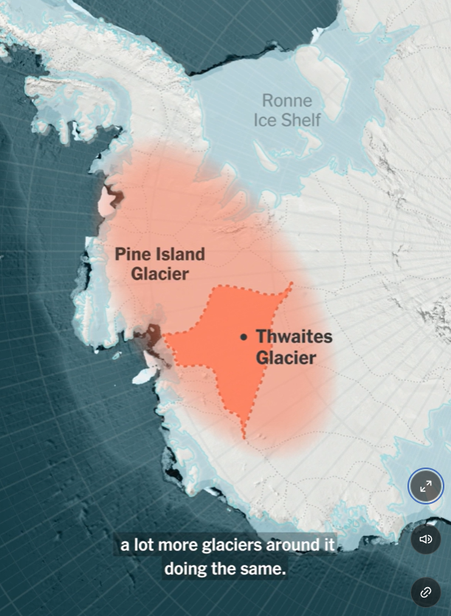
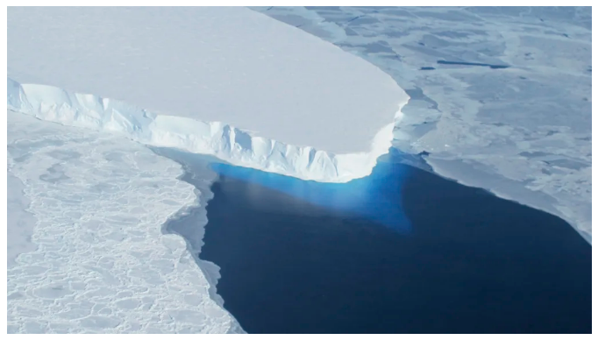
West Antarctica’s enormous Thwaites (“doomsday”) glacier is fissuring from below as warming sea water seeps into cracks.
If Thwaites breaks apart, structural integrity of surrounding glaciers and entire West Antarctic ice sheet gets compromised.

Slide 12
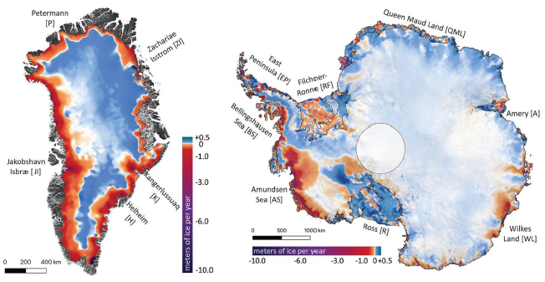
Outlook for Ice Sheet Tipping Points
As melting increases, can reach ‘tipping point.’
Past tipping point, ice sheet may completely melt (after tipping point, very hard to reverse).
Complete melting of ice sheet would take centuries, possibly millennia; but produce major global change.
Complete melt of:
Greenland Ice Sheet would raise global sea level by up to 7 meters; submerge islands worldwide; inundate coastal areas.
West Antarctic Ice Sheet would raise global sea level by 3 meters.
Greenland melt may induce tipping points in other major systems.

Slide 13

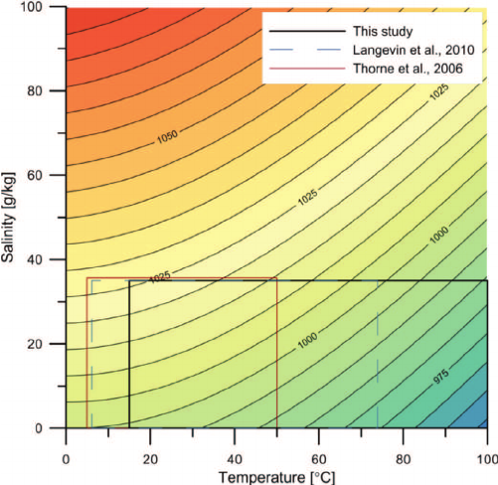
Density of Seawater Depends on Temperature and Salinity
The Dead Sea has salinity of 34%, so is especially dense, making it easy to float.
Density of seawater increases with decreasing temperature and with increasing salinity.

Slide 14
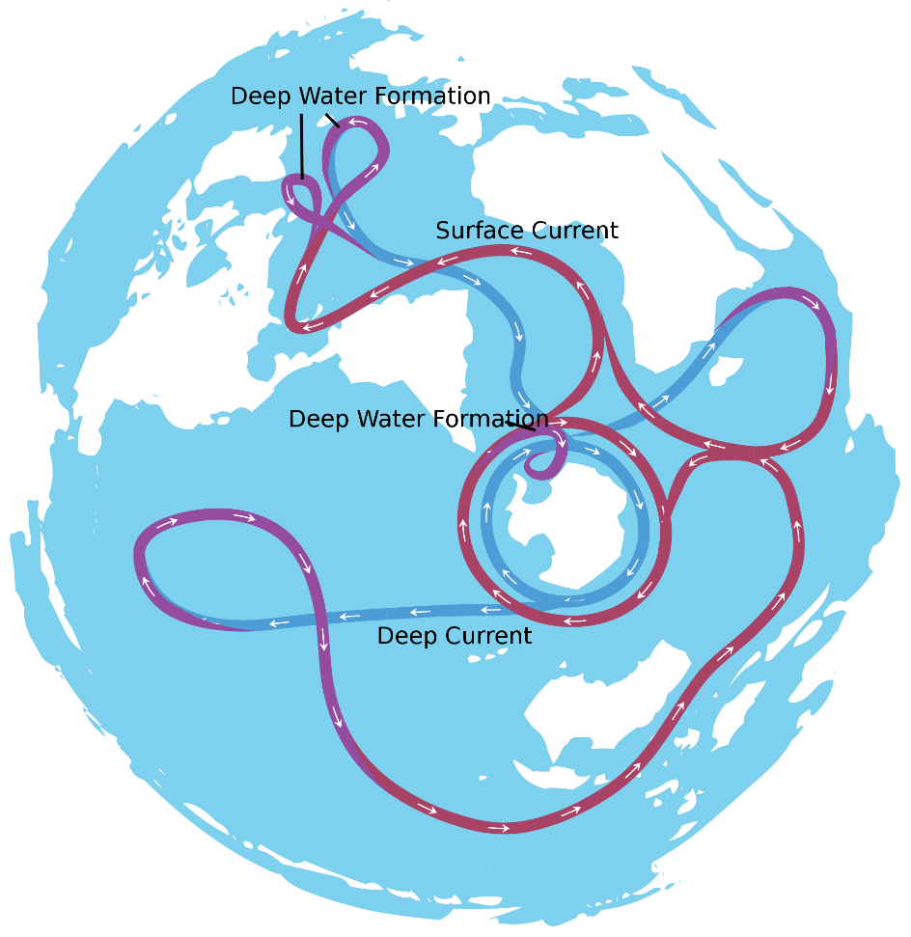
The Global Conveyor Belt of Ocean Currents
The conveyor belt is driven by density variations of sea water.
Cold, salty water is densest of all.
H₂O freezes or evaporates, but not the salt. So water left behind saltier.
Cold, salty water is submerged deep (thousands of meters) below surface at 3 locations: near Iceland, near Greenland, and near Antarctica.
Warm, salty water flows in along surface from Southern Ocean to replace submerged cold, salty water, but then gives up its heat to atmosphere and sinks itself, forming vertical global circulation.

Slide 15
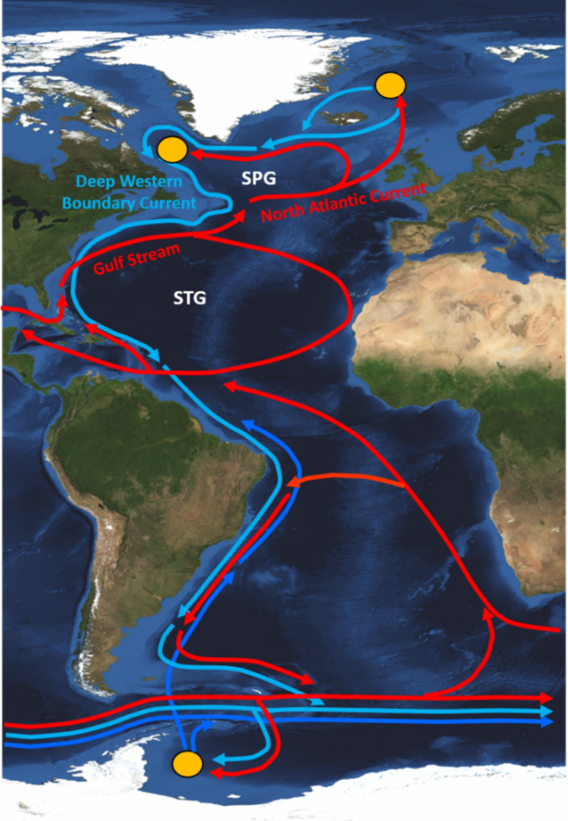
North Atlantic Ocean Circulating Currents
Schematic diagram of Atlantic circulating currents.
Red = warm surface currents
Blue = cold deep-water currents
Yellow = deepwater formation areas
AMOC = Atlantic Meridional Overturning Circulation is part of global conveyor belt.
AMOC warm surface current feeds the Gulf Stream that warms western Europe and the North Atlantic Subpolar Gyre (SPG).
Fresh water from Greenland ice sheet melt can disrupt sinking of cold, salty water, hence, the flow of AMOC and SPG.
As AMOC weakens, less salty water flows from South, a feedback further disrupting flow.

Slide 16
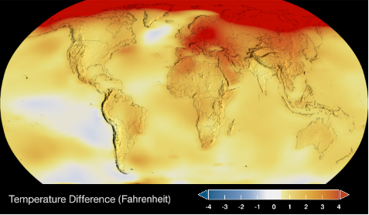
How Close is AMOC to Tipping?
‘Warming hole’ in N. Atlantic suggests that warm water flow from AMOC to SPG is weakening.
Proxy measurements of AMOC flow strength show weakening, too.
But direct measurements began only in 2004, not yet conclusive.
Due to large model uncertainties (tipping between 15 and 300 years from now), IPCC assigns “medium confidence” to no AMOC tipping this century.
Global climate model by van Westen, et al., shows tipping when input flow rate of cold fresh water grows large enough.
Atlantic Ocean current circulation strength
Input flow rate of cold fresh water

Slide 17
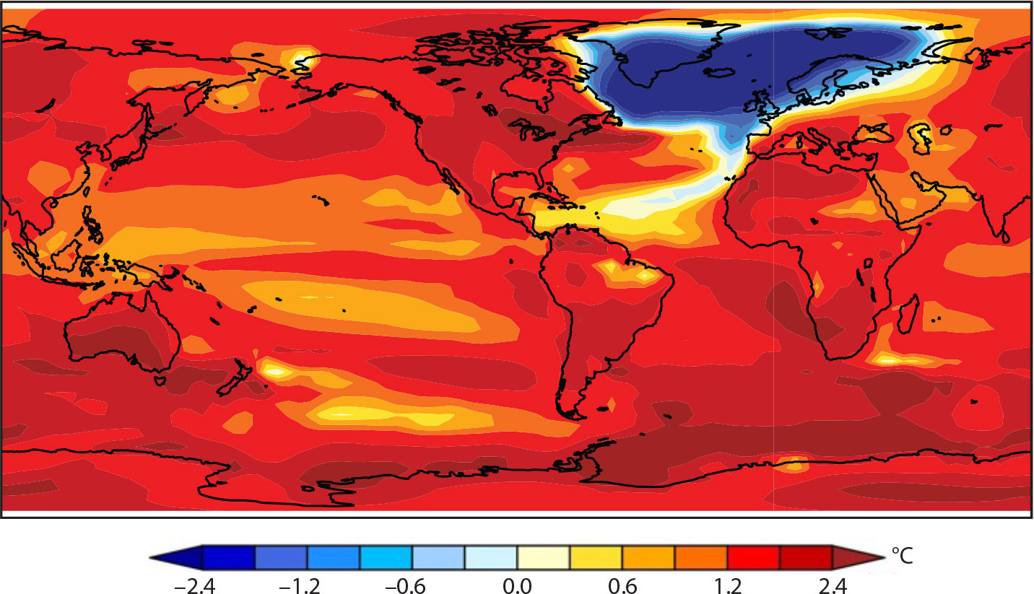
One Model of Global Temperatures if AMOC Collapses
Global warming can trigger a N. Atlantic and western Europe deep freeze!
Warmer Southern Ocean would release lots more CO2, increasing climate change.
Wind and precipitation patterns would be altered around the globe.
Climate change is non-linear, adaptation may be extremely difficult.
Proxy measurements suggest AMOC collapsed from 12,900-11,600 years ago!

Slide 18
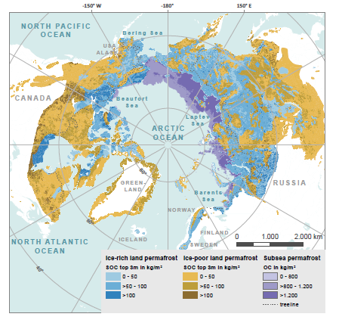
Distribution of Permafrost
Permafrost is frozen ground distributed around Arctic Circle, much of it under thin active layer.
Current estimate: top 3 meters of global permafrost contains 50% more carbon (CO₂, CH₄) than today’s atmosphere.
If global warming causes much of permafrost to thaw, release of all those greenhouse gases will accelerate warming and melting.
Tipping is most likely locally or regionally for ice-rich land permafrost colored in shades of blue above. Rapid thawing of ice can cause subsidence and formation of thermokarst lakes at weak points in the ice layer.

Slide 19
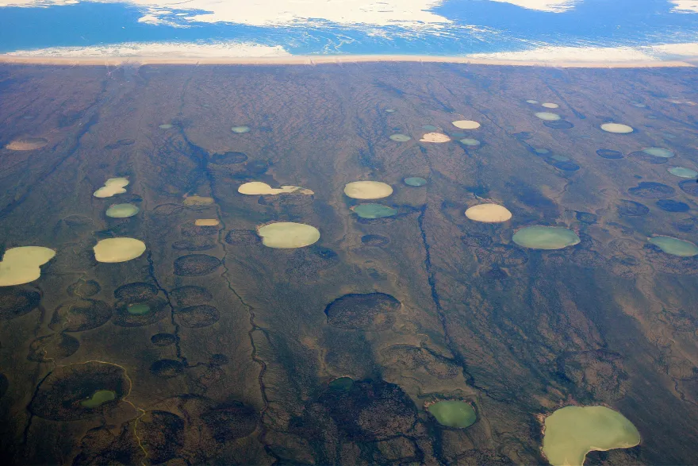
Thermokarst Lakes Forming in Canada’s Arctic Region

Slide 20
Summary of Part III:
Beyond serious climate change impacts we’re already experiencing, a number of Earth systems may pass a “tipping point” that could lead inexorably to much more severe, long-lasting outcomes.
2025 Global Tipping Report from Exeter rates 5 systems as most susceptible to near-term tipping: coral reefs; Greenland and West Antarctic Ice sheets; Atlantic Meridional Overturning Circulation (AMOC); and Arctic permafrost.
Once a tipping point is passed, positive feedback can cause centuries of change even if humans subsequently stop emitting greenhouse gases.
There can be cascades of tipping, as exemplified by melting of the Greenland Ice Sheet triggering a possible AMOC collapse.
Tipping points illustrate the nonlinearity of climate change, which will make human adaptation more costly in the end than mitigation.

Slide 21
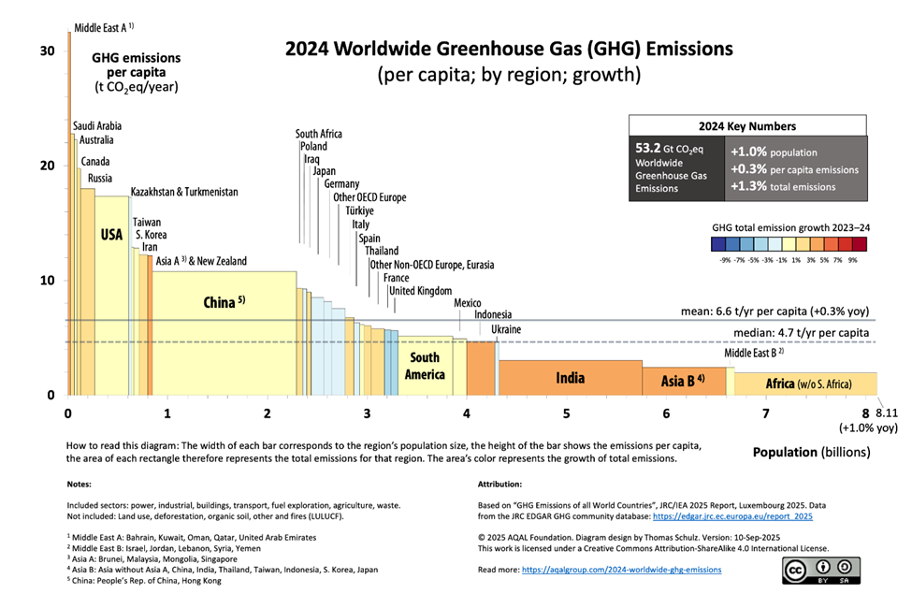
Where Are Greenhouse Gas (GHG) Emissions Coming From?
U.S. among world leaders in GHG emissions per person.
U.S. and China emit the most, but many other countries contribute.
Climate change is a global problem!
Total emissions of each country given by area of rectangle.
GHG Emissions per person (tCO2e)
Population (billions)
To mitigate climate change, we must reduce GHG emissions globally!

Slide 22
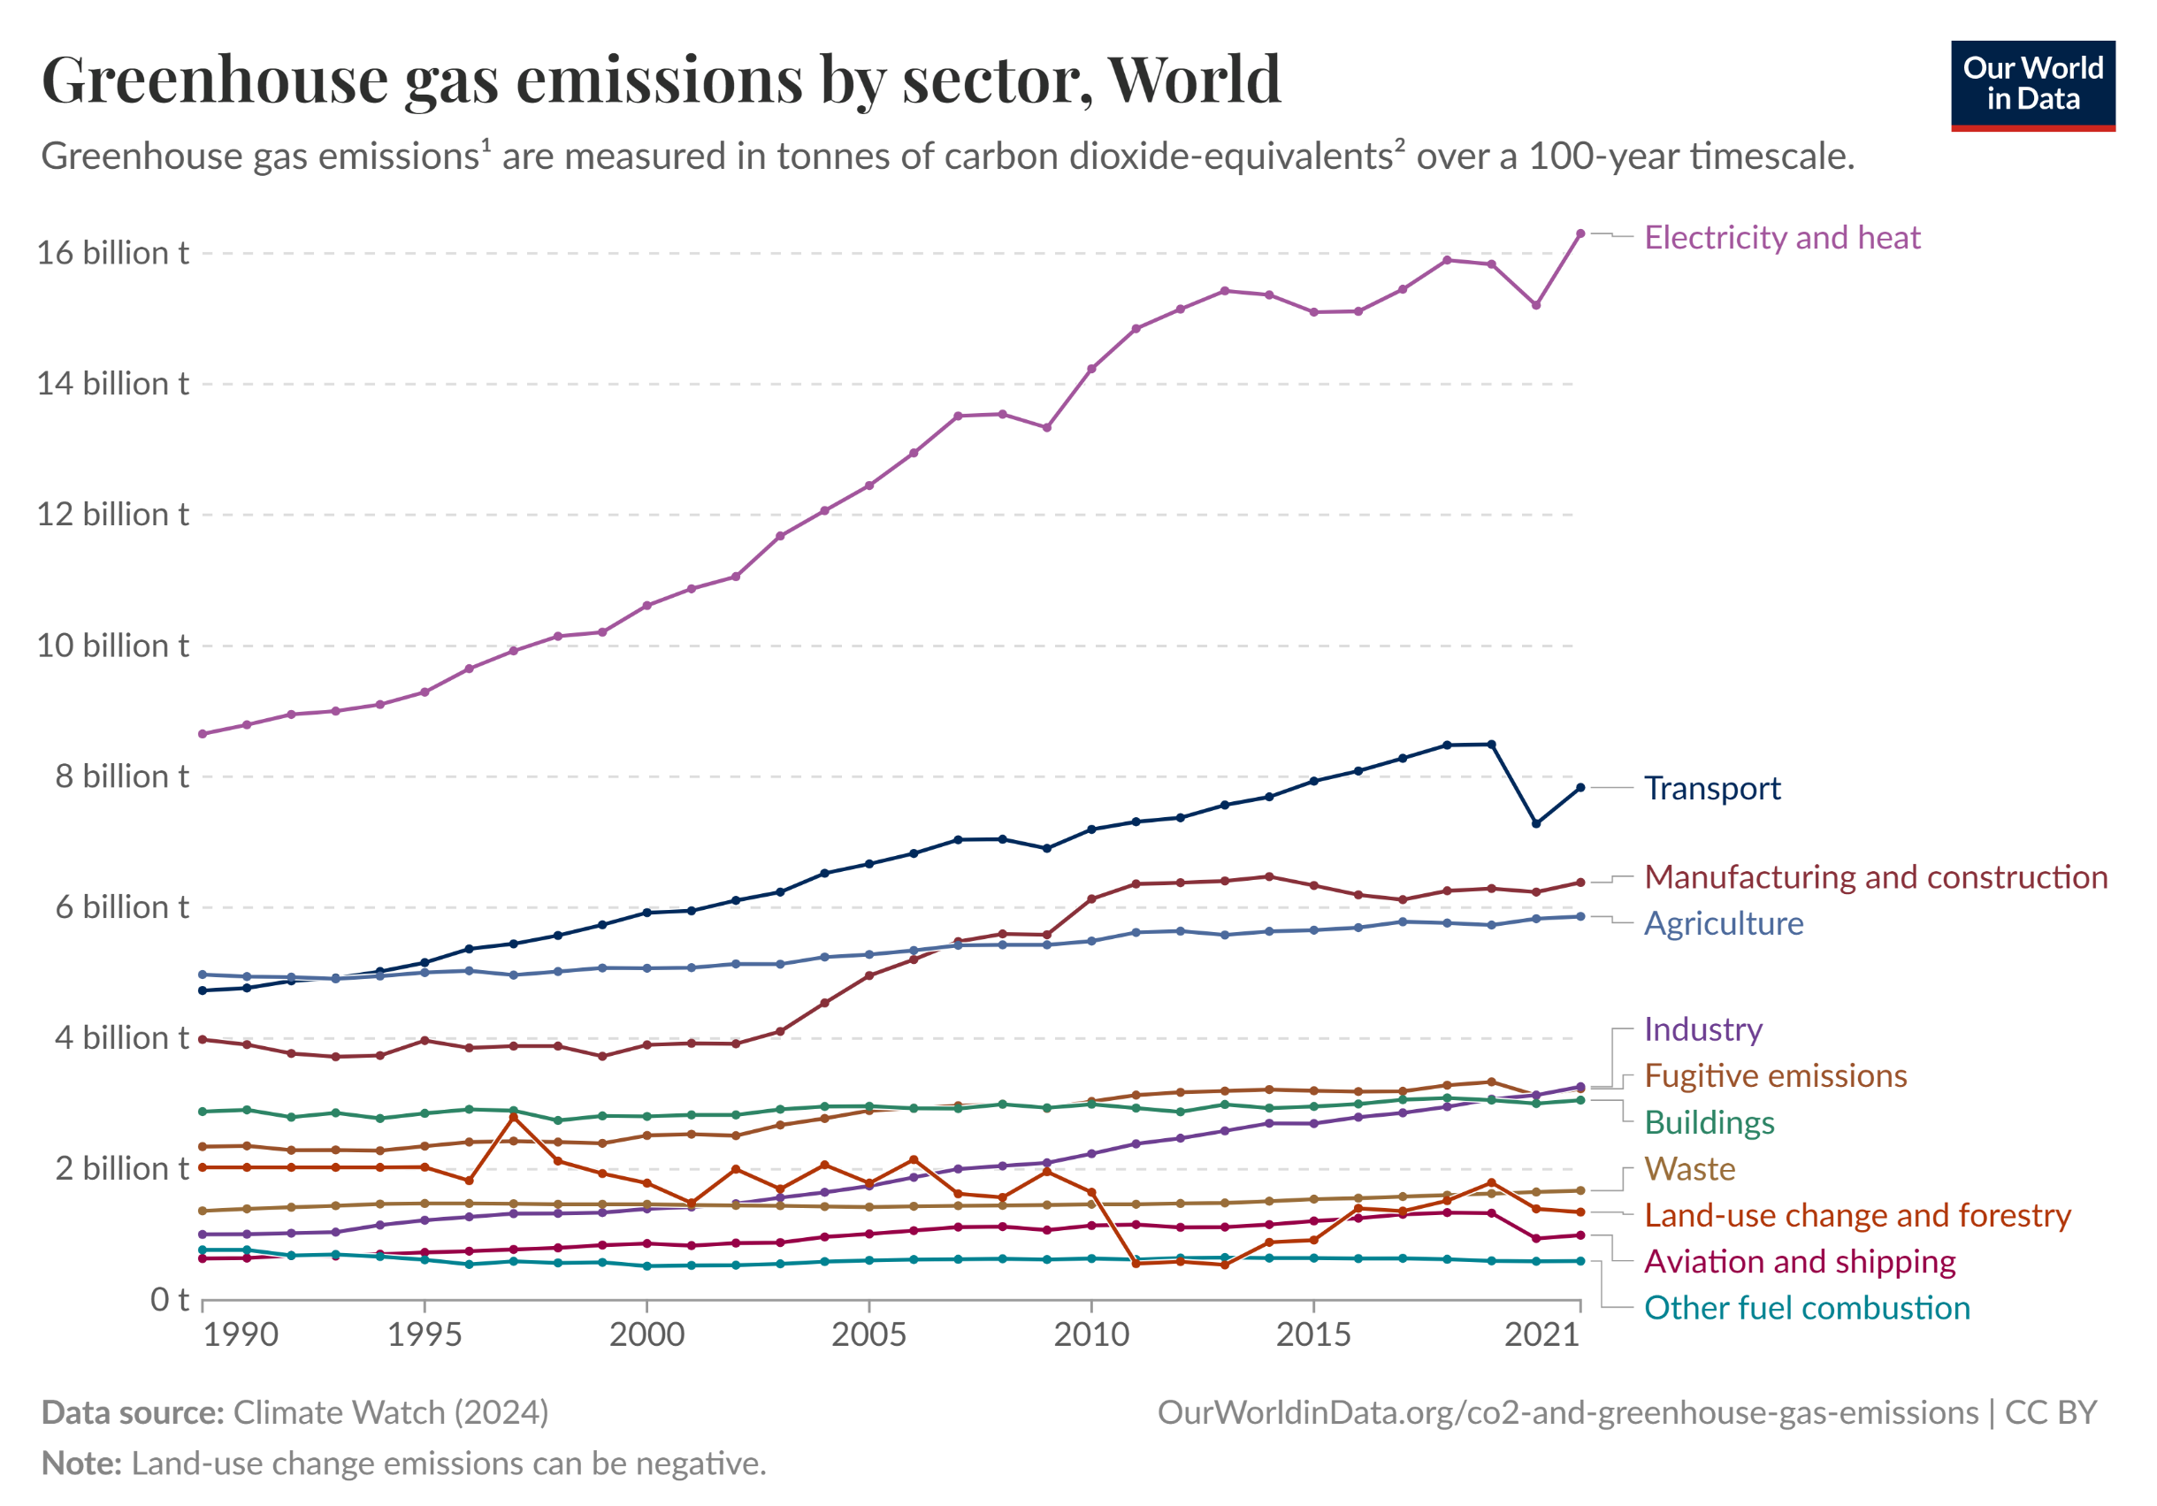
Which Economic Sectors Emit the Most GHG?
The biggest emitters are fossil-fuel burning to produce electricity and to fuel vehicles.
In U.S., electricity prod’n and transport contribute about equally.
Technology exists to replace fossil fuels in energy production and vehicle fuel.

Slide 23
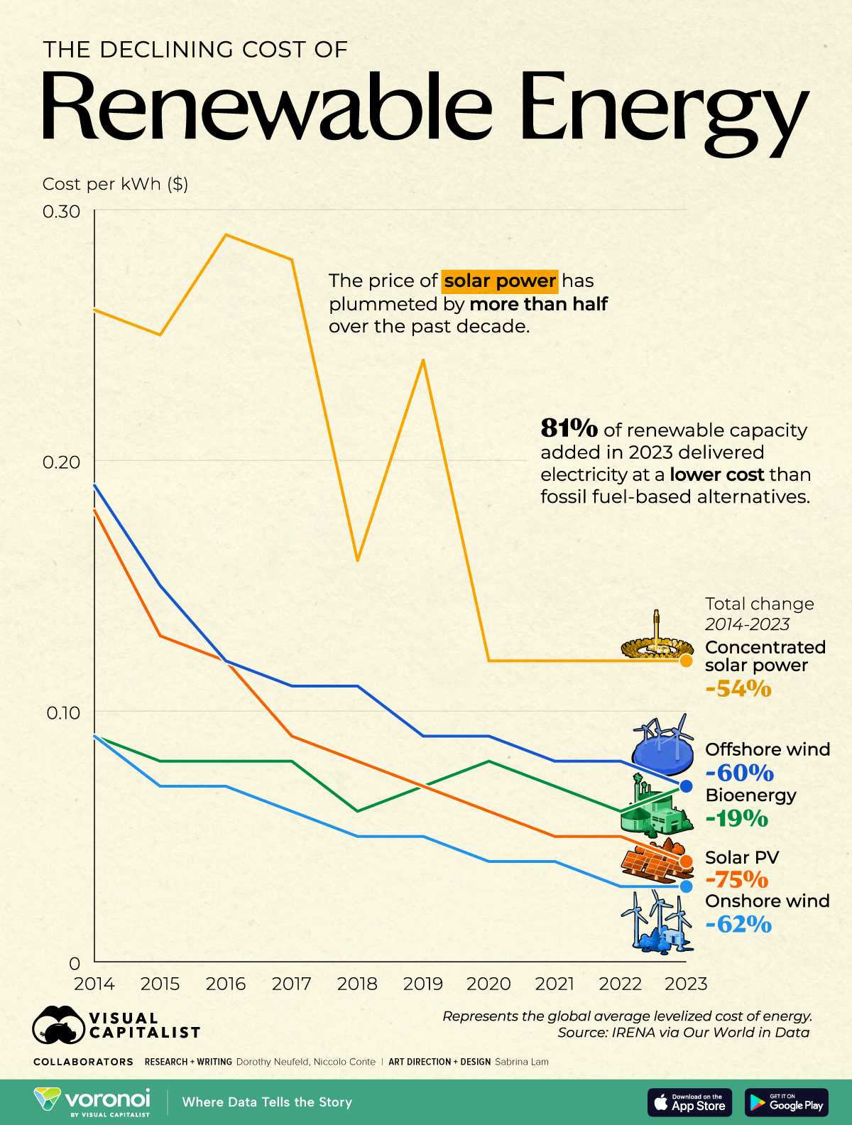
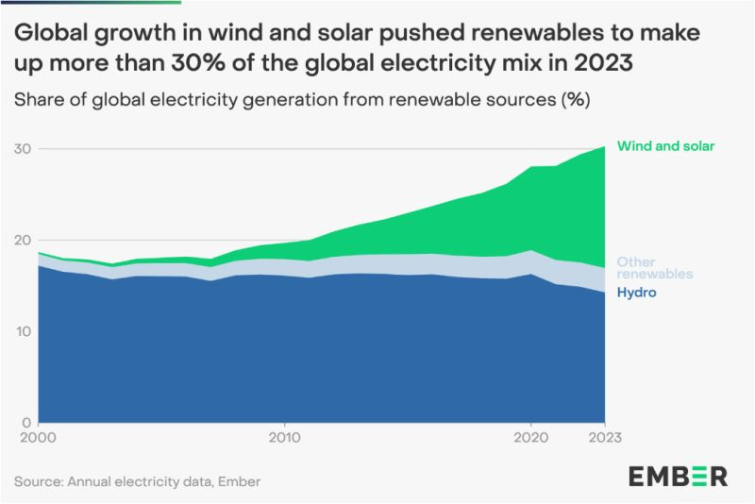
Renewable Energy Contributions are Growing, Costs are Dropping
Renewables now contribute ~30% to global electricity production, thanks to rapid growth in solar and wind.
Solar and wind power costs have decreased by 50-75% over past decade. Ongoing research will improve their efficiency.

Slide 24
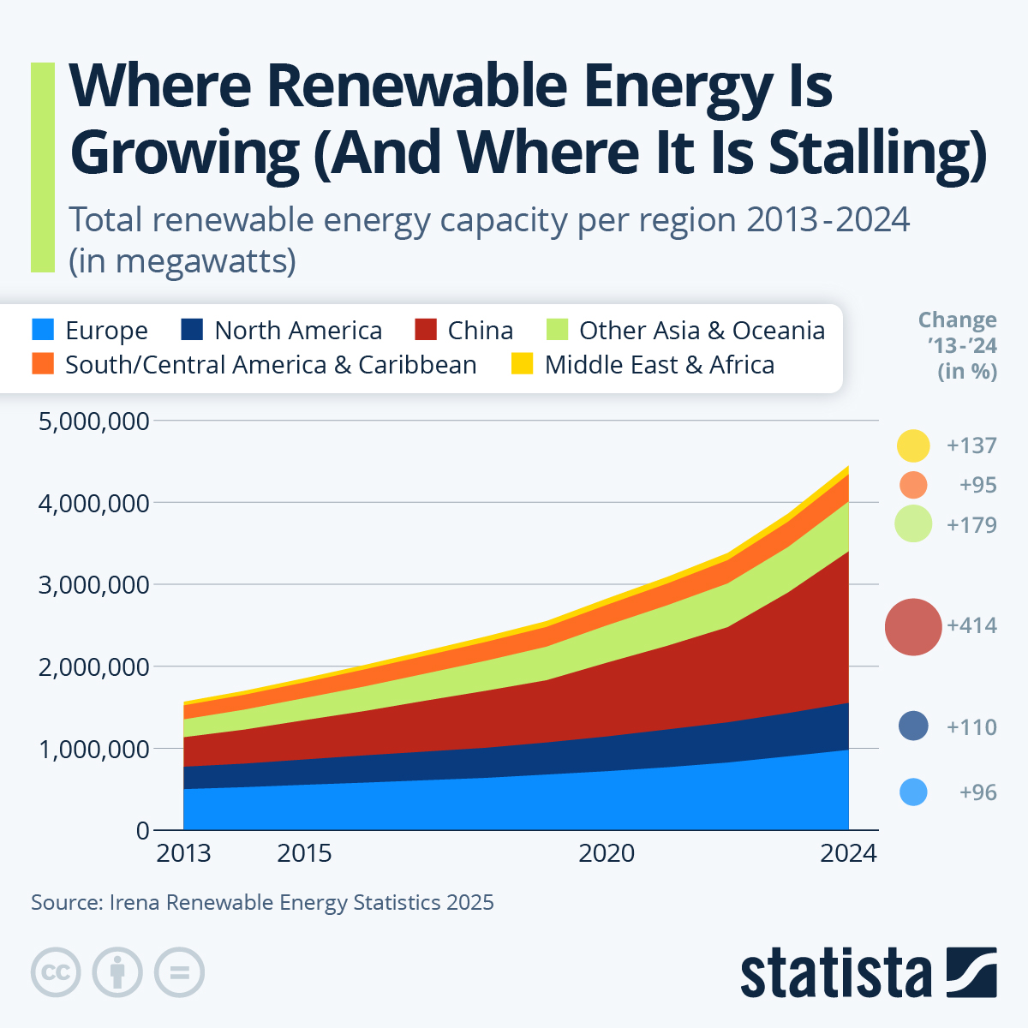
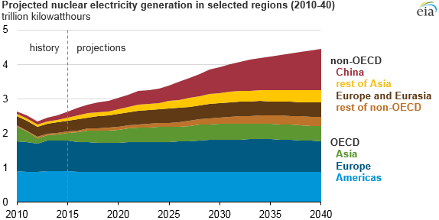
Which Countries Are Developing Carbon-Free Energy?
China expanding renewable and nuclear energy generation faster than rest of world, may also host 1st commercial fusion power plant.
U.S. expanding slowly, must accelerate
Small modular nuclear reactors may help.

Slide 25
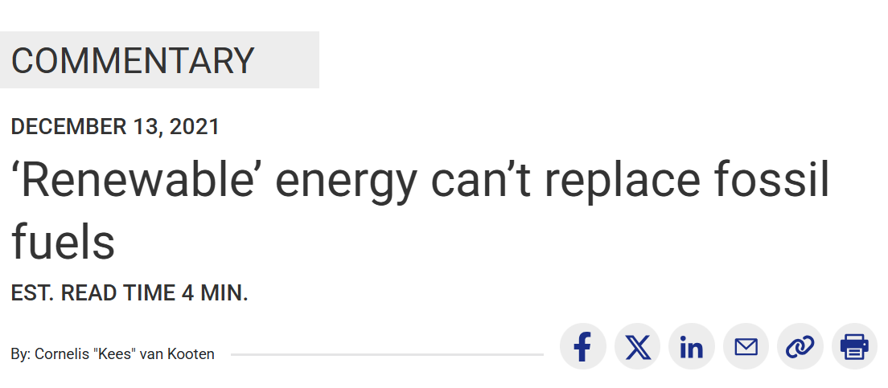
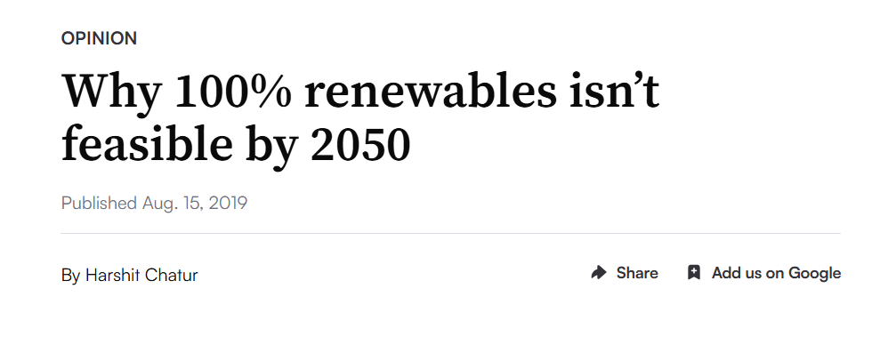
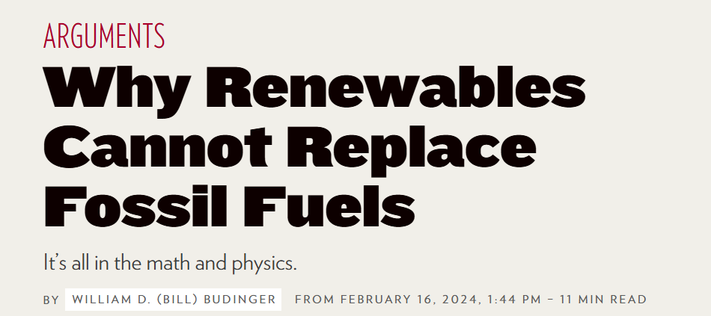
Many Have Said It Can’t Be Done…
But China Is Doing It…

Slide 26

How Is China Expanding Solar Power So Aggressively?
By covering mountains, deserts, lakes, and coastal waters with many millions of solar panels!
With > 1100 GW of solar and > 600 GW of wind power by 2026. At least half of China’s electricity needs by from renewables by 2030.
Also planning a 1 km-wide space array of solar panels to always face the Sun by mid-century, transmitting energy to Earth by microwaves

Slide 27
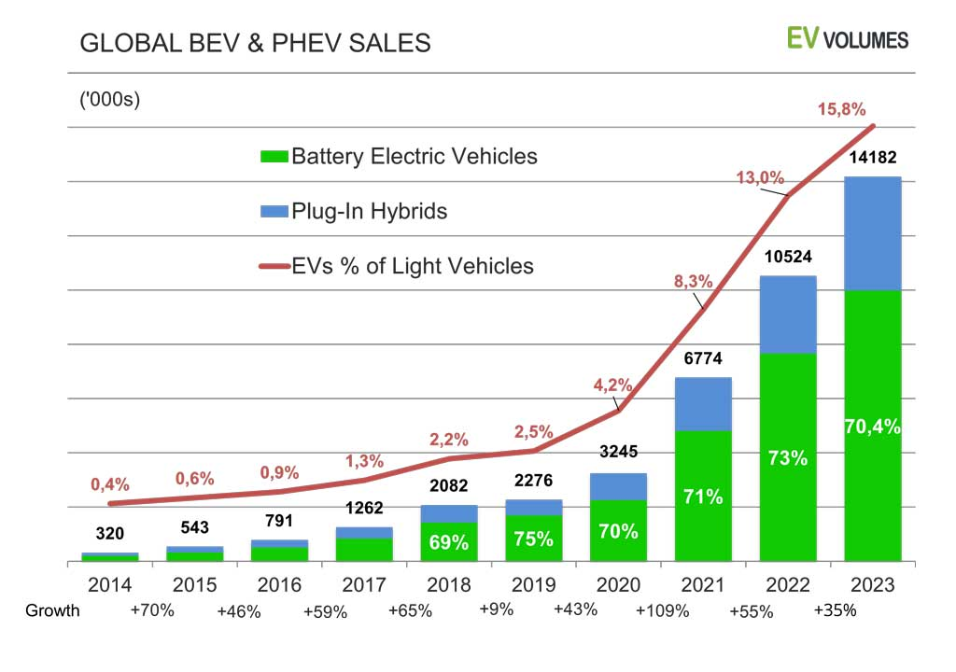
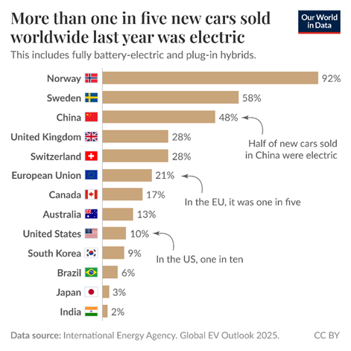
Electric Vehicle Sales Growing Rapidly Globally, but U.S. Lags Behind
China leading exporter of EVs and EV batteries.

Slide 28
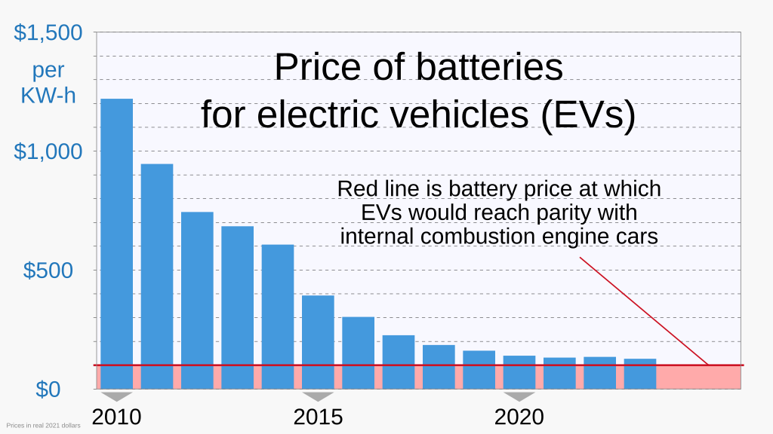
EV Prices Approaching Parity with Internal Combustion Engines
Battery research has lowered EV battery prices by factor of 10 from 2010-2023
In late 2023 average U.S. cost for new EV was $2,800 more than for new gasoline-powered cars, after rapid decline in EV prices.
Numerous other countries have subsidies for EVs. The U.S. has tariffs.
Tariffs, if they persist, will increase price for all cars, but most for EVs, since EV batteries and battery material are mostly imported.

Slide 29

Chinese Auto Manufacturer BYD is Now Ahead of Tesla in Worldwide Sales and is the current driver of state-of-the-art EV charging technology

Slide 30
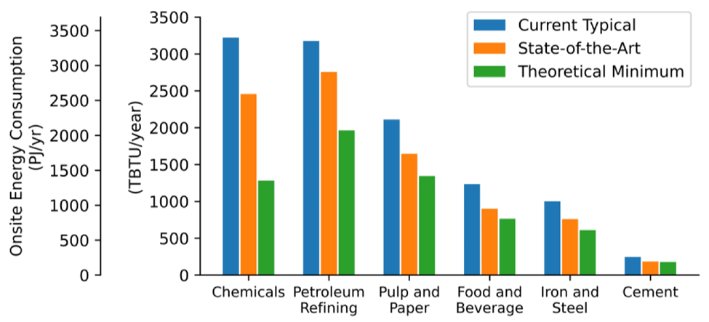
Improving Industrial Energy Use Efficiency
A 2015 Department of Energy report projected improvements possible in 6 manufacturing sectors from uniform adoption of then state-of-the-art practices and further improvements anticipated from ongoing R&D.
Potential Reductions in Energy Consumption by Six U.S. Manufacturing Subsectors
Means of improvement: automation; robotics; computer-aided monitoring of processes; use of next-generation materials; recovery of waste heat; conservation efforts.
Conservation measures can also reduce energy usage in residential and commercial buildings.

Slide 31
Summary of This Video:
Mitigating the most severe impacts of climate change is possible with existing and shortly expected technology. But it requires the political will to transform economies from fossil fuels to carbon-free technology.
Renewable energy efficiency and cost are improving. These can provide for the majority of needs by mid-century. Battery storage and nuclear power (e.g., small modular reactors) can fill in source fluctuations.
Electric vehicle costs and ranges are improving. They can provide the majority of global vehicle needs by mid-century if countries offer modest subsidies. They reduce GHG and other noxious vehicle emissions.
Technology exists to improve GHG emissions from manufacturing, commercial and residential buildings, and the construction industry.
Adaptation alone can’t deal easily with nonlinearity of climate change.
China is leading and the US lagging in mitigating climate change. If political will is not generated in time, the price for future generations will be severe.

Slide 32

Humans Have the Technology to Mitigate Worst Impacts of Climate Change

Slide 33
Backup Slides

Slide 34
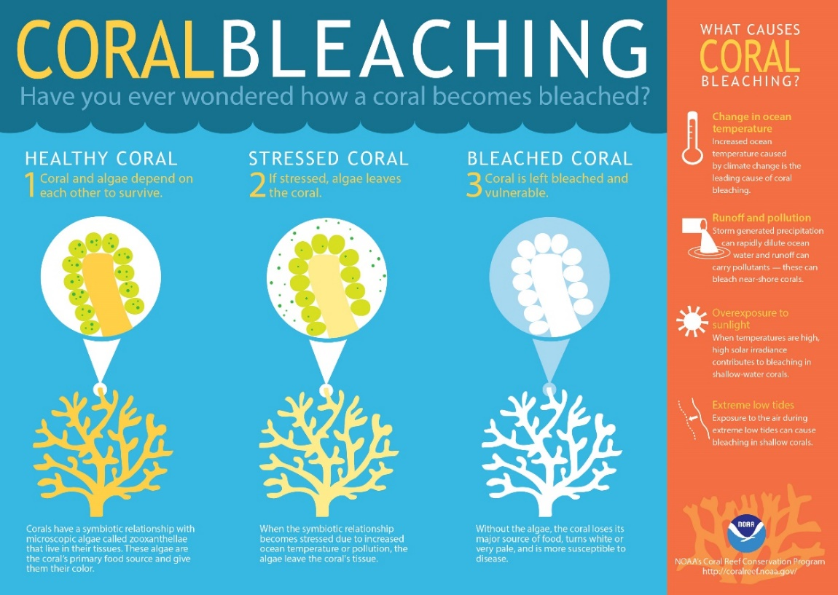
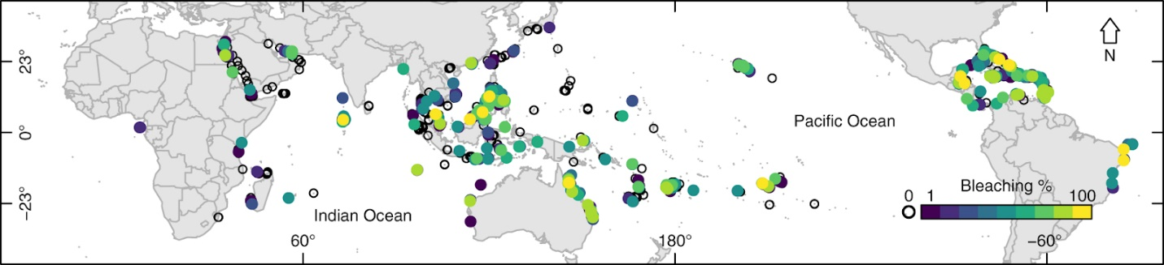
Reefs Under Stress Experience Bleaching
Algae live in tissues of coral, form major food source, give coral its color
When coral under stress, it expels algae
Coral turns bone white (bleaching)
Process can be reversed if corals no longer under stress
Bleaching weakens coral: harder to thrive; if too much stress, coral dies
Global coral reef bleaching episodes, 1998 -- 2017
Color coded: blue 1% damage, yellow 100% damage
Recent bleaching episodes: increased areas, more severe damage.

Slide 35
Greenland Ice Sheet Tipping Point
Most melting today around the edges of Greenland.
But feedback loops are most associated with melting from the peak.
Positive Feedback Loops:
As ice melts, ice surface moves to lower level; warmer air temps → faster melting.
As surface snow melts, remaining ice absorbs more solar radiation → faster melting
Negative Feedback Loop: As air temps increase, more humidity; more snow falls on central region of glacier → slower melting.
Need better models of melting dynamics, tipping points

Slide 36
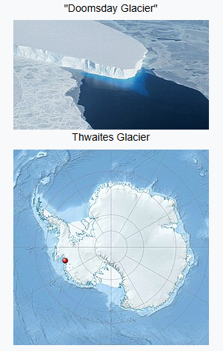

West Antarctic Ice Sheet Threatened by Tipping Point of Thwaites Glacier
Recent underwater probe measurements reveal warming Amundsen Sea water seeping up through cracks is accelerating melt of enormous Thwaites glacier.
As Thwaites glacier melts, it weakens stability of West Antarctic Ice Sheet. Tipping point may be near.

Slide 37


Slide 38

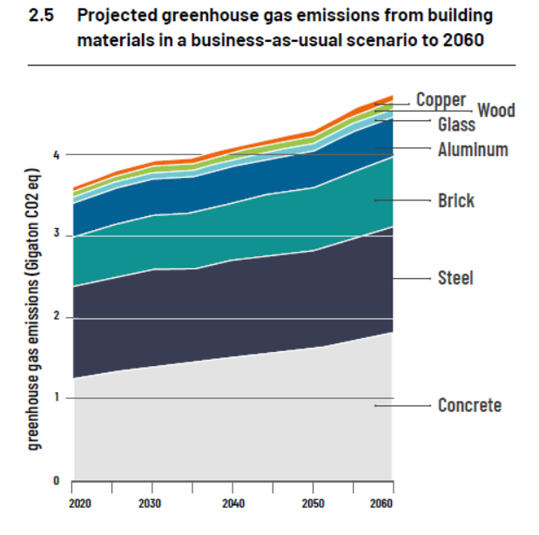
Reducing GHG Emissions Embodied in Current Construction Practices
Embodied carbon becomes more important as energy grid mix moves toward renewables.
Design for “circularity” to allow reuse of building elements when a building’s life-cycle is complete.
Substitute bio-based materials – e.g., timber, wood, bamboo – for carbon-rich building materials like concrete and steel, wherever possible. This can reduce GHG emissions by up to 40% by 2060.

