Slide 1
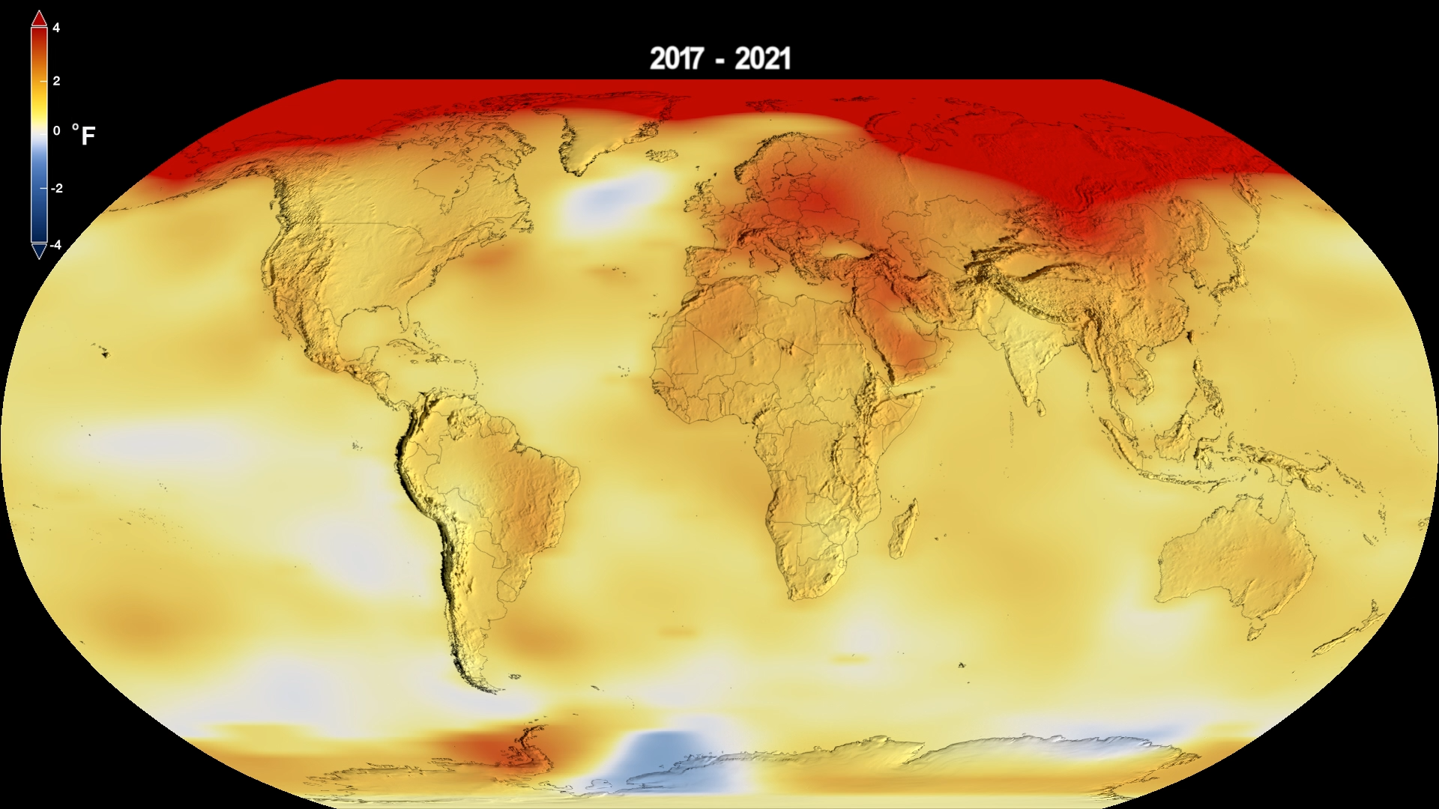
Why You Should Care About Climate Change: What the Data Tell Us
Part I: How we know that global climate change is real
and primarily caused by humans.
Part II: What are the short-term impacts?
Tim Londergan and Steve Vigdor, Traveling University, Apr. 26, 2026
Notes:
Tim starts here

Slide 2


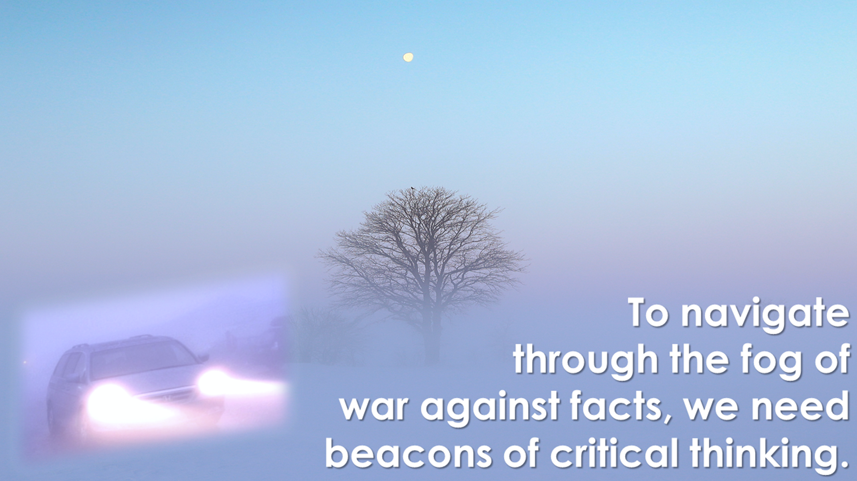
Vigdor/Londergan Science Blog: “Debunking Denial”
www.debunkingdenial.com
Categories covered:
Bad Science
Brain Science &
Brainwashing
Climate change
Conspiracy theories
Cosmology & Astrophysics
Critical thinking
Cyber issues
Demographics
Education
Elections
Energy production
Environment
Evolution
Genes & Genetic
Engineering
Gun violence
Medicine, COVID, &
Vaccinations
Miscellany
Network science
“New Age” hoaxes
Ozone layer
Partisan divides over science
Scientific breakthroughs
Toxic products

Slide 3

A skeptic will question claims, then embrace the evidence. A denier will question claims, then reject the evidence.

Slide 4

Here is Donald Trump at the United Nations, Sept. 23, 2025
Who’s conning whom?

Slide 5
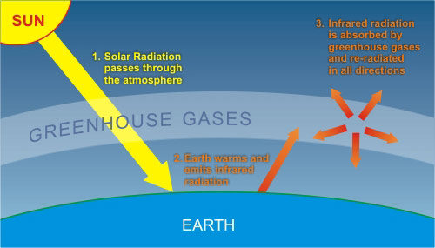
Basic Science of Greenhouse Gases
Heated bodies emit electromagnetic (thermal) radiation
They reach a temperature that balances power out against power in
Earth emits in the infrared
Greenhouse gas molecules in the atmosphere absorb infrared radiation and return much of it to Earth’s surface

Slide 6
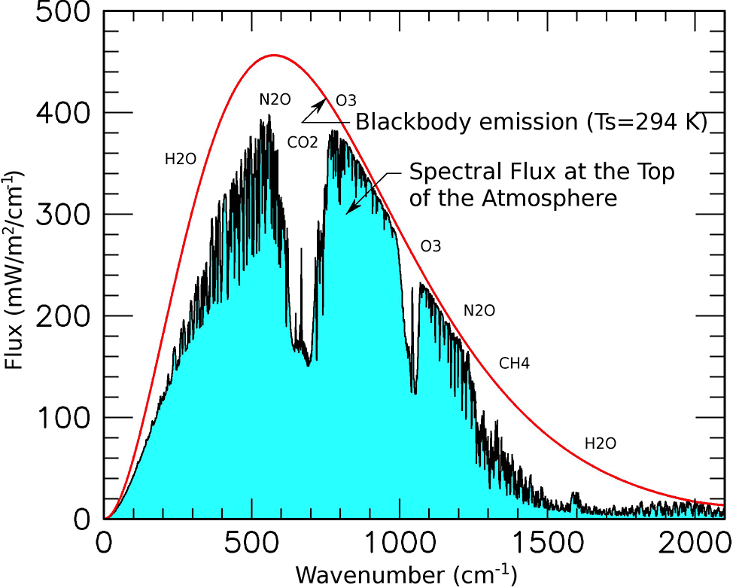
Emitted thermal radiation follows smooth blackbody spectrum, but much of it fails to reach satellites.
How can such a tiny fraction of CO₂ – today, ~428 ppm – absorb so much of Earth’s infrared emissions?
428 ppm of CO₂ corresponds to about 6,000 trillion carbon dioxide molecules per cubic centimeter halfway up the troposphere!

Slide 7
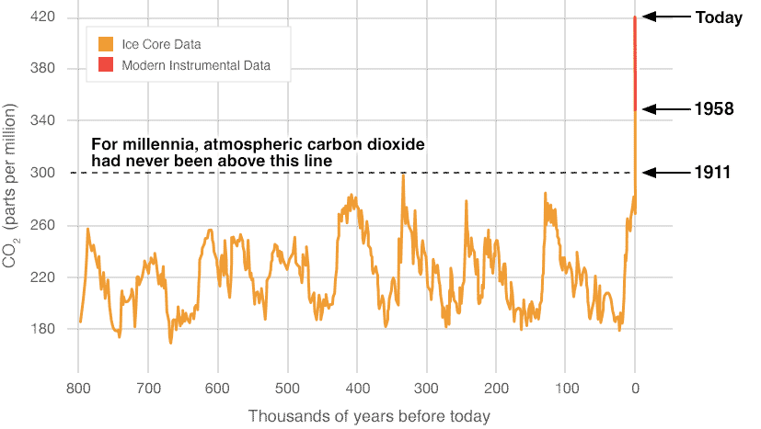
Human Activities are Increasing Greenhouse Gas Concentrations
Carbon dioxide (also methane) concentrations are now much higher than they’ve been for the past 800,000 years!
And much higher than during first 10,000 years of human civilization
The cause is human activity, burning fossil fuels.
Notes:
Tim’s last slide

Slide 8
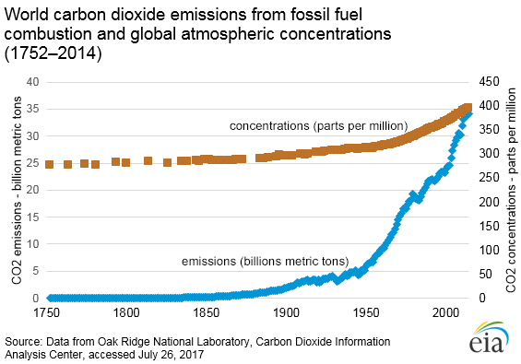
Greenhouse Gas Concentrations Increase with Human Emissions
Burning fossil fuels emits carbon dioxide and builds up concentration in the atmosphere.
The more carbon dioxide (and methane) in the atmosphere, the warmer Earth gets.
Levels now 1.5 times greater than in pre-industrial era, still growing.
Notes:
Steve starts here

Slide 9
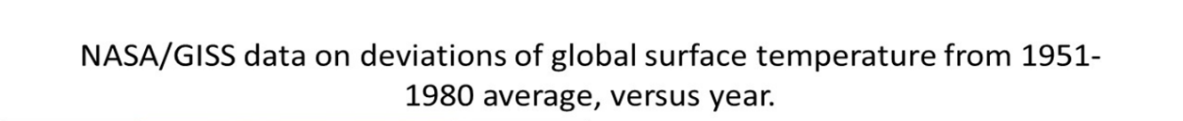
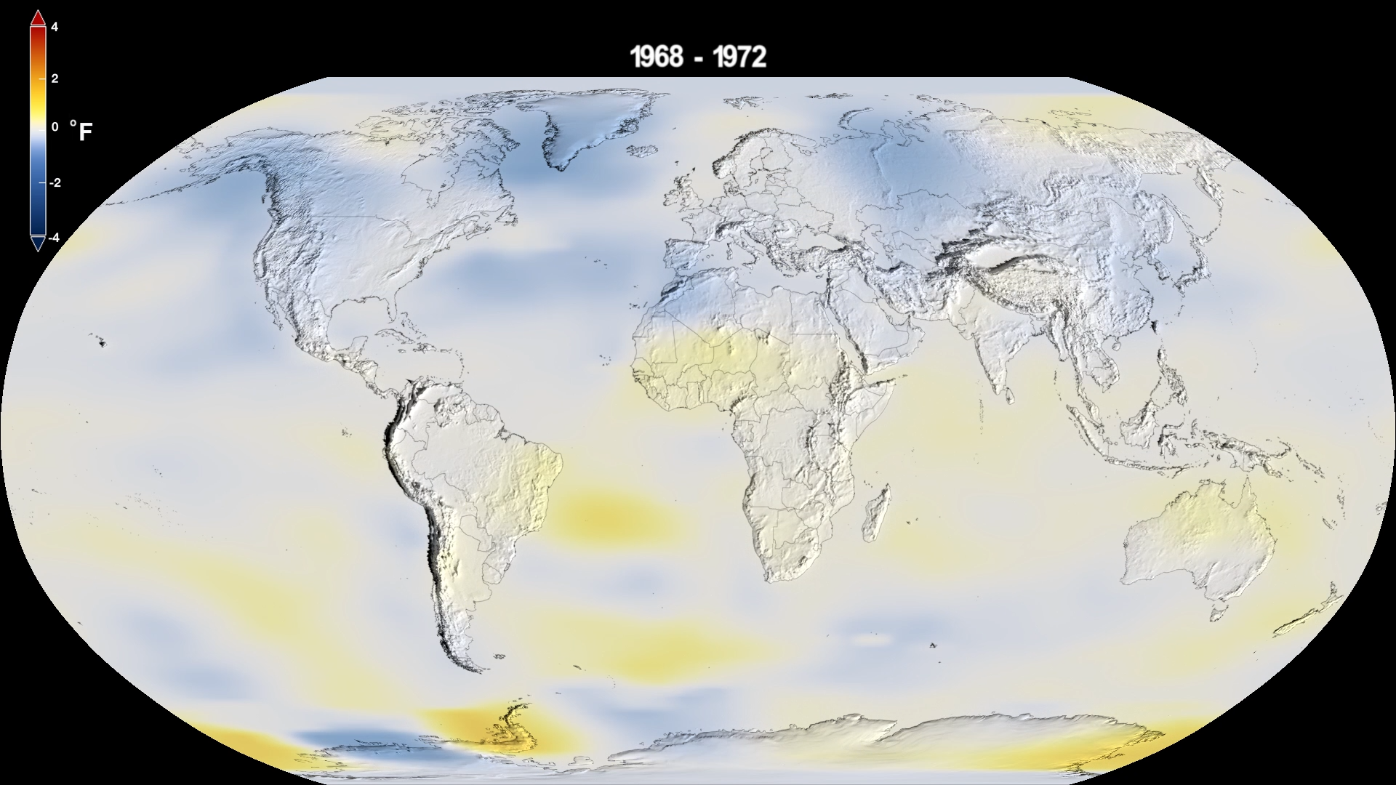
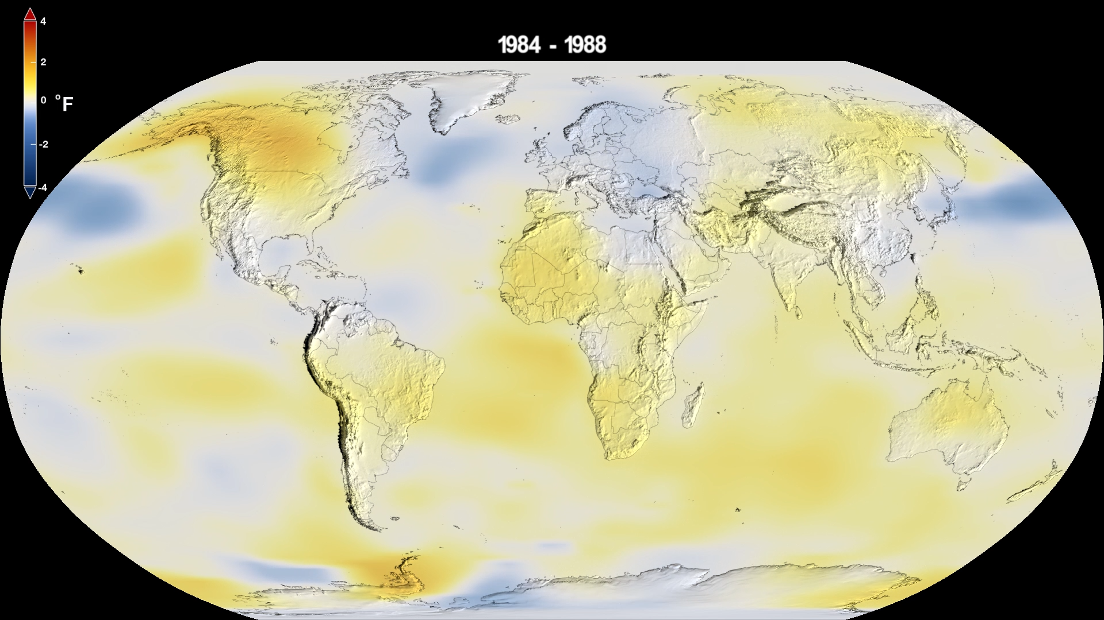
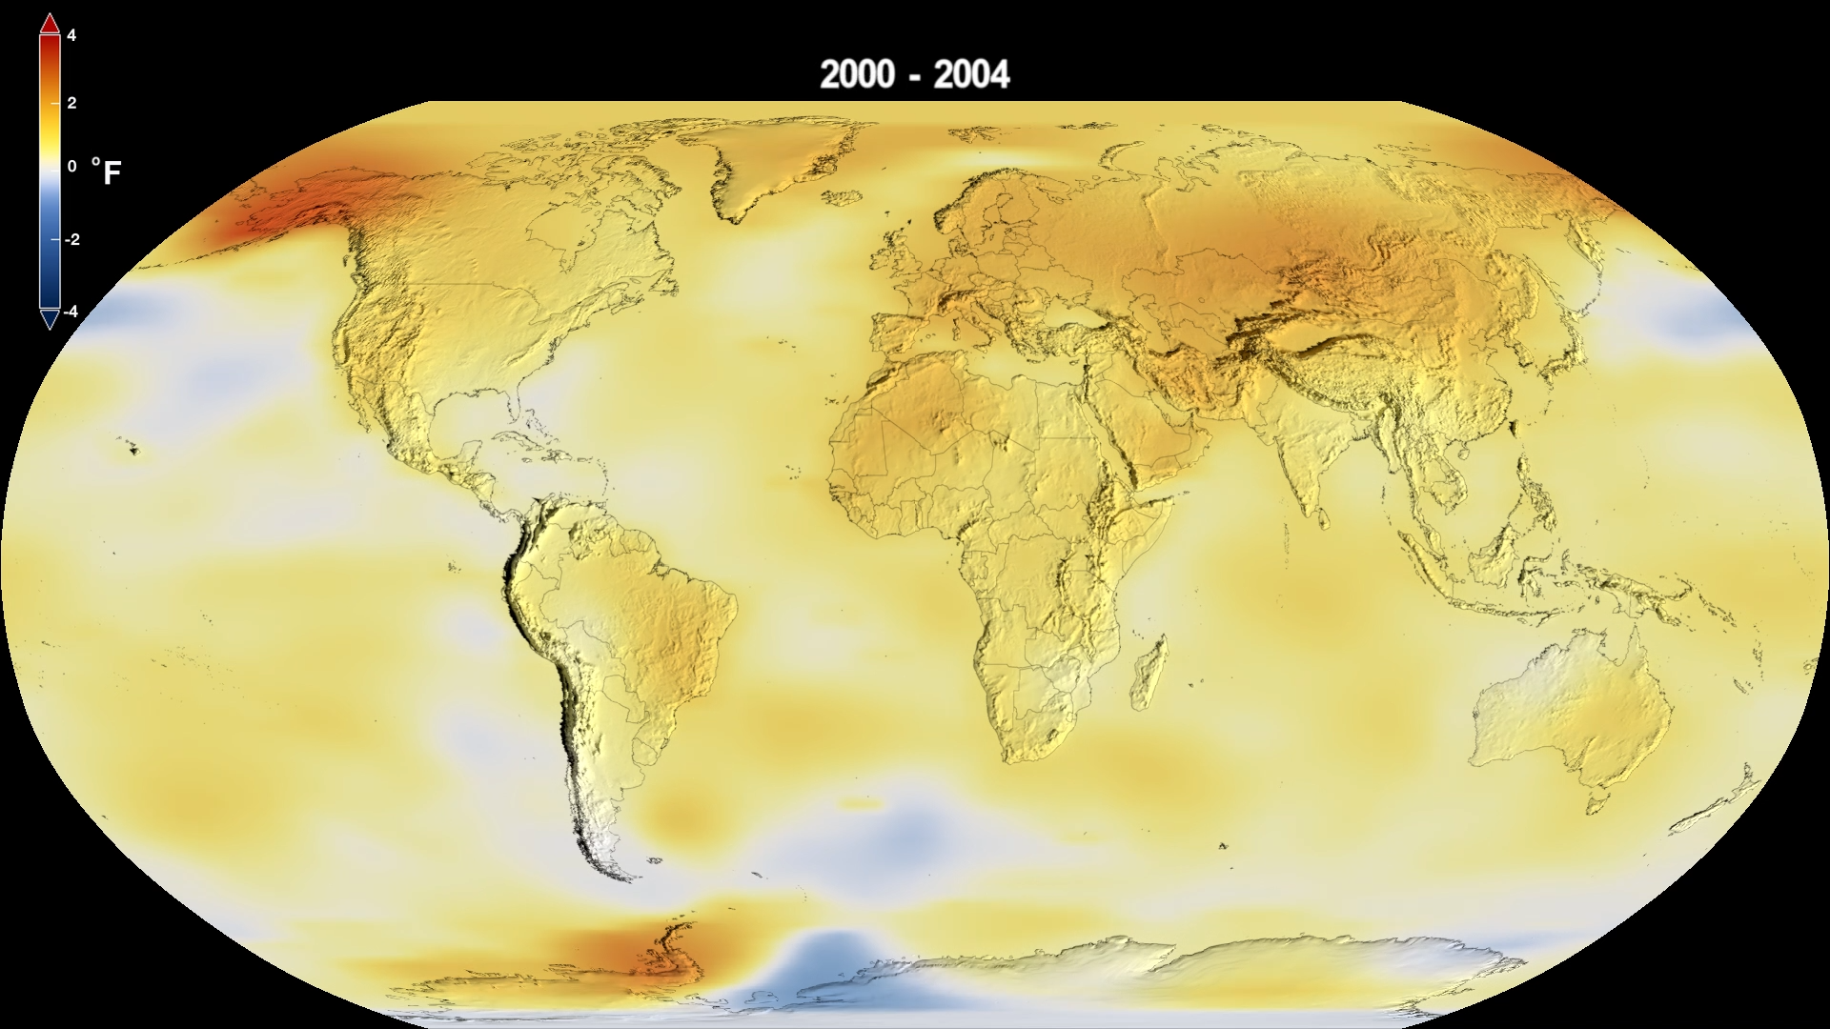
The Warming is a Global Phenomenon
1968-1972
1984-1988
2000-2004
2017-2021

Slide 10
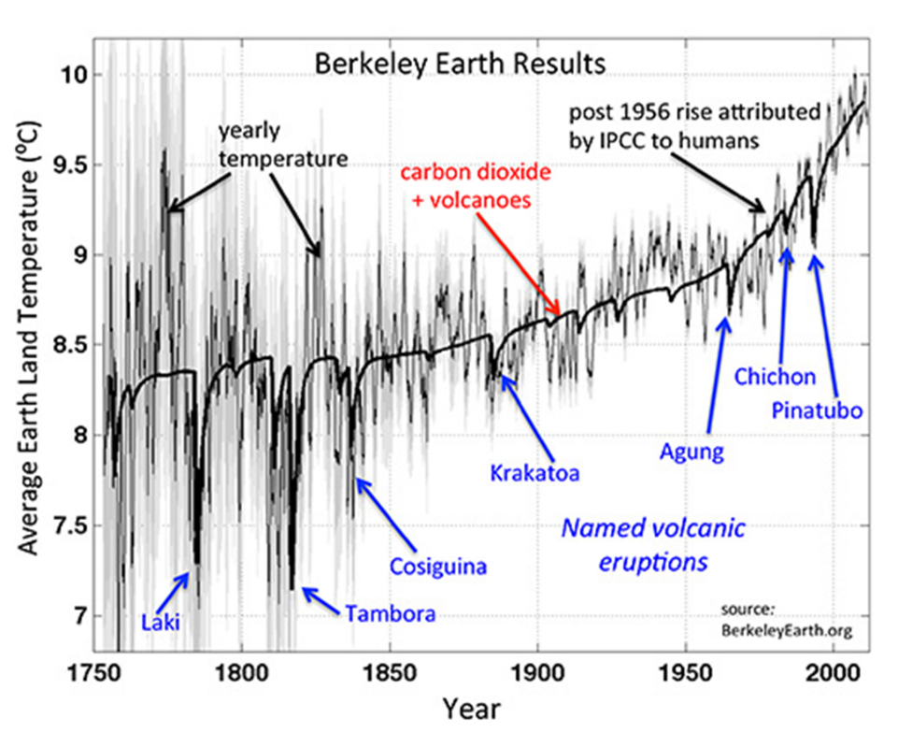
Earth’s global mean surface temperature has been rising since pre-industrial era, most rapidly over past 50 years.
The temperature rise tracks the atmospheric CO₂ rise very closely.
Big volcanic eruptions cause 2-3 year temperature dips by emitting aerosols that reflect sunlight.

Slide 11
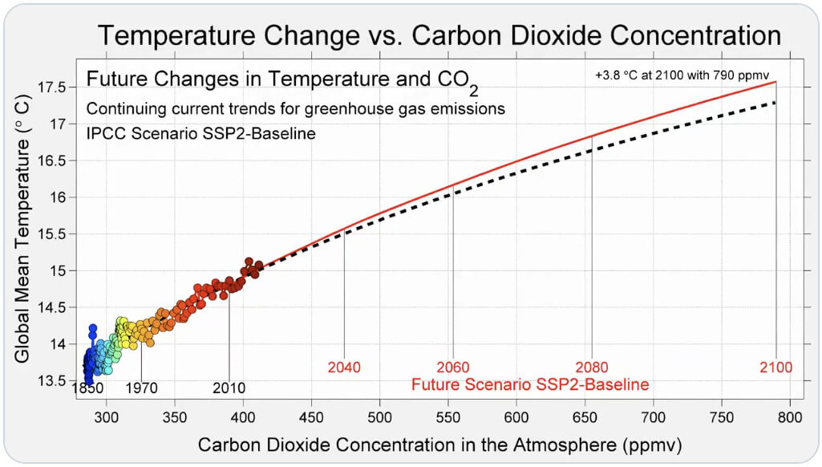
Close temperature-CO₂ correlation suggests future trend even without sophisticated climate models.
Data analyzed by Berkeley Earth Project

Slide 12
Summary of Part I:
Earth is warmed both by the Sun and by infrared radiation returned to Earth from greenhouse gases in atmosphere, predominantly carbon dioxide.
Carbon dioxide released when fossil fuels are burned remains in the atmosphere for many decades and increases the global warming of Earth.
Sophisticated climate models find no alternative explanation for ongoing warming.
At present rate of emissions, Earth will be ~4°C hotter than pre-industrial level by 2100.
We’ll cover very serious consequences of global warming in parts II (next) and III (May 17).
Notes:
Steve’s last slide

Slide 13
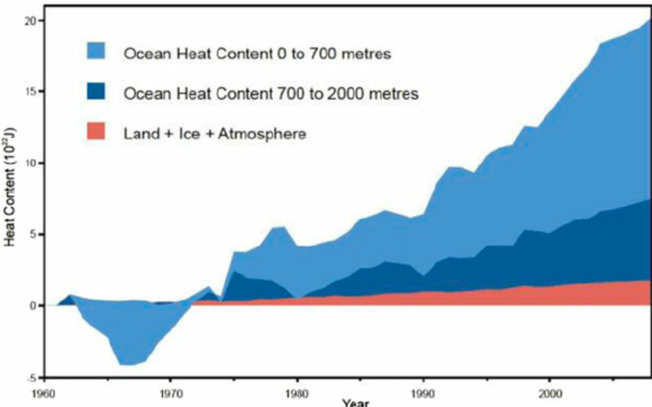
How Bad Can a Few Degrees of Global Warming Be?
90% of heat returned to Earth by greenhouse gases is stored in Earth’s oceans
Energy stored in the oceans equivalent to world-wide electricity demand for nearly 2000 years!
Notes:
Tim restarts here

Slide 14
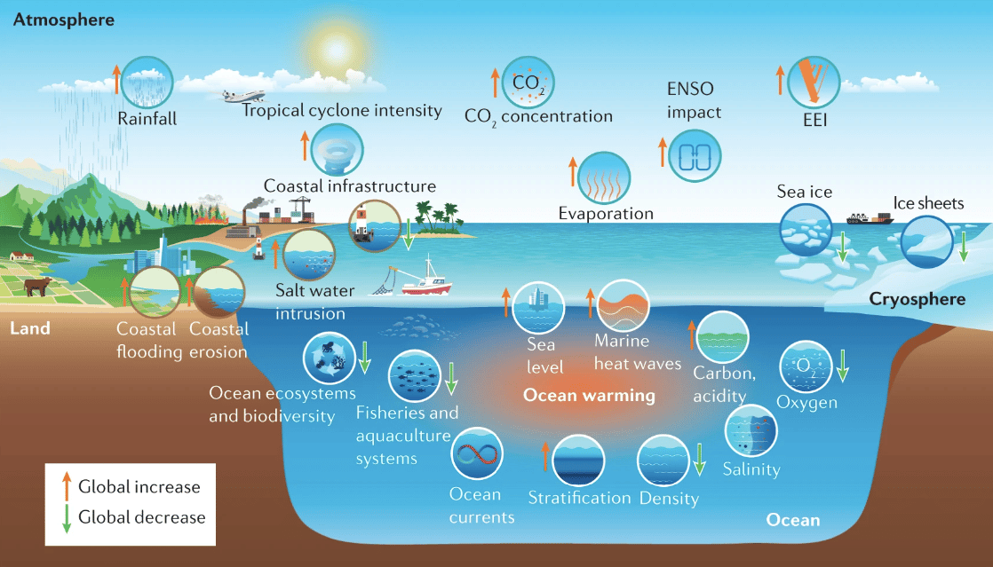
The many impacts of warming oceans – “gifts” that keep on giving!

Slide 15
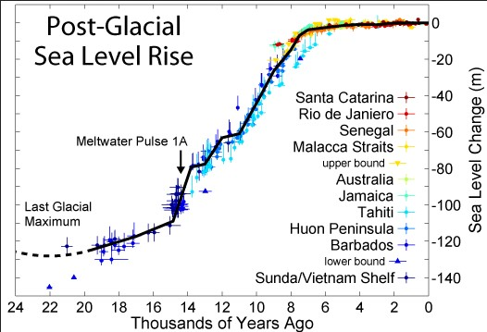
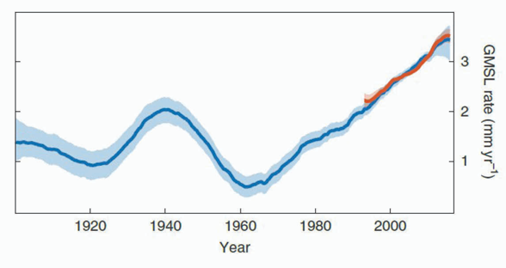
Global sea levels rose by about 400 feet over 10,000 years following the last Ice Age as huge ice sheets melted.
But they have risen very slowly over the 8,000 years of human civilization.
Sea level rise is accelerating!
But tide gauge and satellite measurements reveal that the rate of sea level rise has been increasing since 1970 as the planet warms.
Rise is caused by expanding sea-water and melting ice sheets.

Slide 16
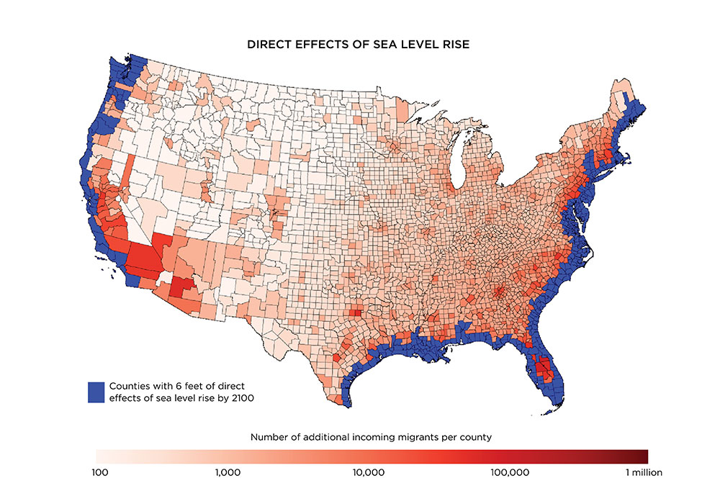
If sea level rise continues to accelerate, by the end of 21st century much of eastern, western, and Gulf coasts may be inundated.
Up to 10 million Americans would have to migrate inland.

Slide 17
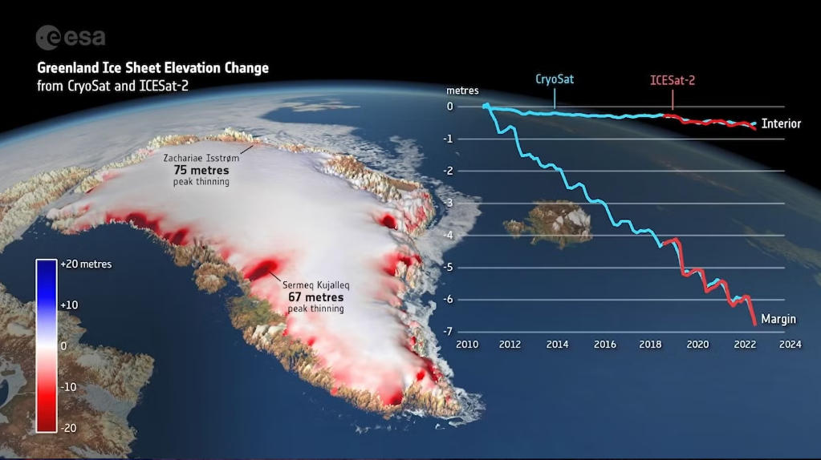
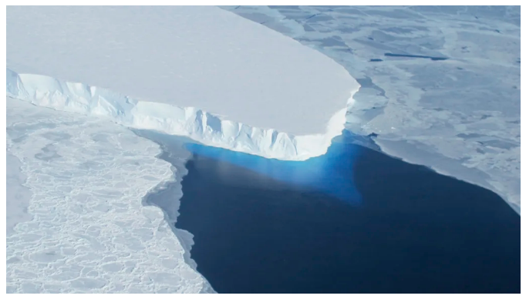
The massive Greenland ice sheet is melting from the top down as peak is exposed to warming air.
West Antarctica’s Thwaites (“doomsday”) glacier is fissuring from below as warming sea water seeps into cracks.
As ice sheets melt, sea level rises faster and Earth reflects less sunlight, further increasing warming.
Furthermore, ocean currents get disrupted.

Slide 18
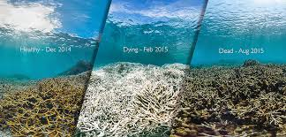
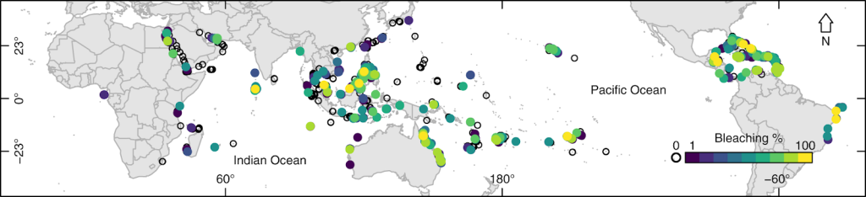
Increasing Ocean Temperature and Acidity Damages Coral Reefs
A coral reef off American Samoa went from healthy to bleached to dead in 2015.
Yellow dots show worldwide reefs that have undergone 100% bleaching between 1998 and 2017.

Slide 19
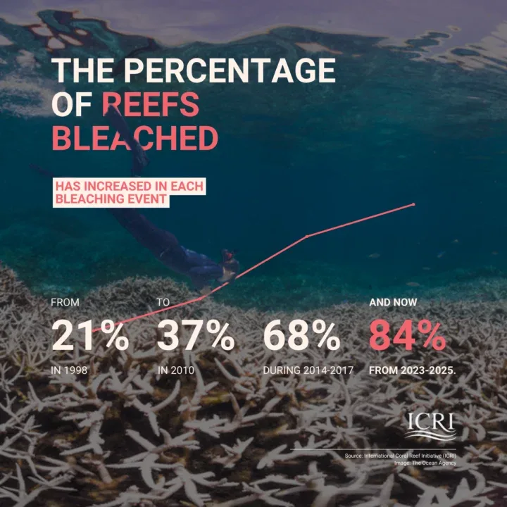
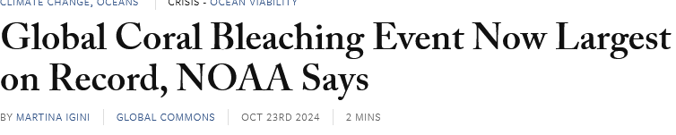
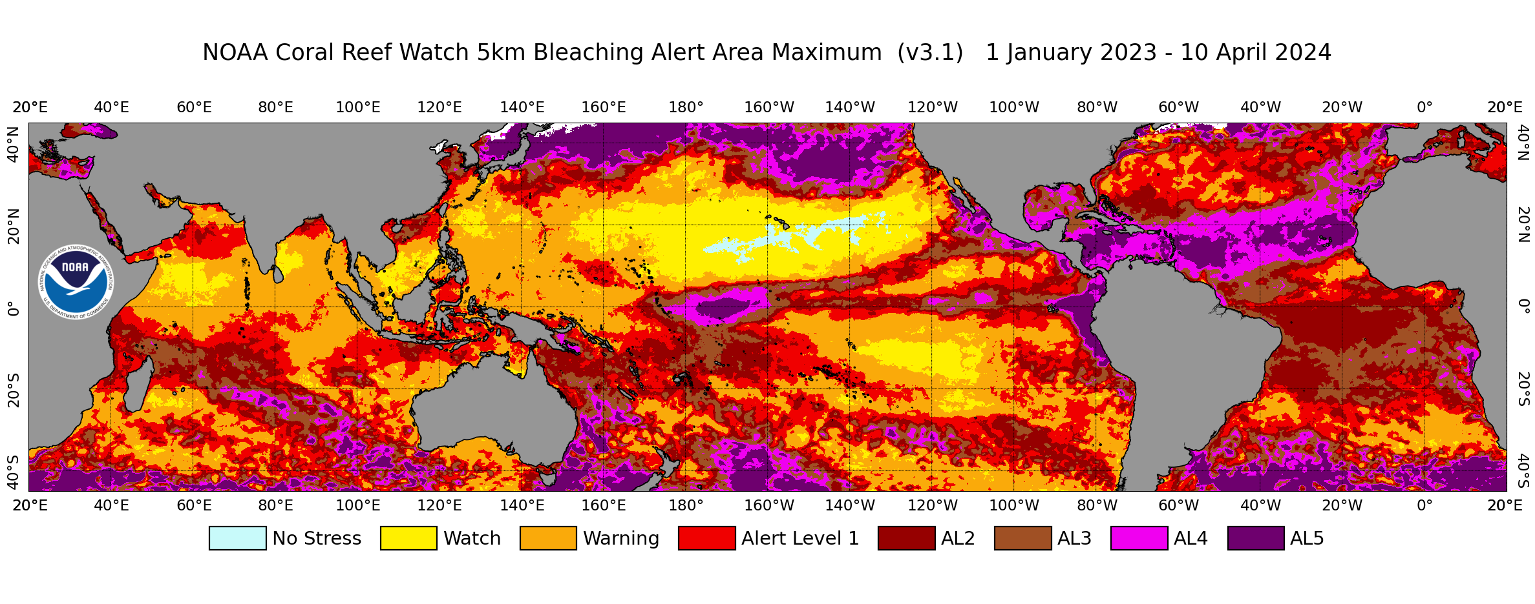
Unheard-of fraction of coral reefs were bleached in 2024 episode
> Reefs sometimes recover from bleaching, but 30% of worldwide reefs already lost this century! Many more at short-term risk!
Color-coded map shows magnitude of 2024 damage to coral reefs (land masses shown in gray)
Notes:
Tim’s last slide

Slide 20
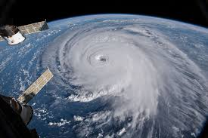
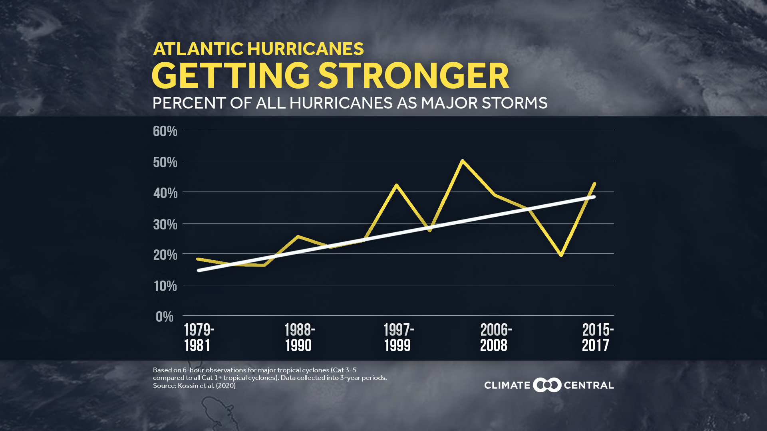
Warmer Oceans Spawn Stronger Storms
Warming oceans transfer more energy and moisture to hurricane winds and rainfall.
The fraction of Atlantic hurricanes that have reached Category 3—5 has doubled since 1980.
Notes:
Steve restarts here

Slide 21
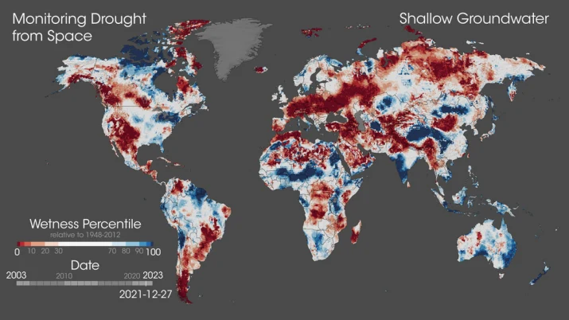
Changing Air and Ocean Currents Alter Precipitation Patterns
Precise satellite measurements of gravity reveal unusually dry (brown) and wet (blue) regions of the globe under global warming.

Slide 22
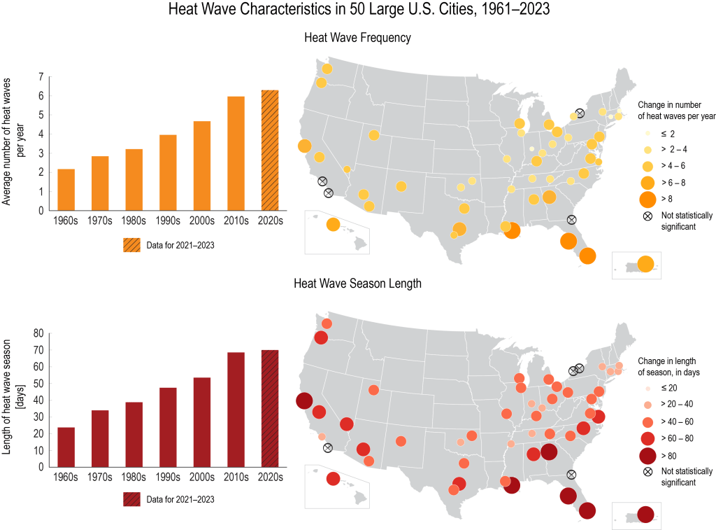
Heat Waves Grow More Severe
Temperature records from 50 large U.S. cities show that the frequency and length of heat waves has nearly tripled since the 1960s.
21st century heat waves responsible for many tens of thousands of human deaths worldwide.

Slide 23
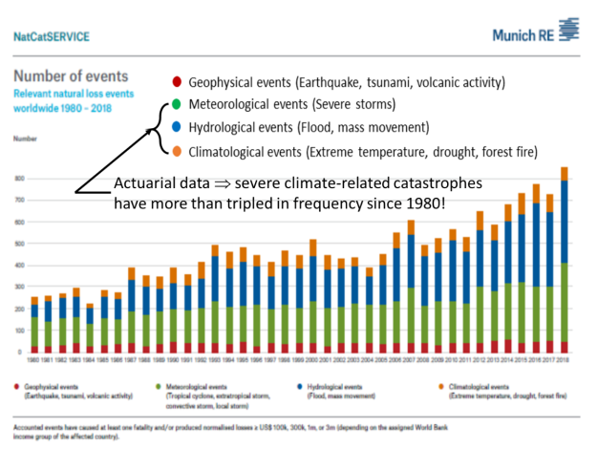
Climate-Related Catastrophes

Slide 24
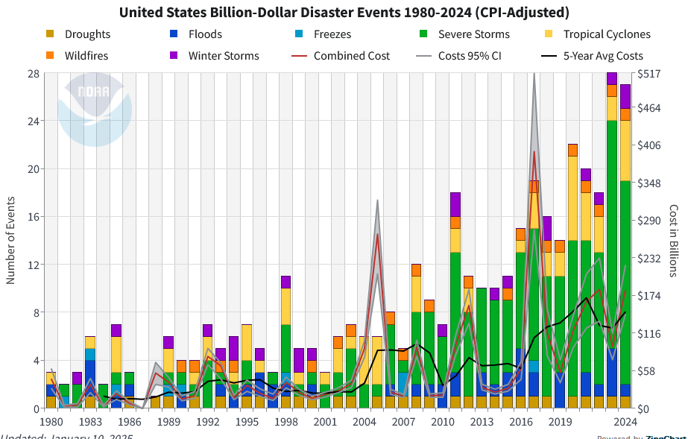
Climate-Related Catastrophes Have Increased in Severity and Cost
Climate-related disasters are currently costing the U.S. ~$150B per year.
Under Trump 2.0, NOAA has stopped monitoring U.S. climate disasters
NOAA data on number and cost of inflation-adjusted billion-dollar U.S. climate disasters 1980 - 2024

Slide 25
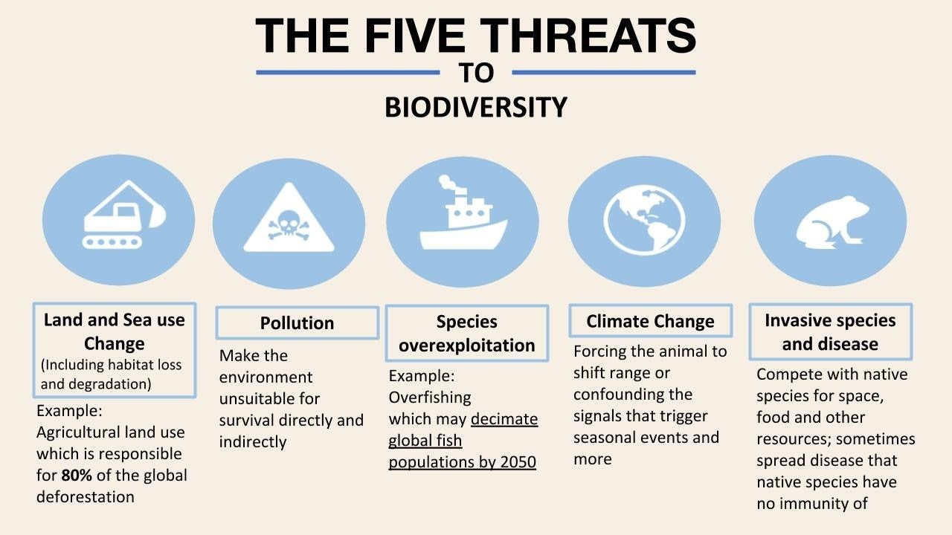

Slide 26
Summary of Part II:
90% of heat returned to Earth by greenhouse gases in the atmosphere is stored in Earth’s oceans. Combined with increasing land and air temperatures, this is already causing:
Accelerating ice sheet melting, sea level rise, increased coastal flooding, and eventual inundation and mass migration
The bleaching and death of coral reefs, reducing marine biodiversity and fishing economies
An increased frequency of severe storms, floods, droughts, forest fires, and extreme heat waves, costing lives and extensive financial damage
Loss of animal and plant habitats and global biodiversity, with impacts on human food supplies and disease exposure

Slide 27
In our second lecture (May 17) we will cover:
Part III: Climate Tipping Points: What May Change Irreversibly
Part IV: How Can Humans Mitigate Climate Change Impacts?
Notes:
Steve’s last slide

Slide 28
Backup Slides

Slide 29
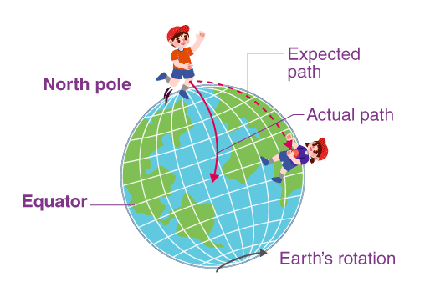
Coriolis Effect on Earth
Earth’s rotation ⇒ tangential speed of points on the surface is greatest at the Equator and decreases with increasing latitude.
Objects that appear from space to move straight north-south appear instead to an observer on Earth’s surface to curve rightward in the Northern Hemisphere and leftward in the Southern Hemisphere.
Wind patterns rushing inward toward a low-pressure region (as in hurricanes) appear to Earth observer to circulate counterclockwise in Northern and clockwise in Southern Hemisphere. Pattern is opposite for winds flowing outward from a high pressure region, as for those that cause the subtropical gyre ocean currents. But North Atlantic Subpolar Gyre is caused by winds surrounding low-pressure region south of Greenland.

Slide 30



Bleaching and Death of Coral Reef Depicted in Indonesian Fiber Art in IU Art Museum Installation, April 2026

