Slide 1
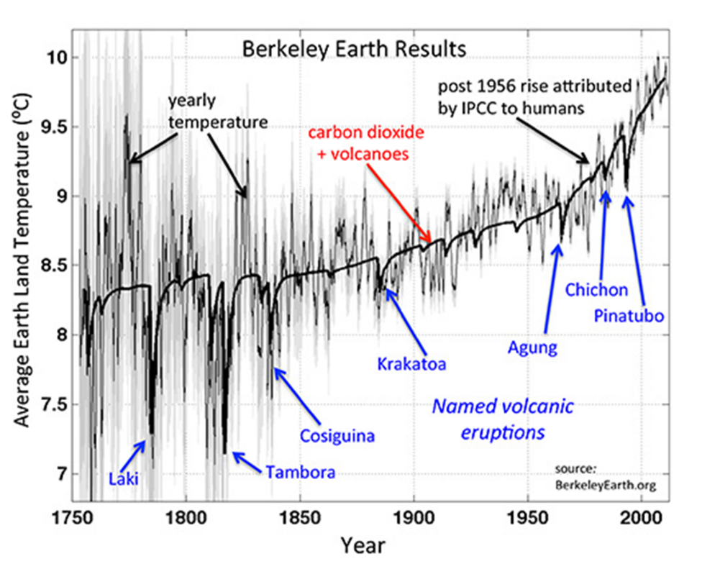
Global Climate Change for Beginners:
Proof: Climate Change is Real & Caused by Human Activity
Tim Londergan (and Steve Vigdor)
Nineteenth Century Club
Dec. 1, 2025
Based on our evidence-based, data-rich blog post at:
www.debunkingdenial.com

Slide 2
Debunking Denial
DISCLAIMER: The views expressed in these videos and on our blog site are our own, and do not represent positions taken by Indiana University.

Slide 3


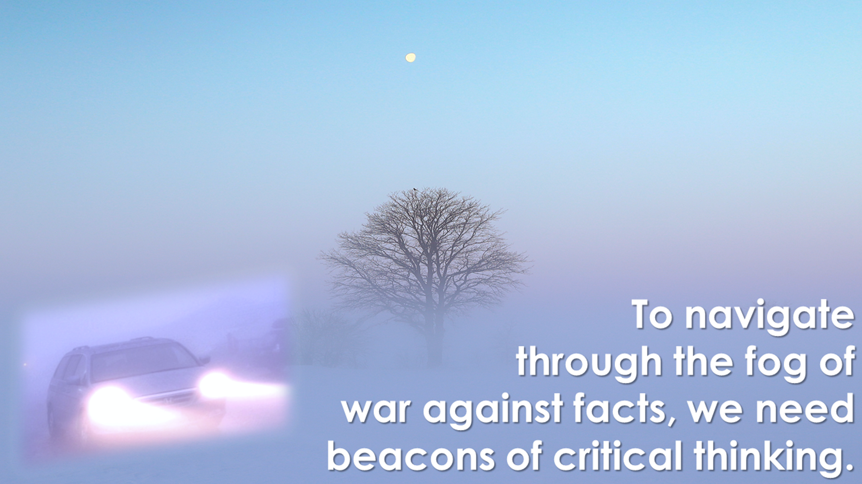
Vigdor/Londergan Science Blog: “Debunking Denial”
www.debunkingdenial.com
Categories covered:
Bad Science
Brain Science &
Brainwashing
Climate change
Conspiracy theories
Cosmology & Astrophysics
Critical thinking
Cyber issues
Demographics
Education
Elections
Energy production
Environment
Evolution
Genes & Genetic
Engineering
Gun violence
Medicine, COVID, &
Vaccinations
Miscellany
Network science
“New Age” hoaxes
Ozone layer
Partisan divides over science
Scientific breakthroughs
Toxic products

Slide 4
In This Talk We Will Show:
Global warming is real, and can be explained by simple physics.
The primary cause of global warming is human activity.
Warming can be understood without resorting to complex math or climate models.
No climate models can explain ongoing warming, without including dominant greenhouse gas contributions .

Slide 5
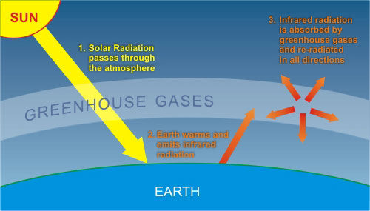
Heated bodies emit electromagnetic (thermal) radiation
They reach a temperature that balances power out against power in
Earth emits in the infrared
Greenhouse gas molecules in the atmosphere absorb infrared radiation and return much of it to Earth’s surface

Slide 6
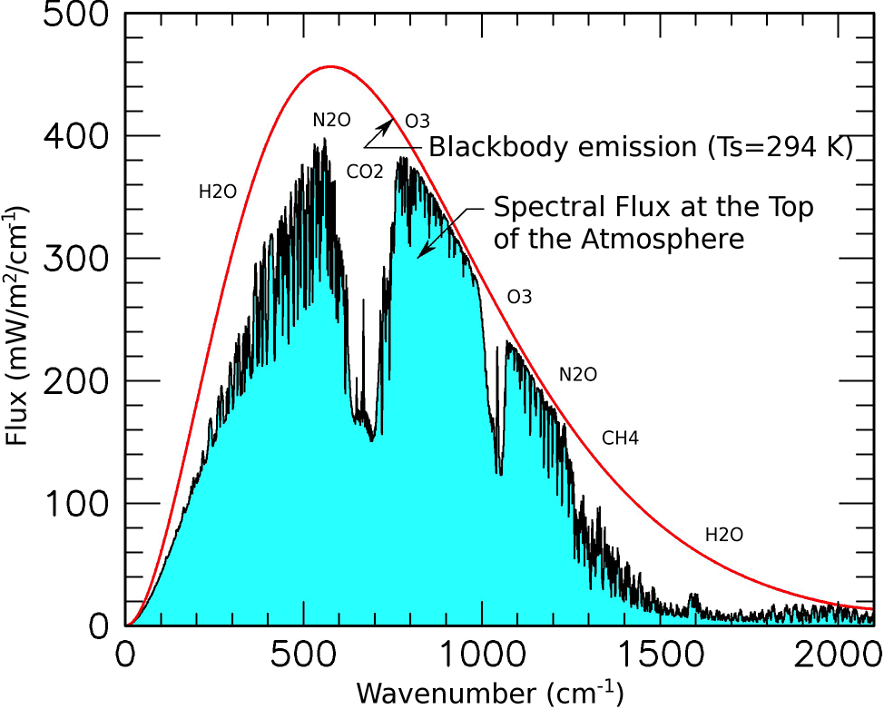
Emitted thermal radiation follows smooth blackbody spectrum, but much of it fails to reach satellites.
How can such a tiny fraction of CO₂ – today, ~420 ppm – absorb so much of Earth’s infrared emissions?
420 ppm of CO₂ corresponds to about 6,000 trillion carbon dioxide molecules per cubic centimeter halfway up the troposphere!

Slide 7
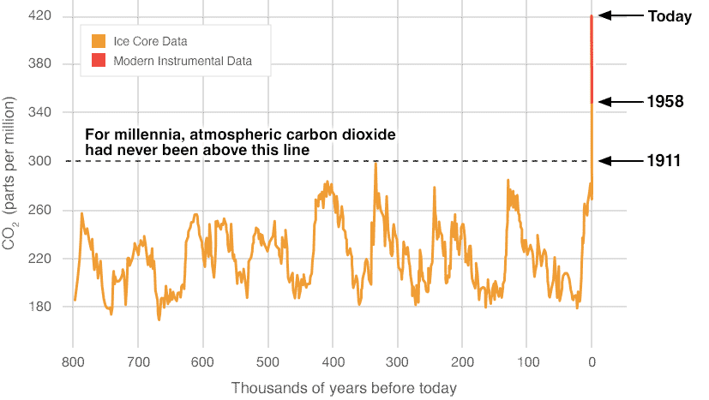
Carbon dioxide (also methane) concentrations are now much higher than they’ve been for the past 800,000 years!
The cause is human activity, burning fossil fuels.

Slide 8
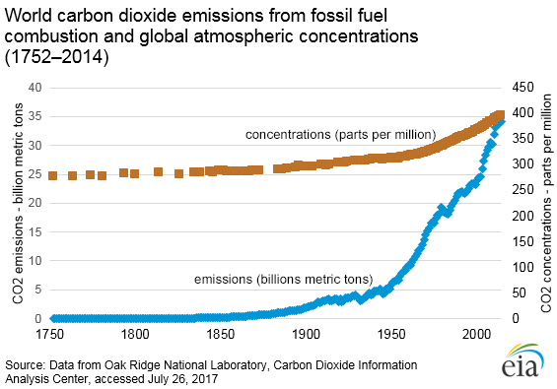
Burning fossil fuels emits carbon dioxide and builds up concentration in the atmosphere.
The more carbon dioxide (and methane) in the atmosphere, the warmer Earth gets.
Levels now 1.5 times greater than in pre-industrial era, still growing.

Slide 9
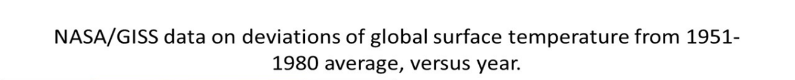
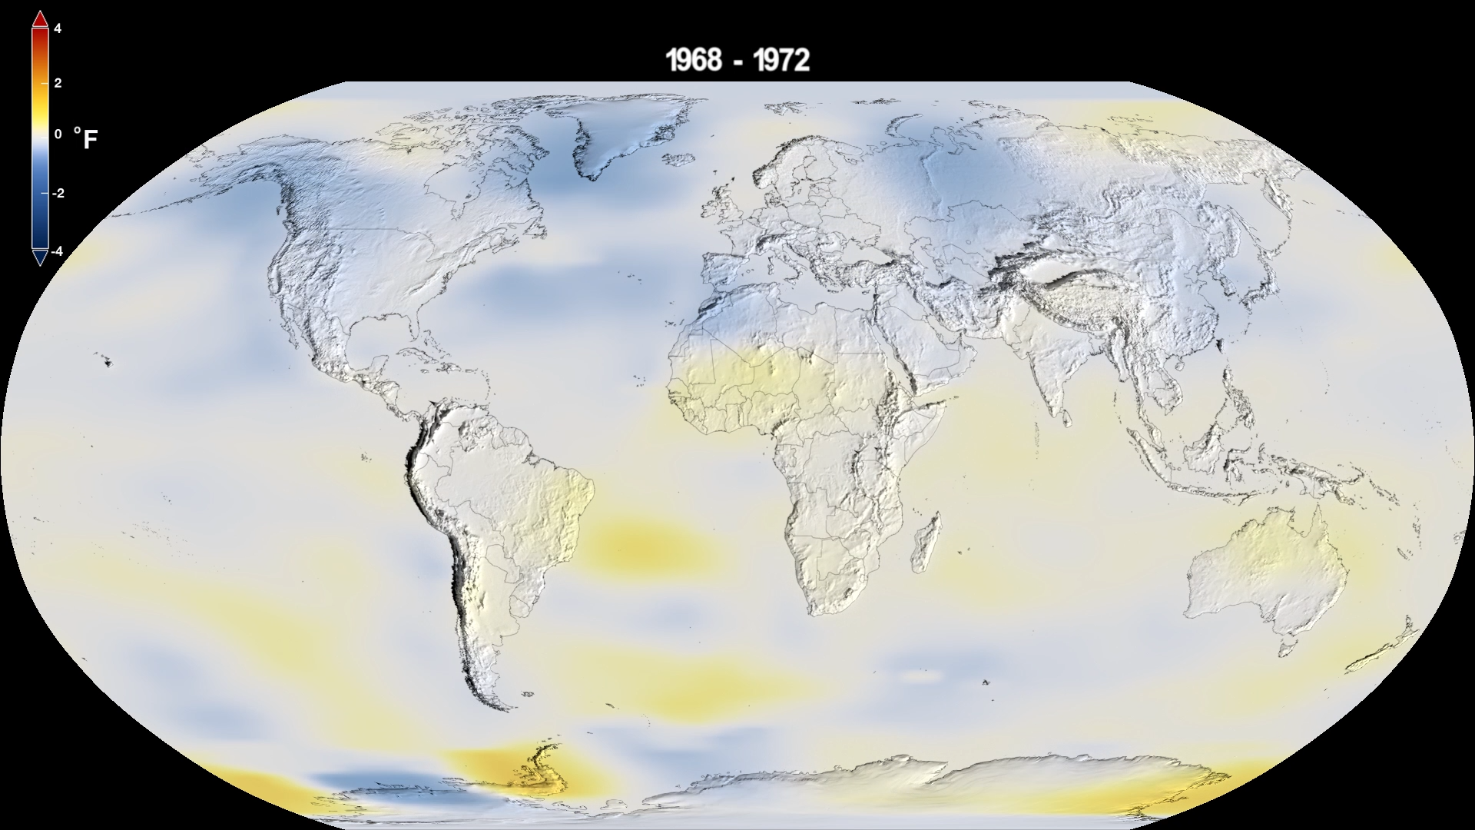
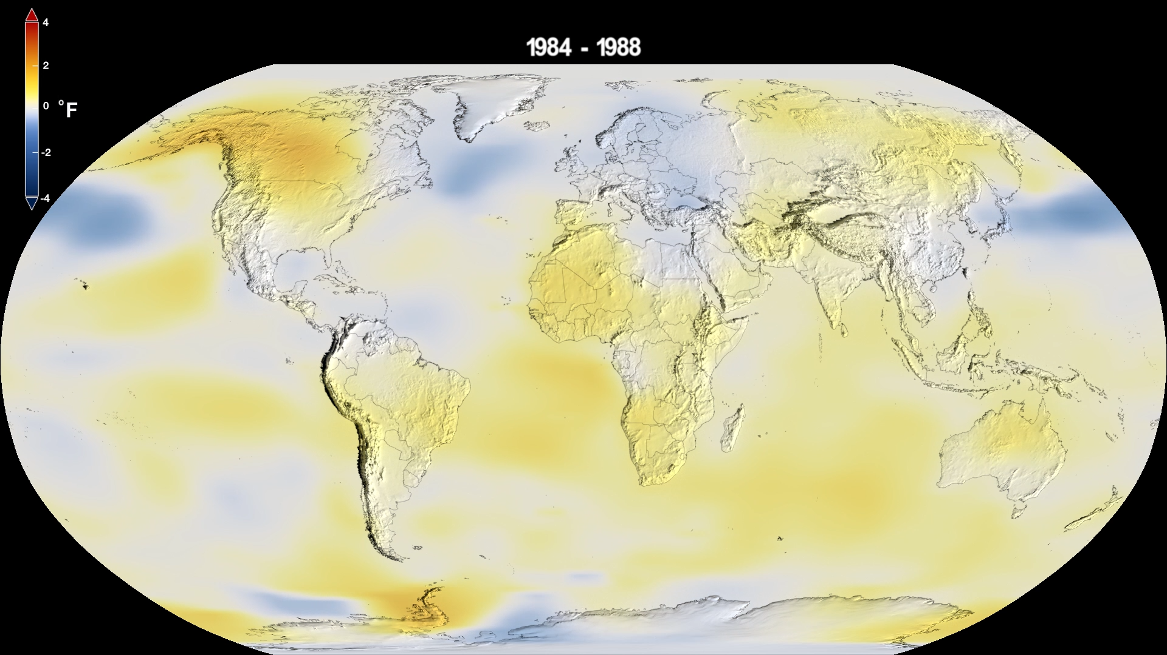
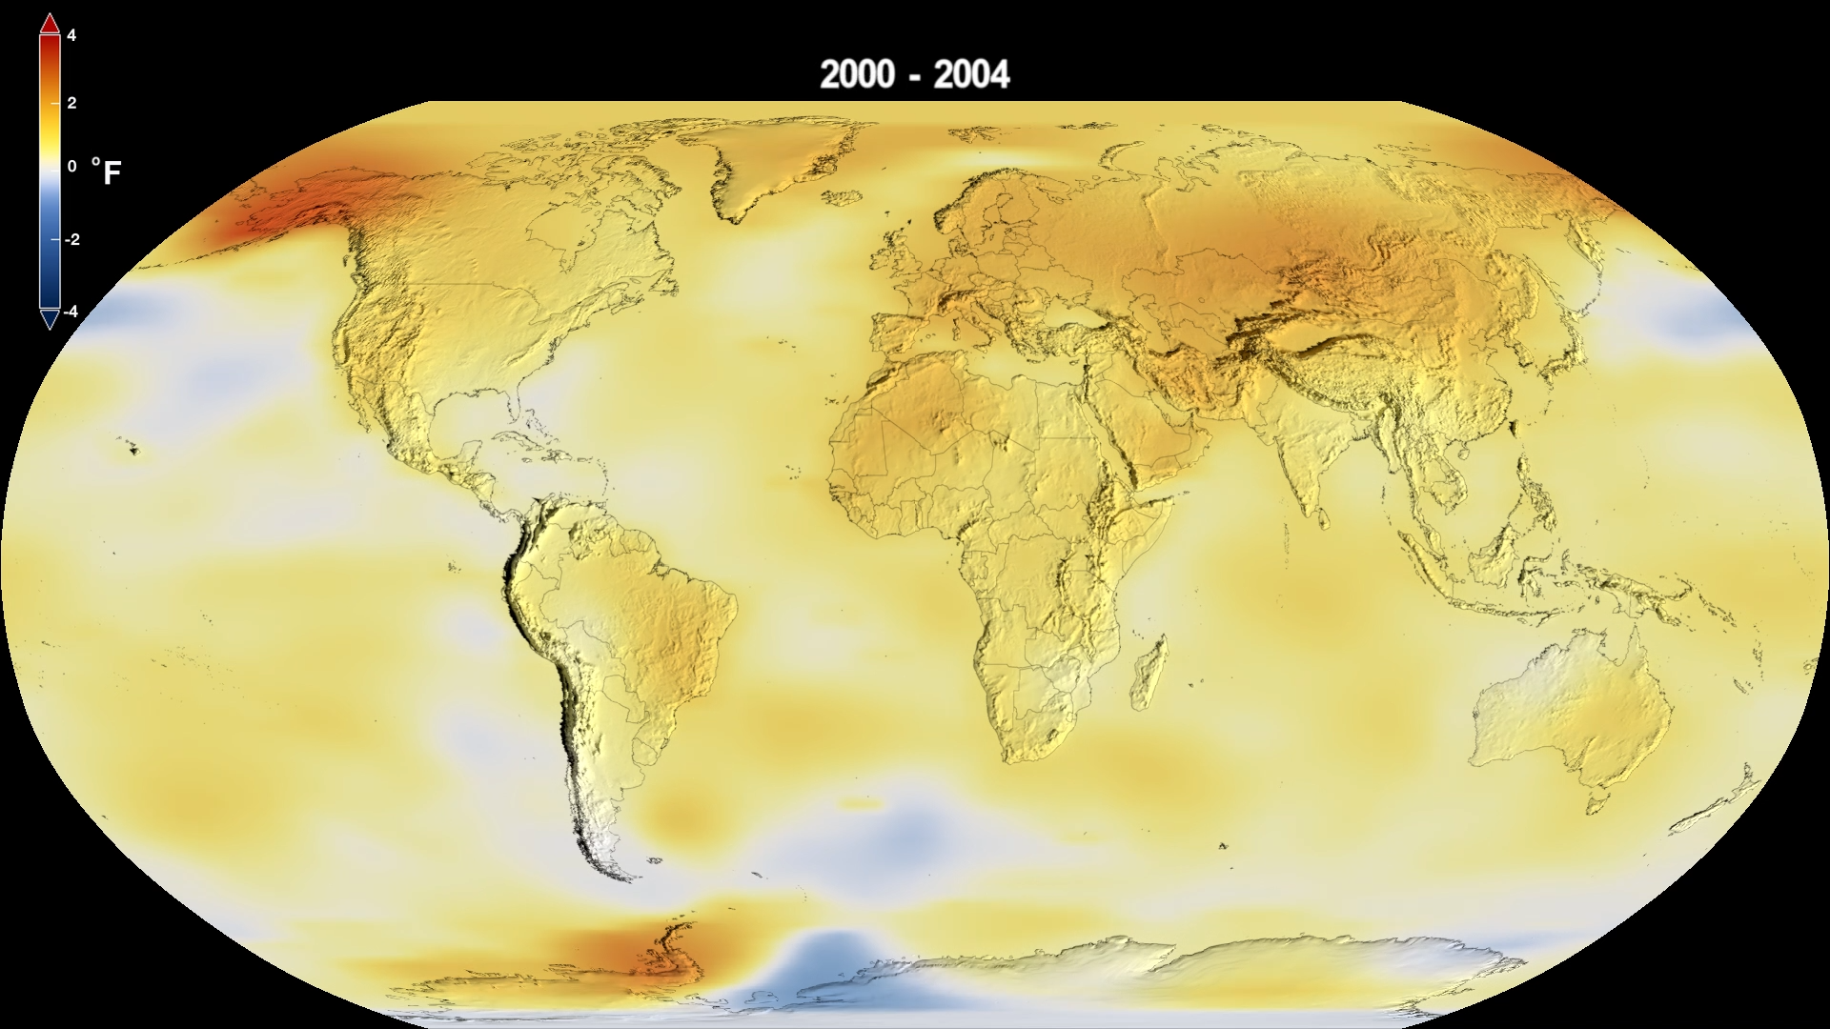
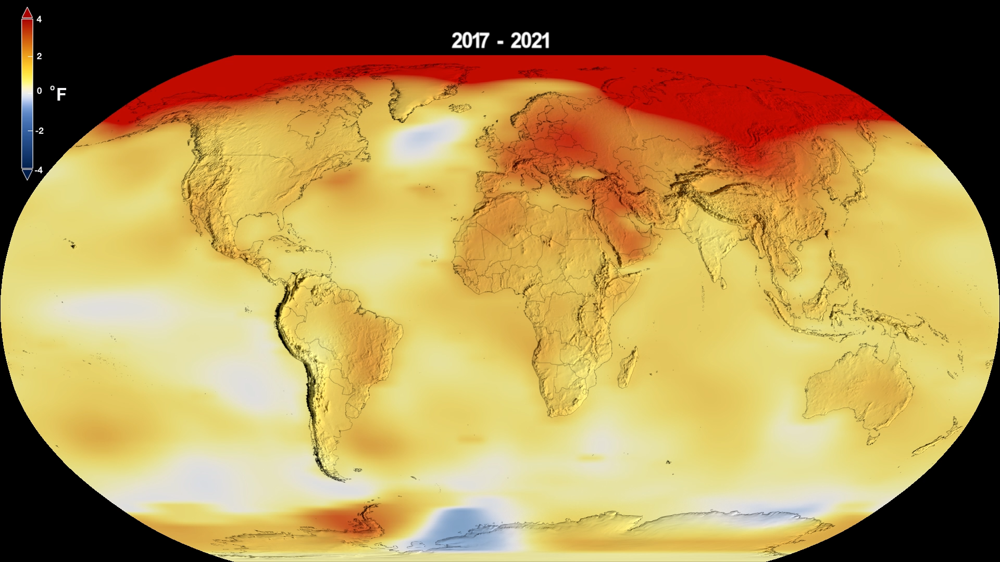
1968-1972
1984-1988
2000-2004
2017-2021

Slide 10
Earth’s global mean surface temperature has been rising since pre-industrial era, most rapidly over past 50 years.
The temperature rise tracks the atmospheric CO₂ rise very closely.
Big volcanic eruptions cause 2-3 year temperature dips by emitting aerosols that reflect sunlight.

Slide 11
Some Current Effects of Global Climate Change:
90% of heat returned to Earth by greenhouse gases in the atmosphere is stored in Earth’s oceans. Combined with increasing land and air temperatures, this is already causing:
Accelerating ice sheet melting, sea level rise, increased coastal flooding, and eventual inundation and mass migration
The bleaching and death of coral reefs, reducing marine biodiversity and fishing economies
An increased frequency of severe storms, floods, droughts, forest fires, and extreme heat waves, costing lives and extensive financial damage
Loss of animal and plant habitats and global biodiversity, with impacts on human food supplies and disease exposure

Slide 12
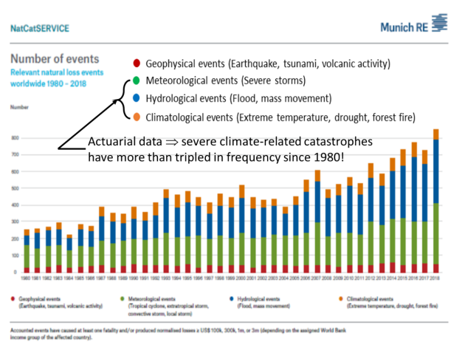

Slide 13
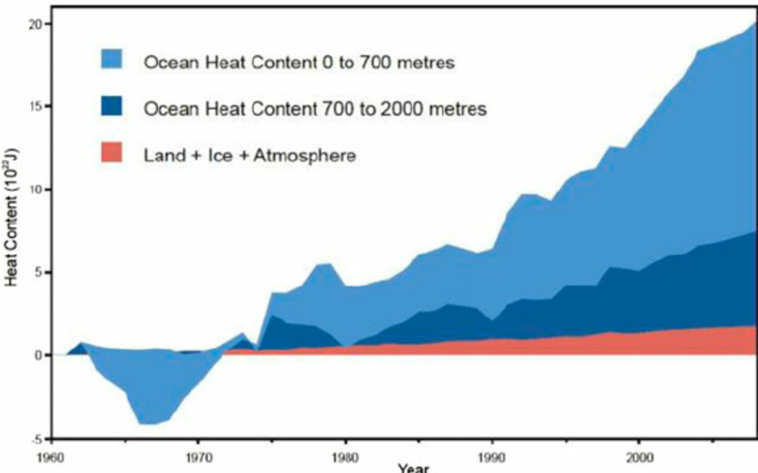
90% of heat returned to Earth by greenhouse gases is stored in Earth’s oceans

Slide 14
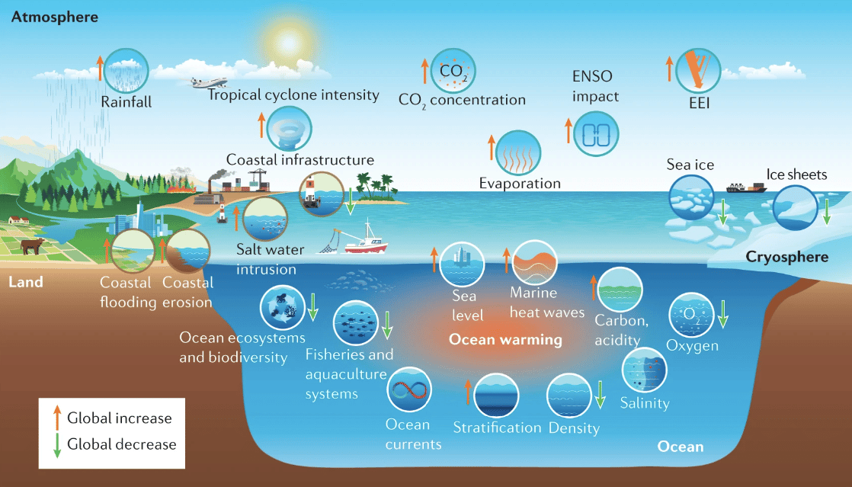
The many impacts of warming oceans

Slide 15
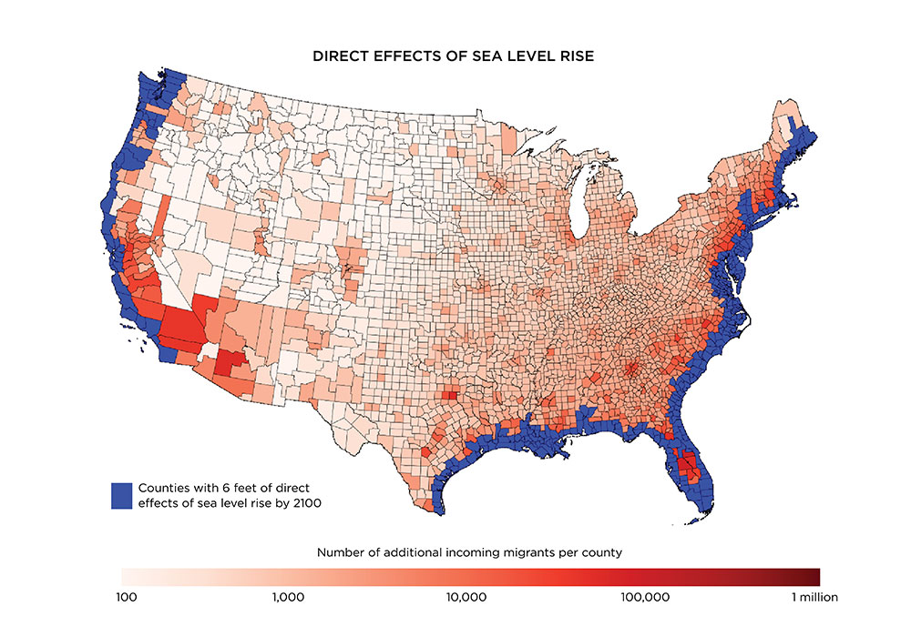
If sea level rise continues to accelerate, by the end of 21st century much of eastern, western, and Gulf coasts may be inundated.
Up to 10 million Americans would have to migrate inland.

Slide 16
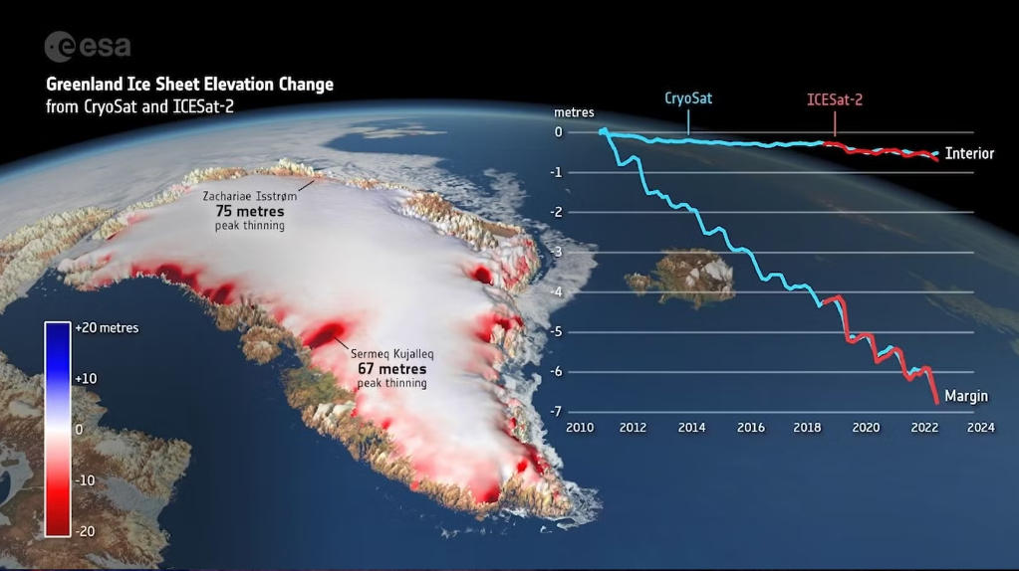
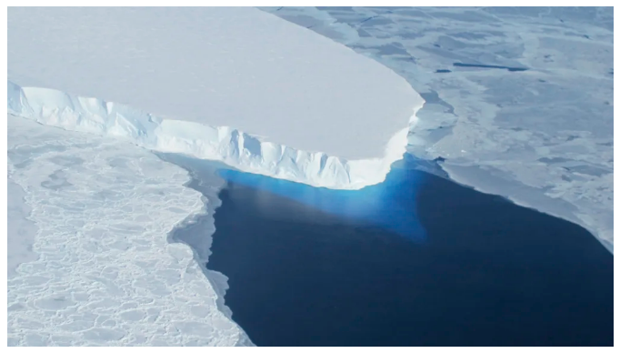
The massive Greenland ice sheet is melting from the top as peak is exposed to warming air.
West Antarctica’s enormous Thwaites (“doomsday”) glacier is fissuring from below as warming sea water seeps into cracks.

Slide 17
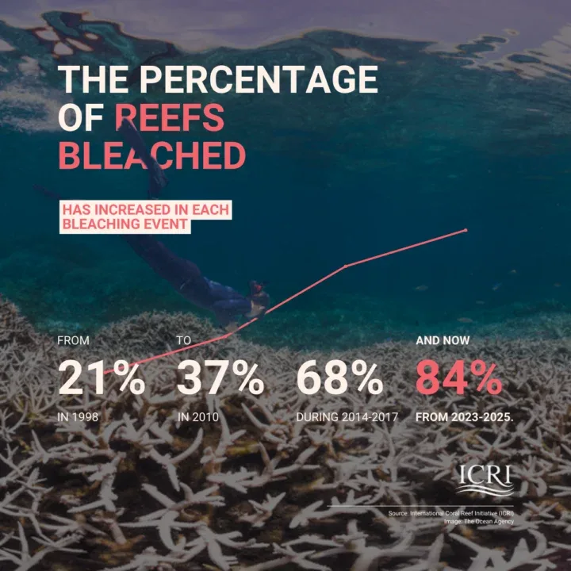
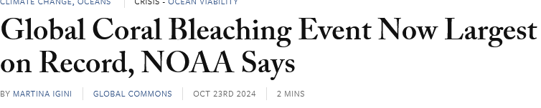
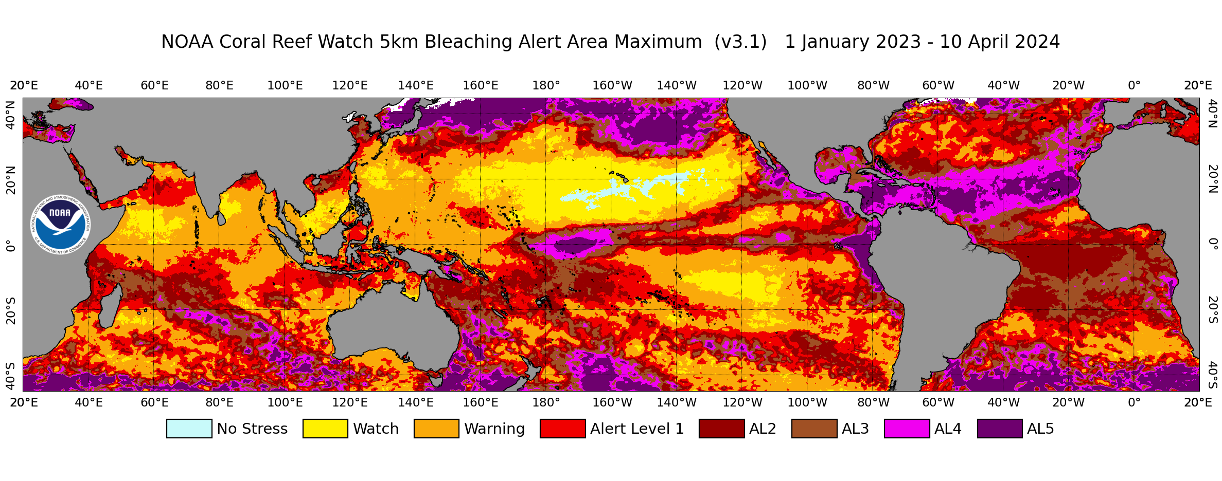
Unheard-of fraction of coral reefs were bleached in 2024 episode
Color-coded map shows magnitude of 2024 damage to coral reefs (land masses shown in gray)

Slide 18
In Summary:
Earth is warmed both by the Sun and by infrared radiation returned to Earth from greenhouse gases in atmosphere, predominantly carbon dioxide.
Carbon dioxide released when fossil fuels are burned remains in the atmosphere for many decades and increases the global warming of Earth.
Sophisticated climate models find no alternative explanation for ongoing warming.
We are currently experiencing a number of adverse events from global climate change.

